Slide 1
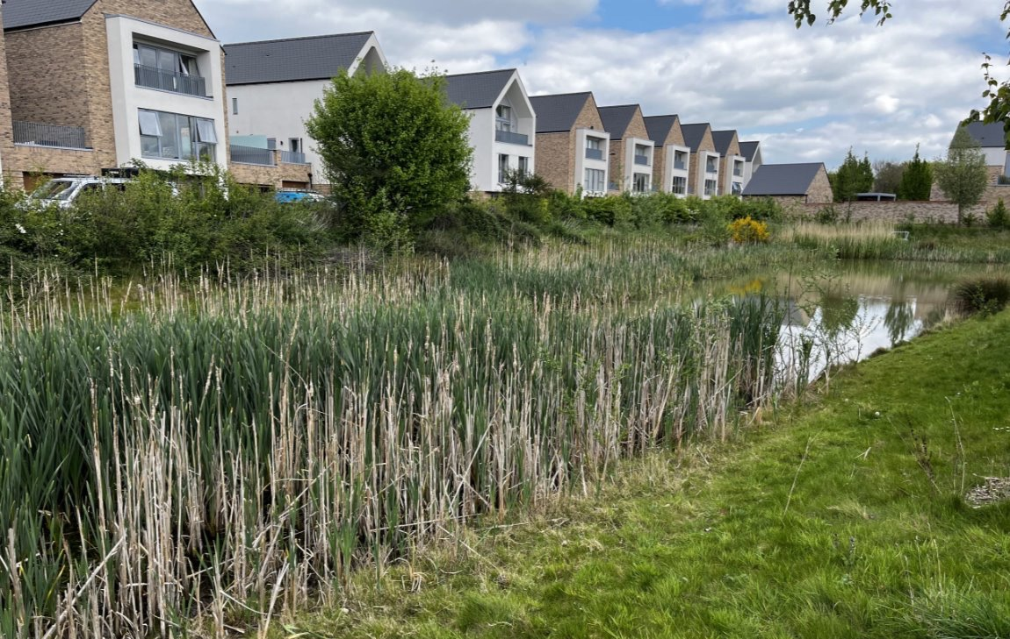
Webinar 4: Embedding climate adaptation action within health systems
Embedding monitoring of implementation for good governance
Case Study of Sustainable Drainage Systems (SuDS) at ARU campuses
Dr Maryam Imani
Associate Professor of Water Systems Engineering
Anglia Ruskin University
Maryam.Imani@aru.ac.uk
25 June 2025

Slide 2
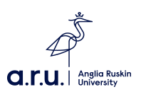
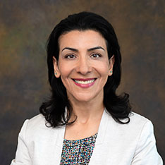
Background
Associate Professor of Water Systems Engineering​,
School of Engineering & the Built Environment, Anglia Ruskin University
Chair of the International Water Association (IWA) ‘Alliance on Water Sensitive Design & Planning (WSDP BrUKInd)’ Working Group​
Core Committee member of the IWA Nature Based Solutions Cluster
Member of the Highway Drainage Task Force
Member of the UK’s Charted Institute of Water & Environmental Management (CIWEM) ​
Advisory Board Member of the EU Horizon Europe Project Nature Demo project
Advisory & Technical Board member for the EA-funded Nene Water Management Strategy
Research Interest: Water/Wastewater Infrastructure Resilience, Optimisation, and adaptation (with particular focus on SuDS/Blue-Green-Grey Infrastructure/Nature-Based Solutions)​

Slide 3
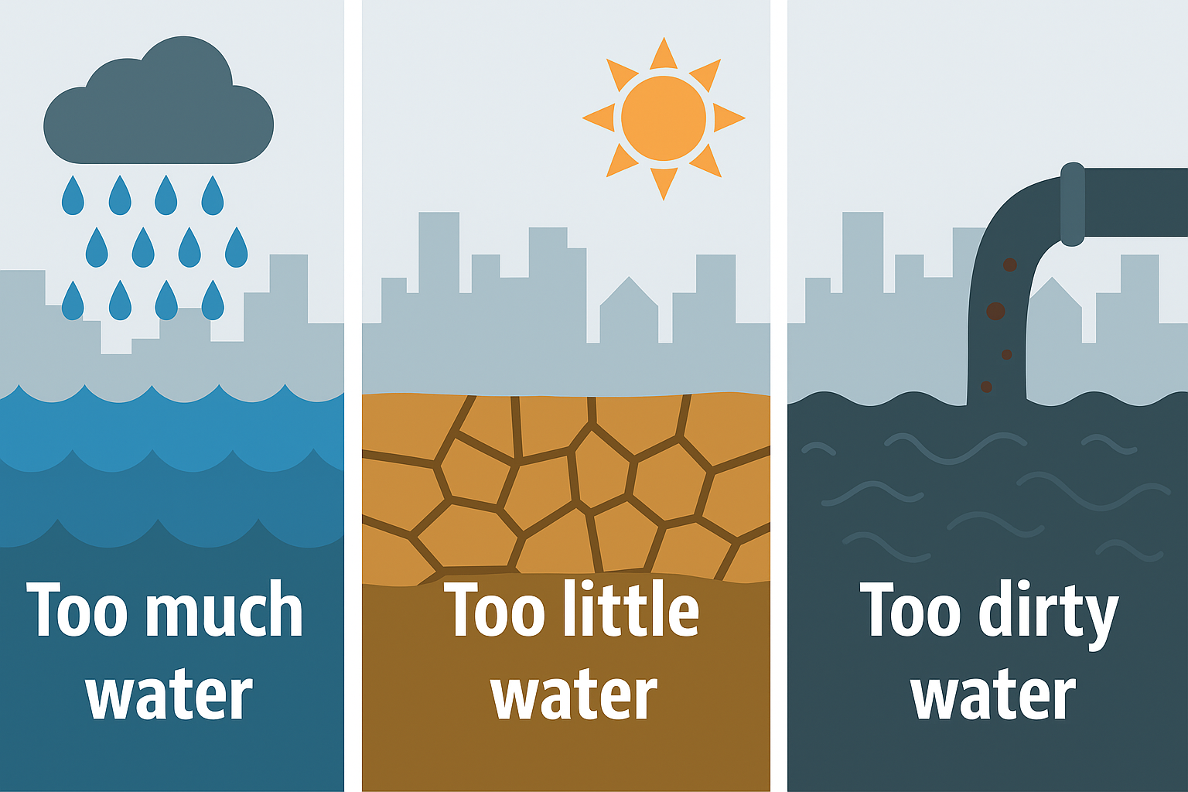
Water-Related Challenges

Slide 4
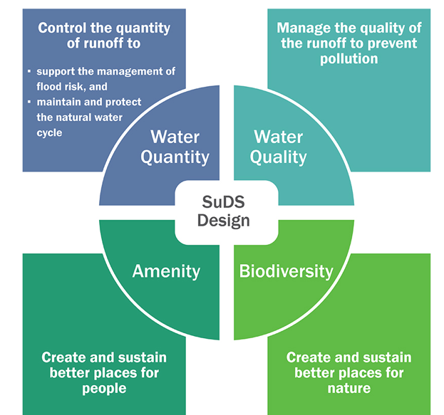
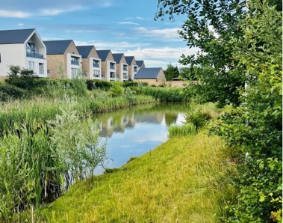
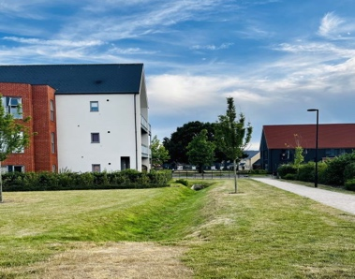
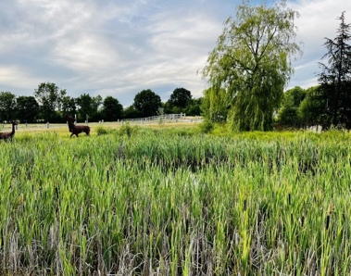
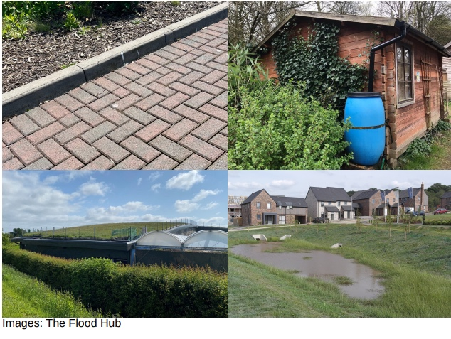
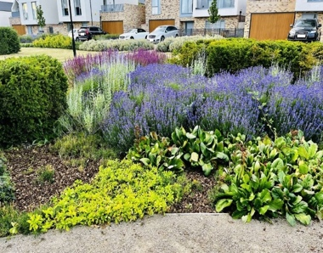
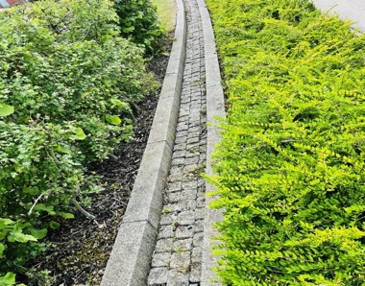
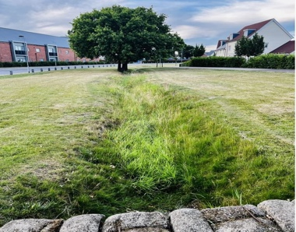
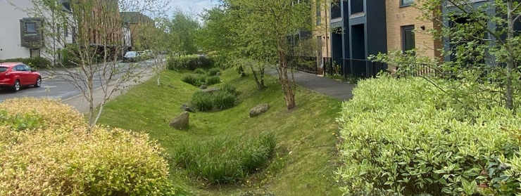
Sustainable Drainage Systems (SuDS)
SuDS stands for Sustainable Drainage Systems — a set of techniques used to manage rainwater (surface water runoff) in a natural, sustainable way, especially in urban areas.
SuDS mimic natural processes to:
Slow water down
Let it soak into the ground
Store it temporarily
Clean it naturally before release
Four Pillars of SuDS Design
Notes:
Low Impact Design (USA), Sustainable Drainage Systems (SuDS) (England and Wales), Sustainable Urban Drainage Systems (SUDS) (Scotland),Water Sensitive Urban Design (WSUD) (Australia), Best Management Practices (BMPs) (USA), …

Slide 5
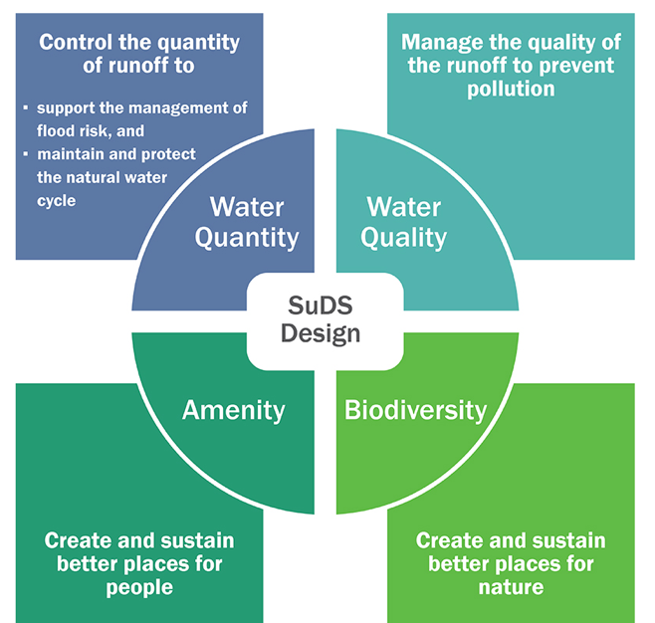
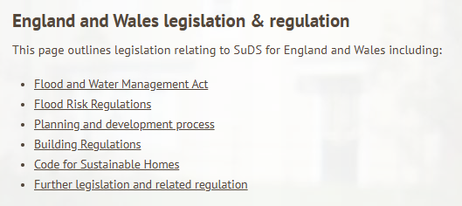
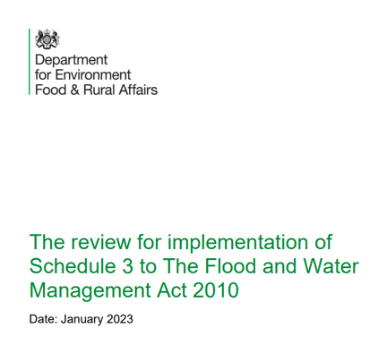
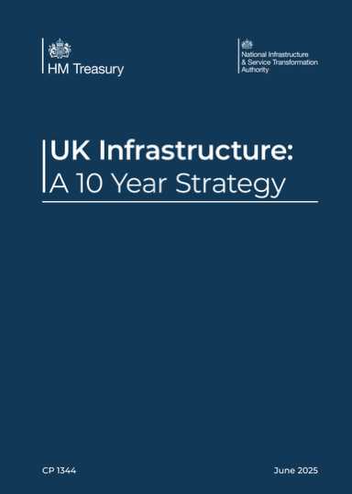
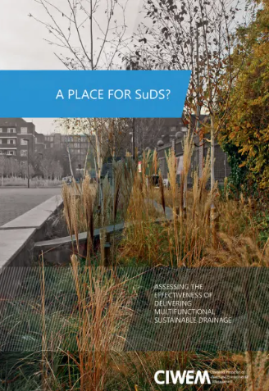
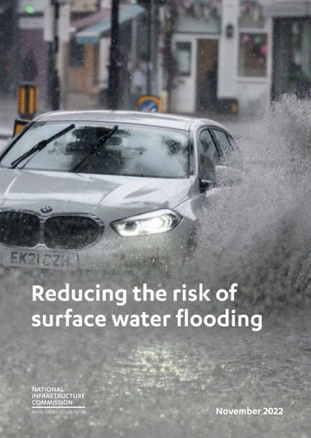
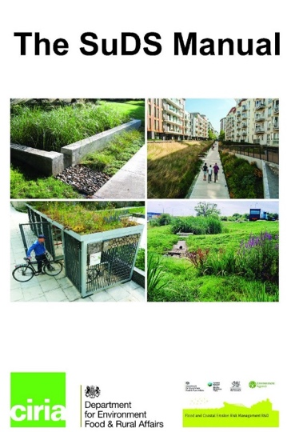
SuDS in the UK
In the UK, SuDS are being integrated into urban planning, infrastructure projects, and public services, often mandated by policy or planning conditions
Surface water management forms part of the local planning requirements for increasing sustainability and managing flood risk. The installation of SuDS on new developments became mandatory in 2023. Full implementation is expected during 2024.
Four Pillars of SuDS Design

Slide 6
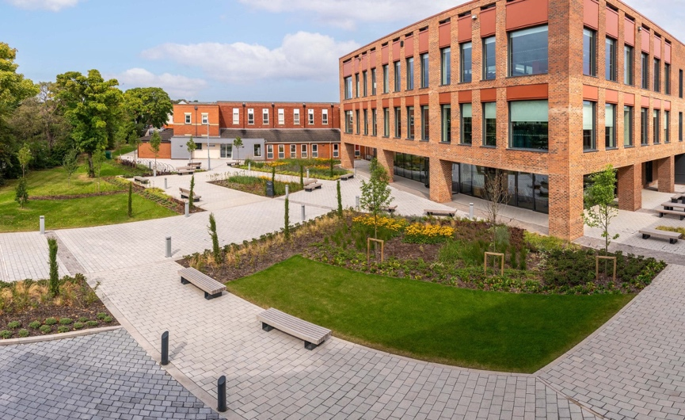
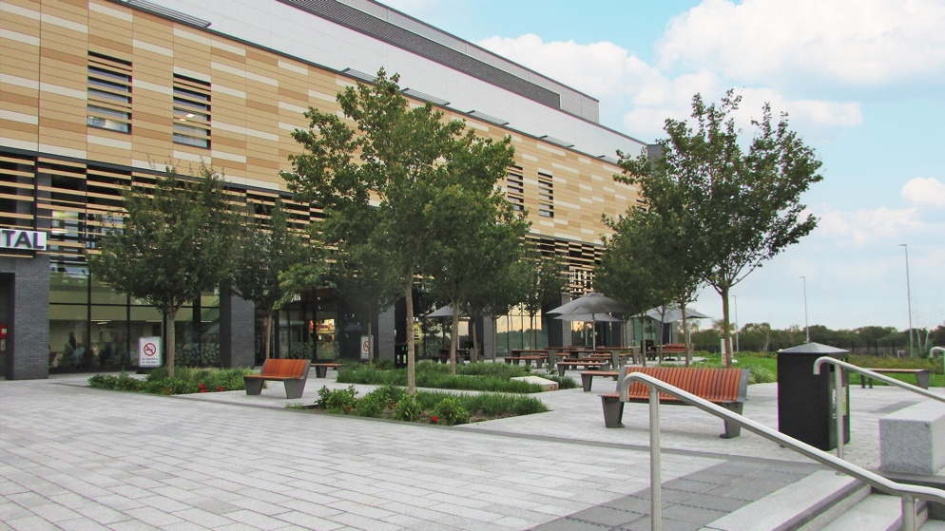
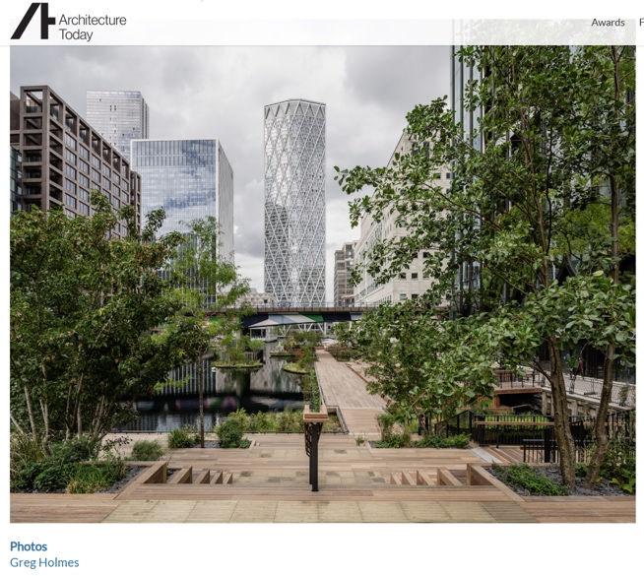
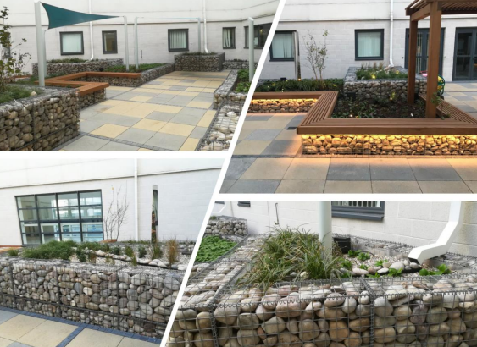
Exemplar Projects
Multi-Functional Design: Infrastructure should be designed to serve multiple purposes to ensure multiple benefits, greater return on investment and adaptability to climate change.
Monkwearmouth Hospital in Sunderland
Chase Farm Hospital, Enfield
https://www.tobermore.co.uk/professional/project/monkwearmouth-hospital/
Raingardens Retrofit at Basildon University Hospital
Eden Dock - London’s Canary Wharf

Slide 7
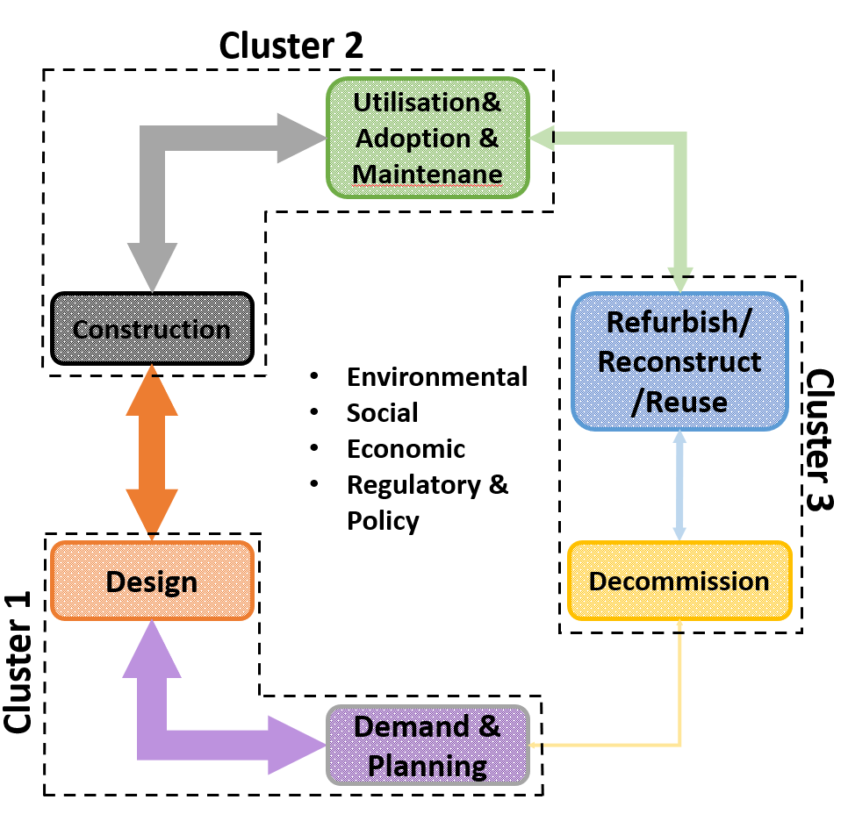
Our Vision – SuDS Life Cycle
Key Challenges in Delivering Effective SuDS
Fragmented Roles & Responsibilities
Weak Regulation and Enforcement
Skills and Knowledge Gaps Across Sectors
Planning Trade-offs and Competing Priorities
Poor Understanding of Long-Term Performance
Lack of Data to Demonstrate Impact
Maintenance Costs
Inconsistent or Poor Maintenance
Limited Monitoring and Evaluation
Low Public Awareness & Engagement

Slide 8
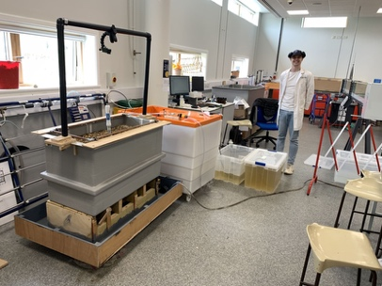
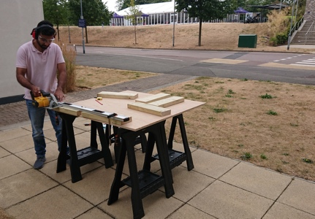
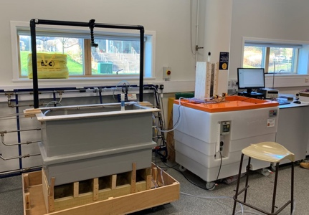
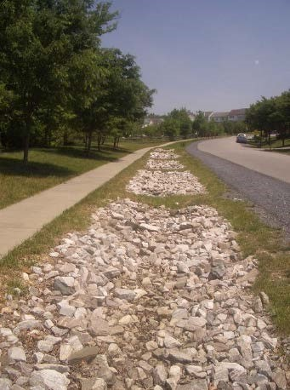
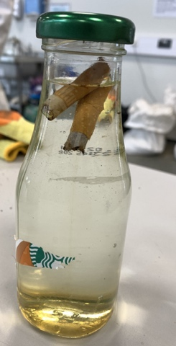
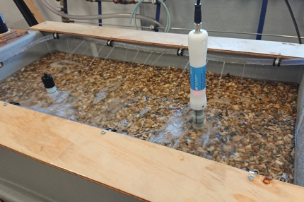
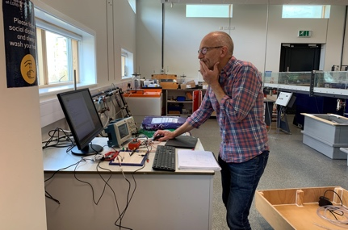
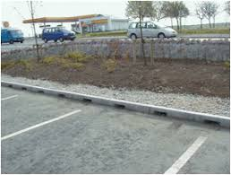
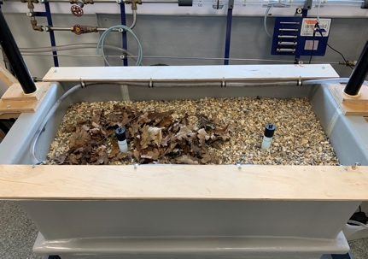
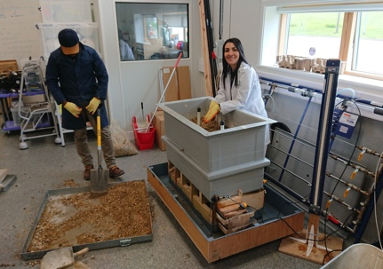
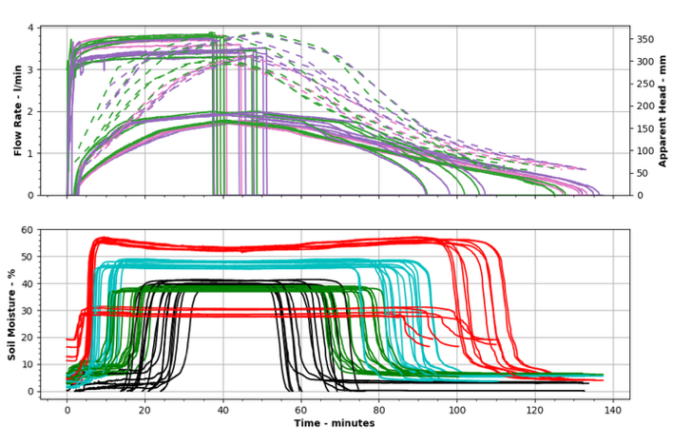
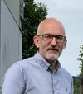
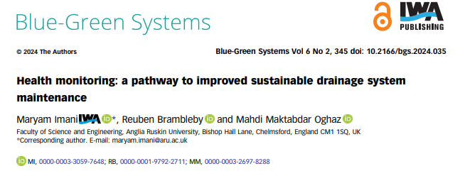
Pilot SuDS Monitoring Projects
Smart Sustainable Drainage System Health Monitoring (Smart SuDS)
Aim: ‘to propose a smart system through state-of-the-art AI-driven models and remote sensing technologies (e.g., multispectral imagery, IoT devices, wireless sensors) to automate SuDS health monitoring and maintenance process’.

Slide 9
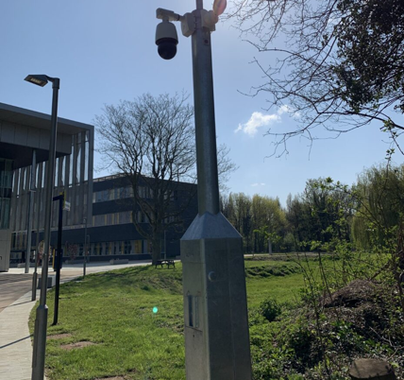
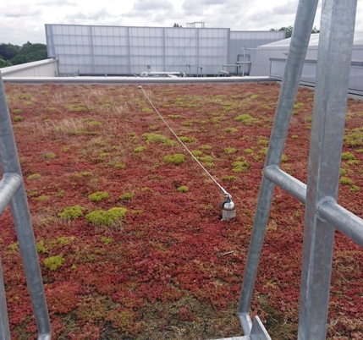
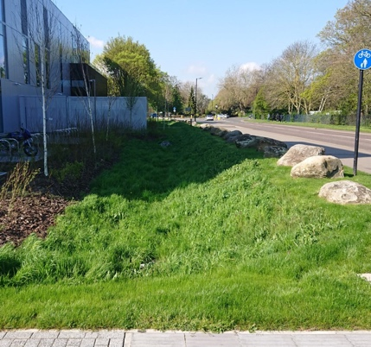
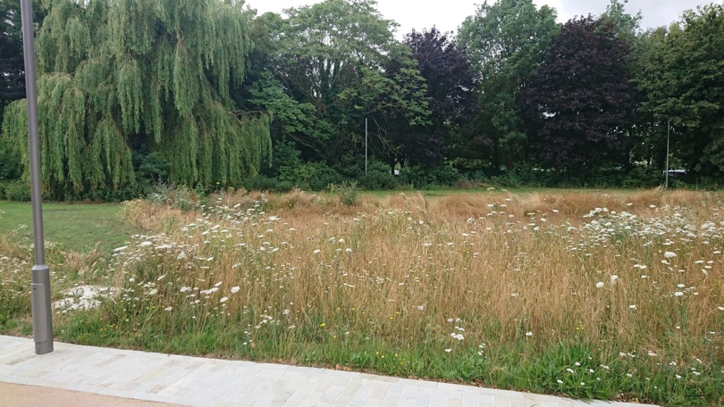
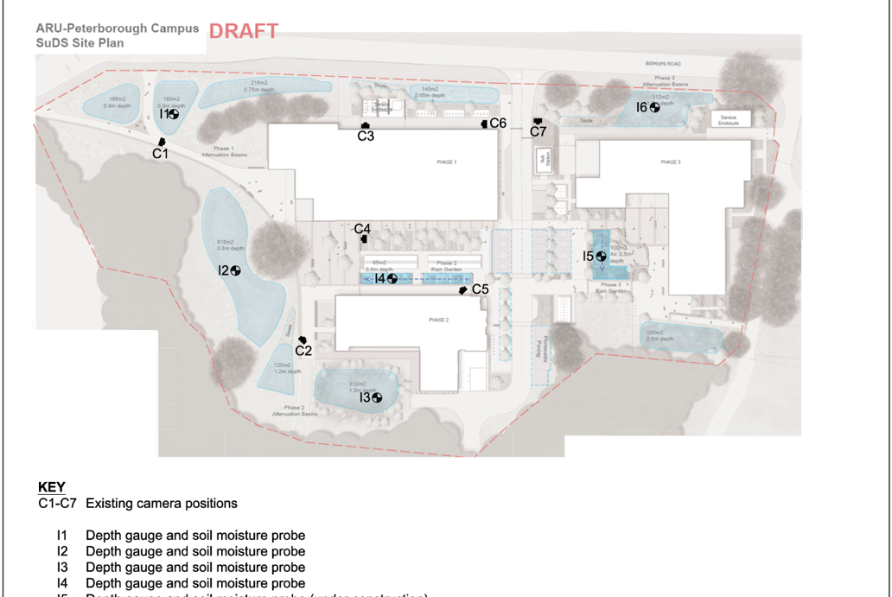
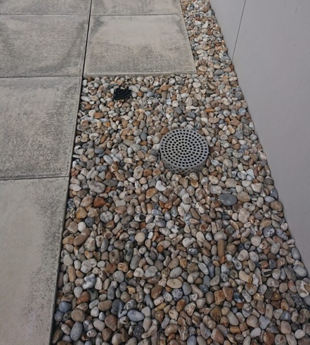
ARU Peterborough SuDS Lab
Grass Swale
CCTVs & Multi-Spectral Cameras
Green Roof
Not well-maintained attenuation basin
Rain Garden
Infiltration Trench
Proposed Instrumentation plan
Aim
This pilot project has the objective of establishing a monitoring system for SuDS features within ARU Peterborough Campus. It achieves this goal through the instrumentation of the current SuDS features, ultimately generating a Digital Twin of the campus.

Slide 10
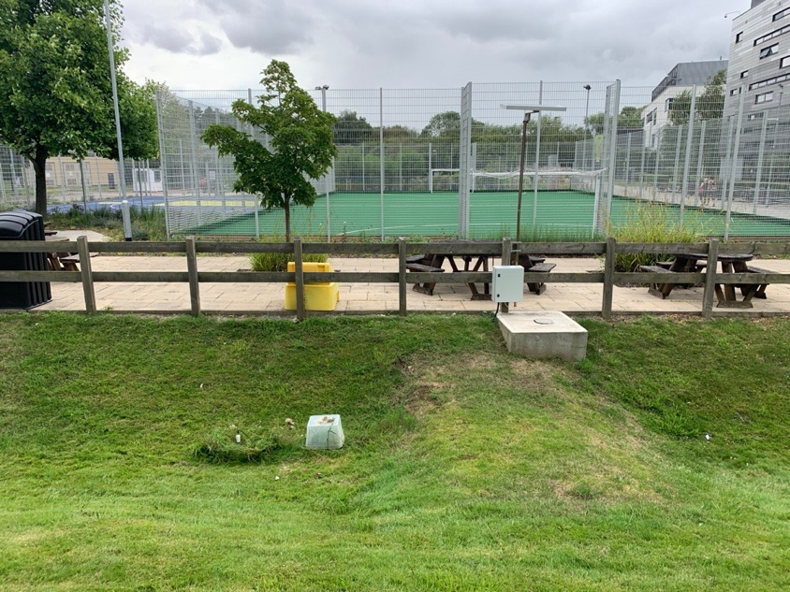
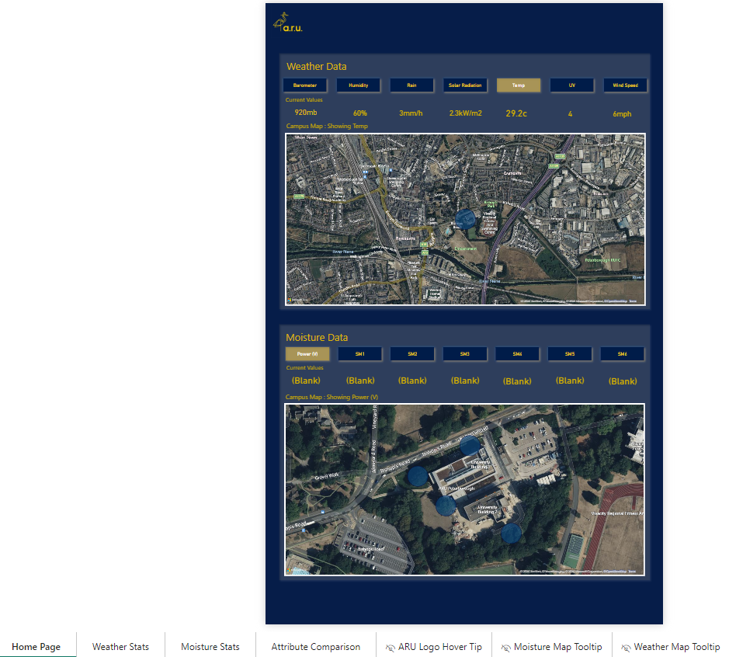
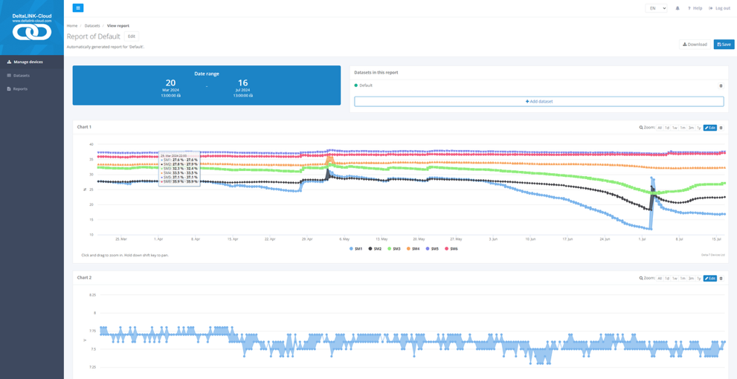
ARU Chelmsford SuDS Lab

Slide 11
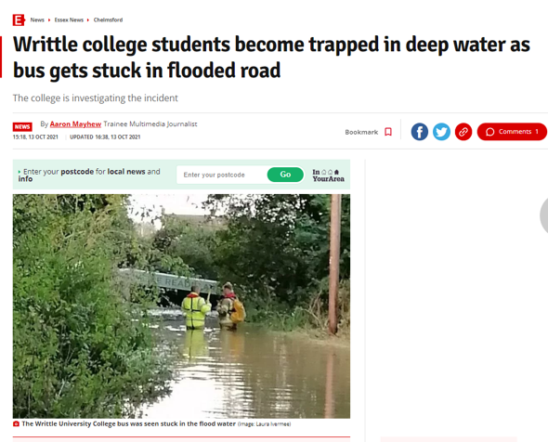
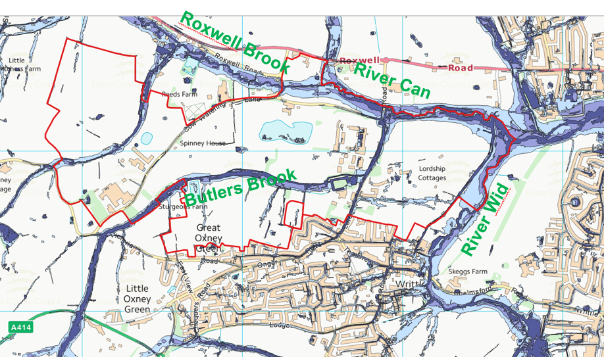
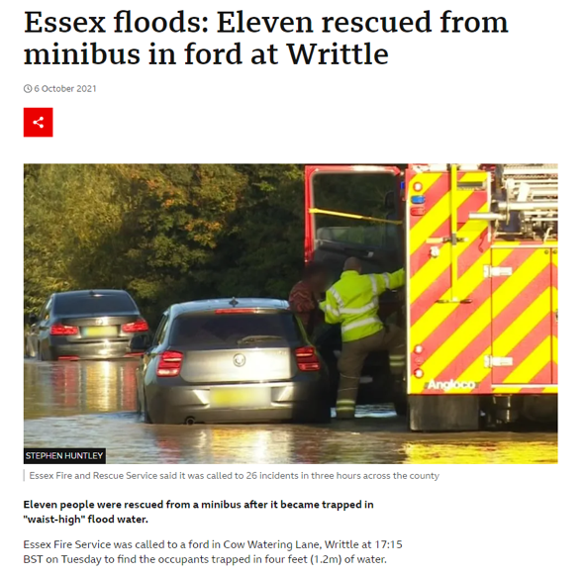
ARU Writtle NBS Demonstration Lab
Ongoing & increased Flooding
Surface water pollution
Loss of biodiversity & ecosystem degradation
Vision: Create a space to showcase, test, and promote practical applications of NBS for environmental, social, and climate challenges.

Slide 12
Embedding SuDS Monitoring for Good Governance….
From Compliance to Performance
Moves governance beyond tick-boxes to accountability through evidence.
Data Drives Decisions
Informs all life cycle stages including investment in better climate-resilience strategies.
Enables What Works
Supports replication of best practice across the NHS and public infrastructure.
Strategic & Essential
Monitoring needs planning, funding, and skills—not optional, but vital.
The government’s £6 billion/year NHS capital investment is a strategic opportunity to deliver resilient, green, and adaptive facilities.
Builds Trust & Collaboration Evidence empowers cross-sector coordination and long-term impact.

Slide 13
Thank you
Q & A
Maryam.Imani@aru.ac.uk
25 June 2025

