Slide 1
Tackling Modern Slavery in Supply Chains
Karen Amber
Sustainability Estates Solutions Framework Agreement
Karen Amber, Sustainability and Social Value Manager, NHS Commercial Solutions

Slide 2
Content
Brief overview of NHS Commercial Solutions
Development of the Sustainable Estates Solutions Framework
The Social Value Model Missions
Sustainable Estates Solutions Framework Agreement Refresh
How to procure via the Framework Agreement

Slide 3
NHS Commercial Solutions
NHS Commercial Solutions is a fully NHS owned organisation, providing procurement services to the health and care system, as well as the wider public sector. We are all NHS employees.
Our quality of service is important to us. We are an accredited framework host under NHS England’s commercial efficiency programme, fully meeting the standards needed to deliver high quality routes to market.
Collaboration is in our DNA, pooling resource to influence markets.
We specialise in Workforce, Estates and Facilities, Digital, Healthcare Services, Corporate Services, and Sustainability and Social Value through end-to-end procurement services.
We have been providing specialist procurement support for over 15 years to the NHS and wider public sector.
Our approach to partnerships is a cornerstone of our commitment to delivering value. We have established a strong partnership with the three other NHS Procurement Hubs and Crown Commercial Services under the ‘NHS Workforce Alliance’.
Creating value
through
modern-day
procurement
“Our partnership with NHS Commercial Solutions continues to add value to our business operations. Their unwavering support and collaborative approach has saved us considerable resource over a number of category areas, on top of a multitude of learning events hosted throughout the year, keeping us informed and moving towards best practice.”
Alex Williams, Associate Director of Procurement, Ashford and St. Peter’s Hospitals NHS Foundation Trust

Slide 4
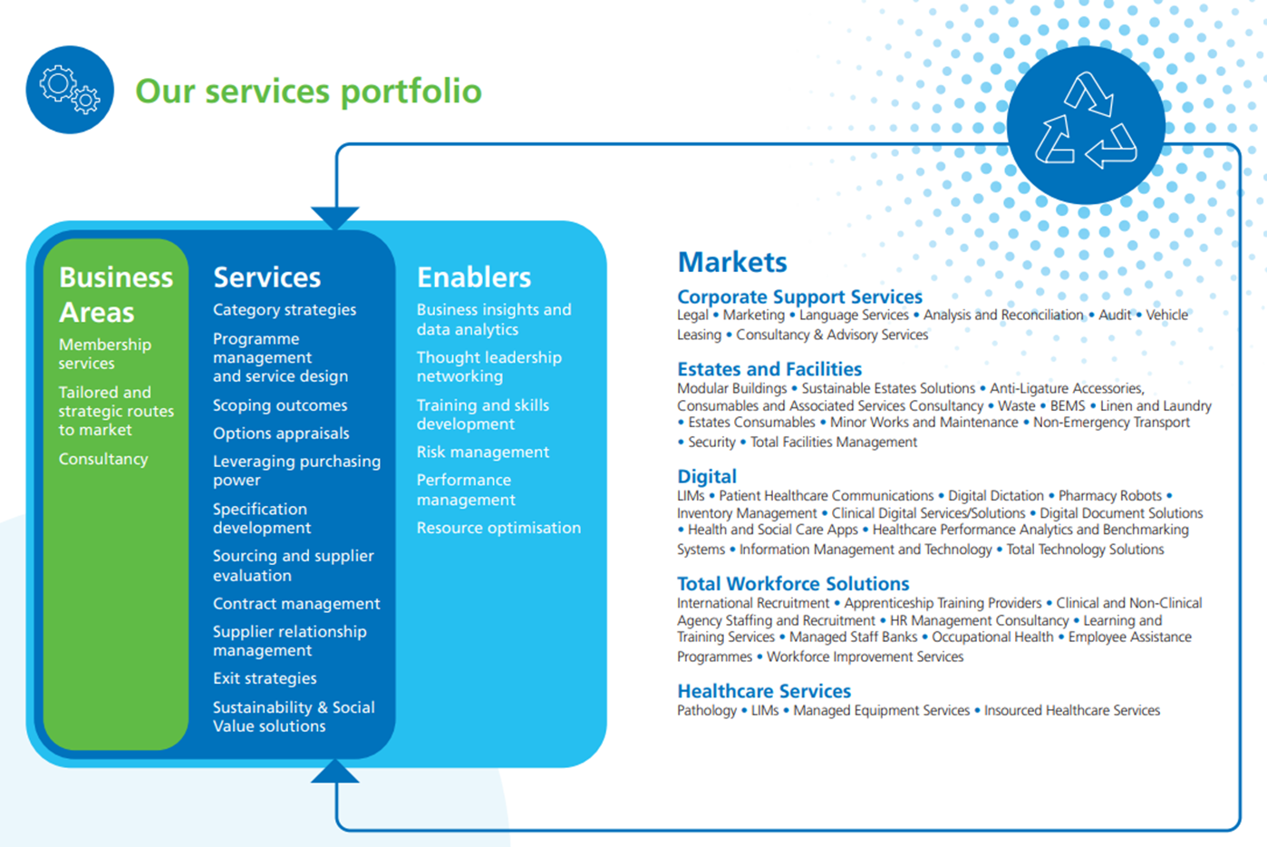
Our procurement experts help across the full procurement lifecycle. We leverage a wide range of category markets to get the best value for our customers in both price and quality outcomes.

Slide 5
Development of the Sustainable Estates Solutions Framework Agreement
Green Plan Scoping
Climate risk to services
Gap in the market
Pre-market engagement with Suppliers
Pre-market engagement with NHS Trusts
Identifying sector risks – Modern Slavery and Human Rights violations, Biodiversity, Waste, Energy consumption
Delivering Sustainable Solutions in a sustainable way – no trading off

Slide 6
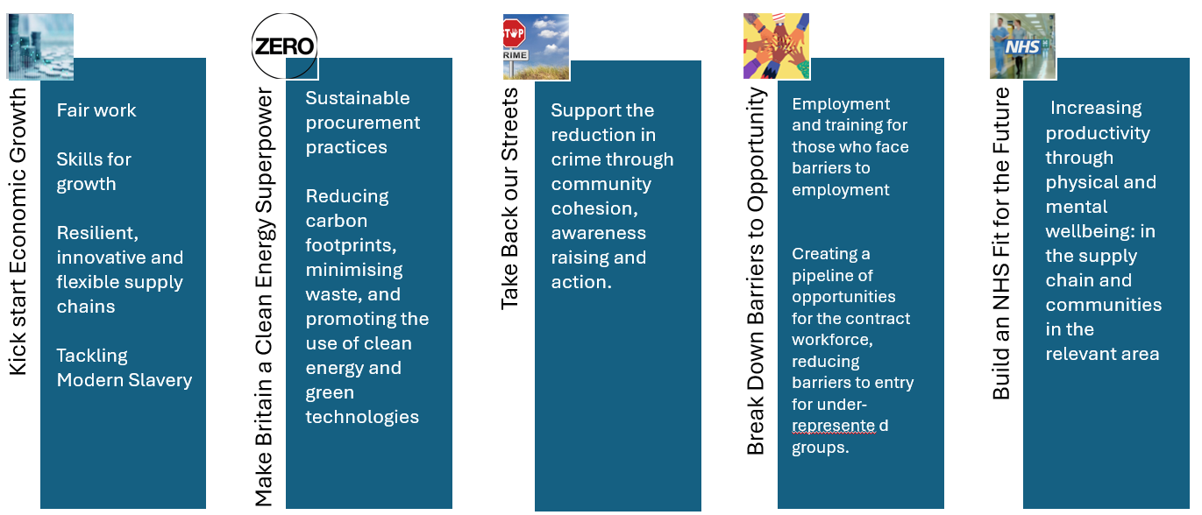
Social Value Model Missions

Slide 7
NHS Commercial Solutions Sustainable Estates Solutions Framework
The NHS Commercial Solutions Sustainable Estates Framework is a compliant route to market enabling you to meet the aims of the NHS green plan and the NHS climate risk assessment and framework from design to delivery.
The Framework is aligned to the UN Sustainable Development Goals – not only are the solutions sustainable but with a 20% Sustainability and Social Value weighting on the framework you can be assured the suppliers are not only providing sustainable solutions, but they are developed in a sustainable way.

Slide 8
Refreshed Framework to be awarded 2025 under PA23
Lot 1: Consultancy Services Environmental consultancy services Ecological consultancy services Sustainability consultancy services Social Value consultancy services Design/architectural services Sustainable Insulation Natural Ventilation Energy Efficient Windows and Doors Heat Pumps/Passive Cooling Systems Combined Heat and Power Systems Rainwater Harvesting Energy & Water Efficient Appliances Energy-Efficient Lighting Systems Solar Shading/Canopy Cover Solar Film Solar Power Generation and Storage Living Walls Rainwater Gardens Green Roof Spaces Wellbeing Green Spaces Water efficient system Energy efficient system Wind Power Generation & Storage
Lot 2: Building Remediation 2A - Sustainable Insulation 2B - Natural Ventilation 2C - Energy Efficient Windows and Doors 2D - Heat Pumps/Passive Cooling Systems 2E - Combined Heat and Power Systems 2F - Rainwater Harvesting 2G - Energy & Water Efficient Appliances 2H - Energy-Efficient Lighting Systems 2I - Solar Shading/Canopy Cover 2J - Solar Film 2K - Water efficient system 2L - Energy efficient system 2M – Zoned heating/cooling and lighting system 2N – Electric Vehicle Charging Systems/Stations
Lot 4: Nature-based Solutions 4A - Living Walls 4B - Rainwater Gardens 4C - Green Roof Spaces 4D - Wellbeing Green Spaces 4E – Kitchen Garden and Allotment Solutions 4F – Gardening & Landscaping Services
Lot 5: Bespoke Service To include combination service with a combination of service in Lot 1, 2, 3, and 4
Lot 3: Power Generation and Storage 3A - Solar Power Generation and Storage 3B – Wind Turbine and wind energy generation systems

Slide 9
How to Procure
The framework agreement is open to:
All NHS organisations
Social Enterprises and Community Interest Companies (CICs)
All public sector organisations in the UK and their subsidiaries
Contracts can be awarded via Mini- Competition or Direct Award
NHSCS support to Contracting Authorities:
NHS Standard T&Cs for call-off Contract;
Templates for specification, Tender documents suit, Order forms;
Procurement guidance and best practise advises; and
Procurement support is available through the framework

