Slide 1
Circular Economy in Clinical Procurement: A Climate Adaptation Strategy for NHSE Trusts
Petar Tabakov
Research Fellow at the Brighton and Sussex Medical School
University Hospitals Sussex NHS Foundation Trust

Slide 2
The scale of the problem
Sources: NHS - Spend Comparison Service – Accounts Payable. 2025. Available from: https://apps.model.nhs.uk/a-z#S ;
NHS. 2022. Delivering a “Net Zero” National Health Service. Available from: https://www.england.nhs.uk/greenernhs/publication/delivering-a-net-zero-national-health-service/ ;
Department of Health and Social Care and The Rt Hon Wes Streeting MP. 2024. Major crackdown on NHS waste – Press Release. DHSC: London. Available from: https://www.gov.uk/government/news/major-crackdown-on-nhs-waste
NHS. 2023. NHS clinical waste strategy. Available from: https://www.england.nhs.uk/estates/nhs-clinical-waste-strategy/
NHSE Annual Spend:
~3 Billion £
(NHSSC data only)
Over 115,000 Suppliers
NHSE Annual Purchased Volume:
> 20 Billion Eaches
More than 95% of those – likely disposable
NHSE Carbon Footprint from Clinical Procurement:
2.5Mt CO2e
Waste volume: 156, 000 tonnes (secondary care only)
Notes:
NHS trusts across England spend more than 20 Billion GBP annually on clinical procurement
Over 115,000 Suppliers
NHS trusts buy more than 20 Billion items
Data from the UHSussex NHS Foundation Trust shows that more than 95% of those items are single-use, likely more than 99%
NHSE estimates that medical procurement contributes to around 2.4Mt (2022)
Inaccurate number because it is based on spend

Slide 3
NHSE Trusts Engagement with Supply Chain Climate Adaptation
Only 18% of Trusts are addressing Supply Chains in their Climate Adaptation Plans
63% of them refer to broader business continuation
None of these Trusts have SMART Commitments in Supply Chain Adaptation
Failure to Frame Adaptation as a Supply Chain Issue
Failure to Understand Supply Chain as an Adaptation Issue

Slide 4
Guidance on Climate Adaptation
Updated beginning of May 2025
No explicit guidance on addressing supply chain and procurement
Useful tool for climate change risk assessment
Relevant examples of organisational changes and challenges

Slide 5
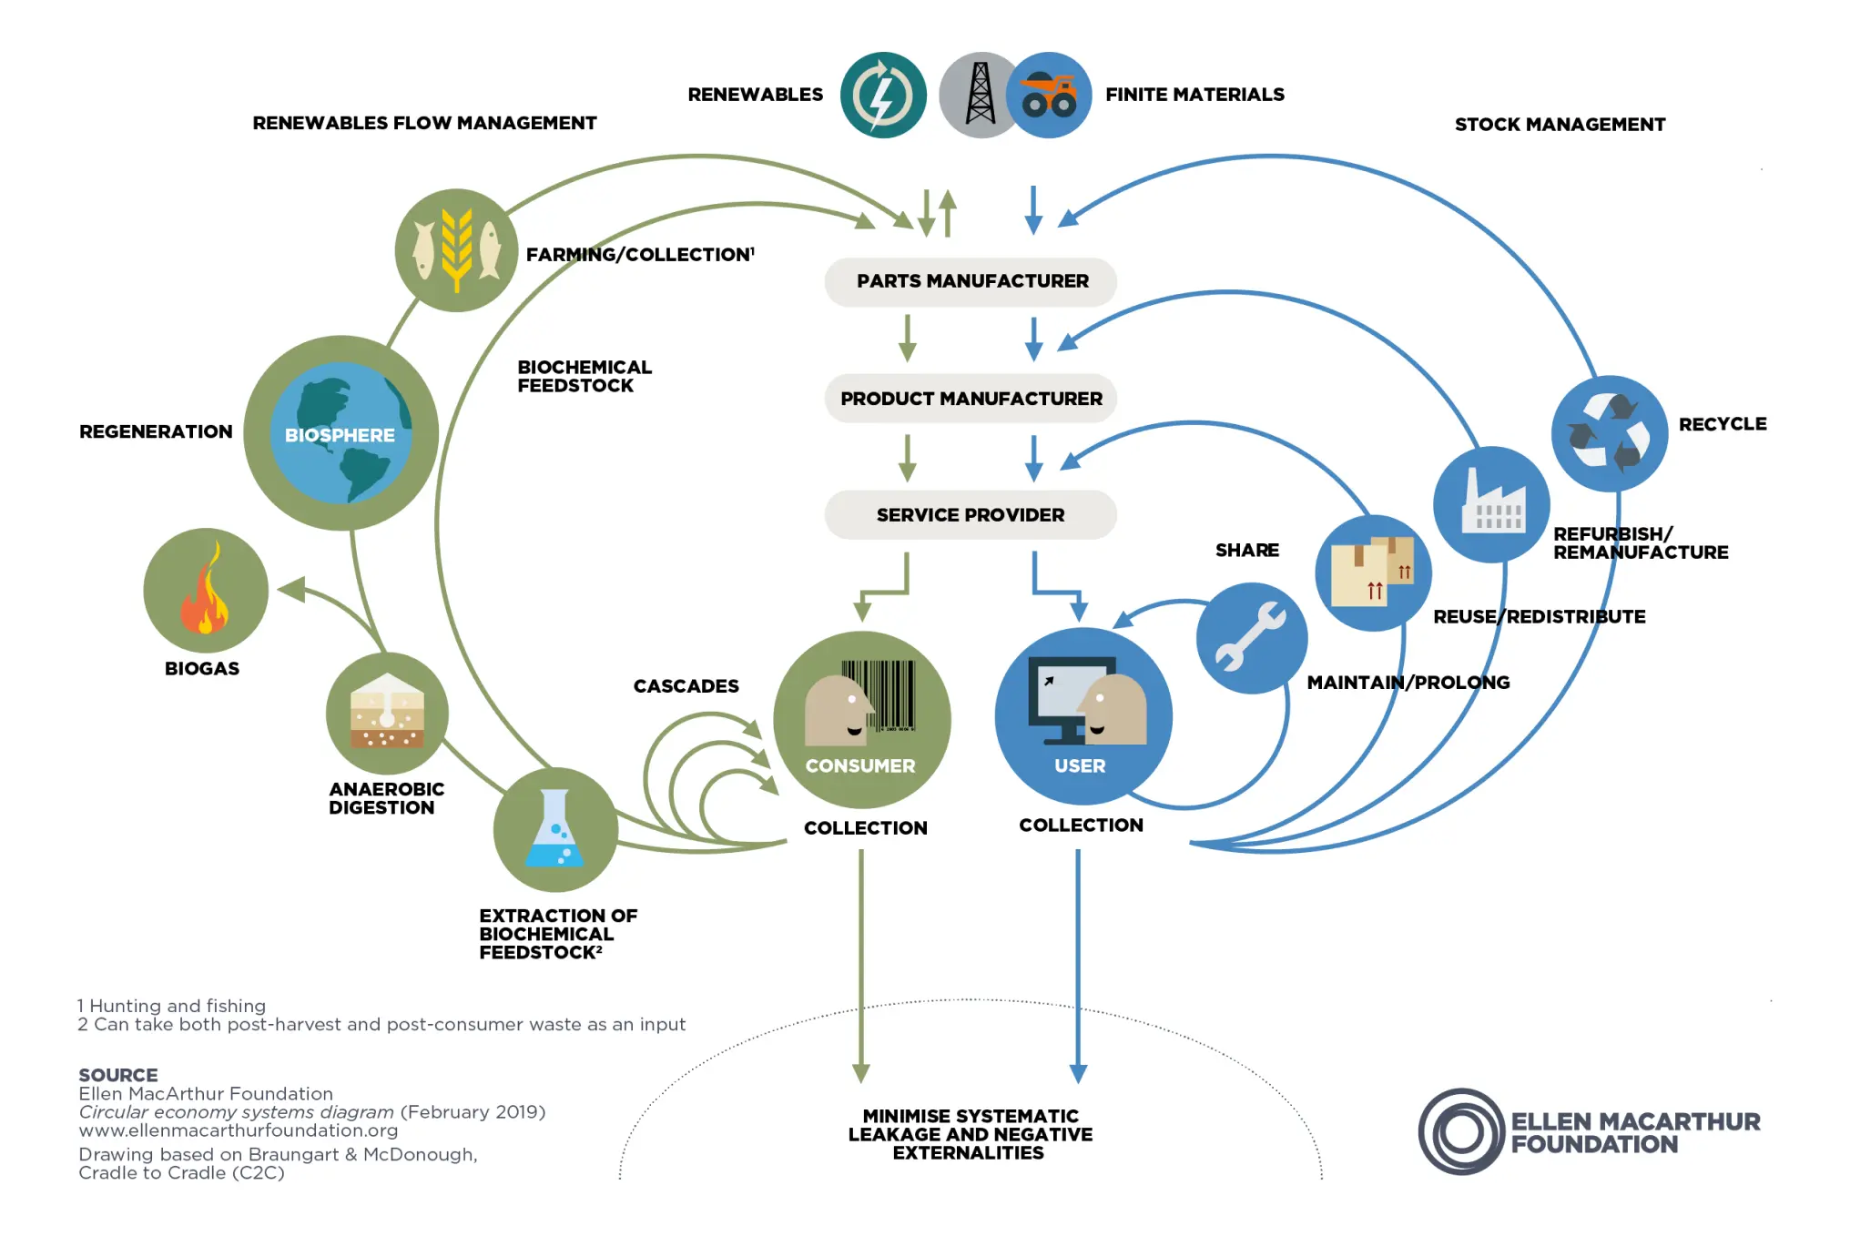
Introducing a Circular Economy Culture in NHSE Procurement Practices
Sources: Ellen MacArthur Foundation. 2025. It is time for a circular economy. Available from: https://www.ellenmacarthurfoundation.org/

Slide 6
Building Supply Chain Resilience
Reducing reliance on volatile supply chains
Influencing international trade and fostering a global circular economy
Increasing local capacity to meet demand
Decreasing Procurement Volumes and Costs
Source: Department of Health and Social Care and The Rt Hon Wes Streeting MP. 2024. Major crackdown on NHS waste – Press Release. DHSC: London. Available from: https://www.gov.uk/government/news/major-crackdown-on-nhs-waste
Ellen MacArthur Foundation. 2025. It is time for a circular economy. Available from: https://www.ellenmacarthurfoundation.org/

Slide 7
Circular Economy and Climate Adaptation
Framework for Adaptable Supply Chain Procurement | The Role of Circular Economy in that Framework
Prioritising products that are maintainable or repairable
Encouraging practices that prolong the product’s lifecycle
Prioritising products that are resilient towards climate change
Prioritising suppliers that would be willing to engage with the adaptability of the supply chain
Adapted from: Elstow, L. and MacAskill, K., 2025. Procuring for Adaptation: A guide for incorporating climate adaptation into healthcare investment decisions.

Slide 8
Questions for further research:
Ensuring the adaptability of the circular infrastructure
Translating the principle of circular economy to wider procurement practices
Ensuring system-wide engagement, quality monitoring and reporting

Slide 9
Conclusion:
Supply Chain Adaptation remains an important problem in front of NHSE Trusts
Circular Economy practices could decrease the reliance on volatile supply chains
More research is needed on embedding the cultural shift and understanding of this change

Slide 10
Thank you for your attention!

