Slide 1






PEACCH Climate Adaptation in Healthcare Webinar Series
This event is co-funded by EPSRC and ESRC Impact Acceleration Award: EP/X525686/1
This event is co-funded by EPSRC and ESRC Impact Acceleration Award: EP/X525686/1

Slide 2
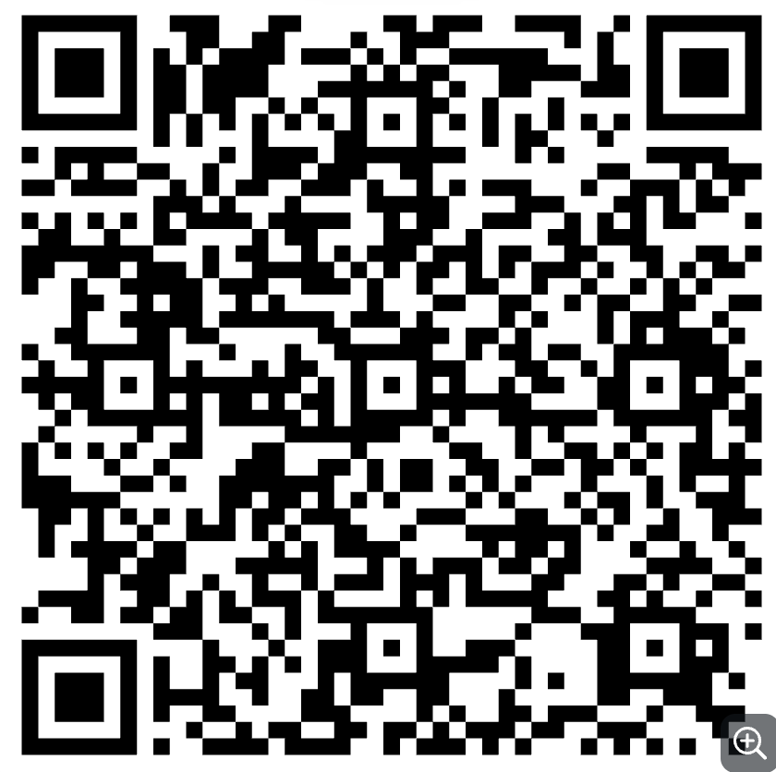
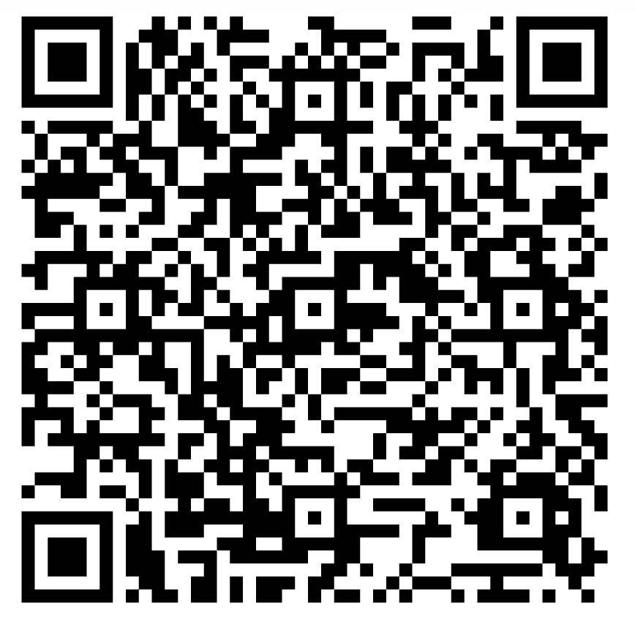
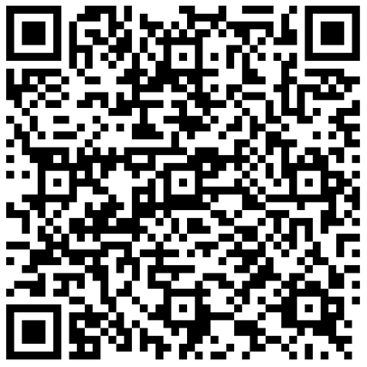
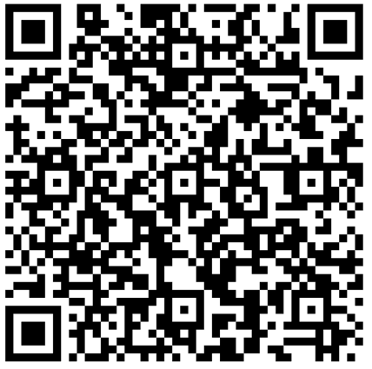
PEACCH Webinars
1. Intro to Climate Adaptation in Healthcare
17 June 2025, 1200-1300:
2. A closer look at heat risks
18 June 2025, 1200-1300:
3. A closer look at flooding / drought risk
23 June 2025, 1200-1300
4. Tools for embedding adaptation action
25 June 2025, 1200-1330:

Slide 3
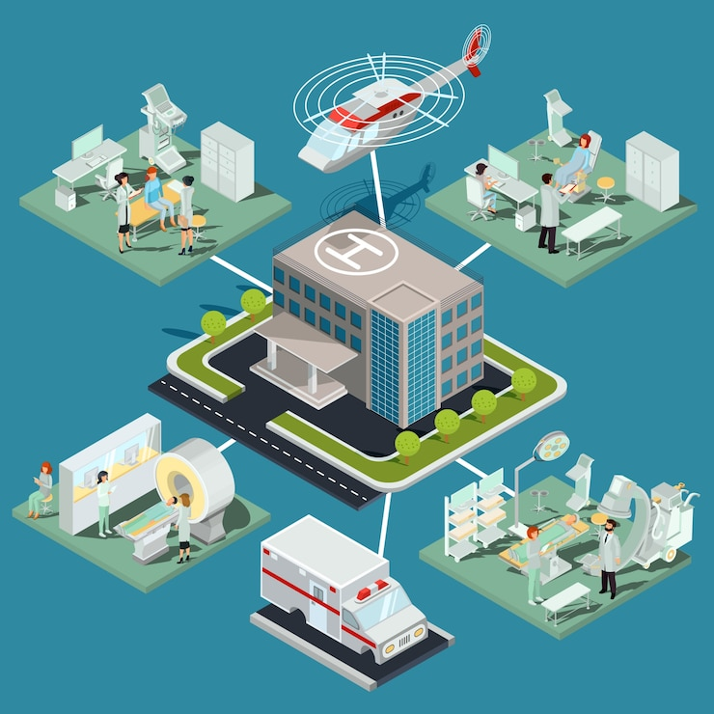
Housekeeping
Feel free to introduce yourself on the chat
Sessions are being recorded and a link to these will be shared within the next week.
Keep your questions until the end of the session- use the Q&A function (these will not be in the final published version)

Slide 4
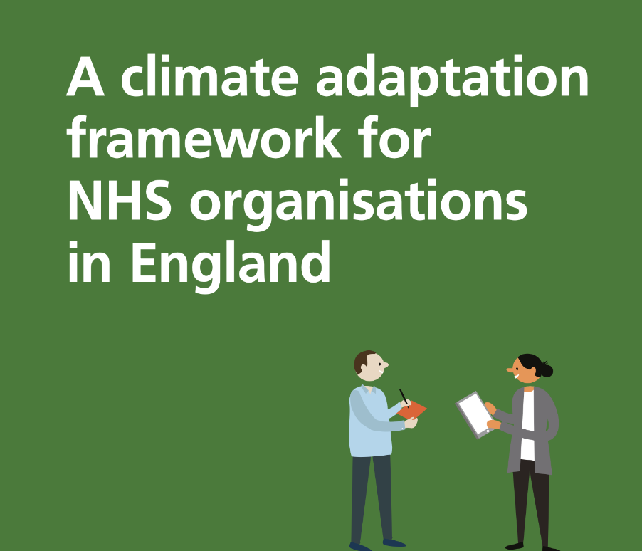
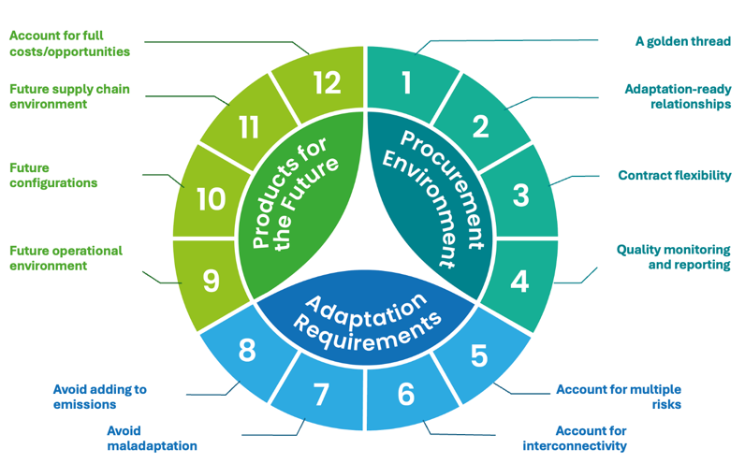
Webinar 4: Tools to embed
Speaker | Topics
Louise Elstow | Welcome, introduction to PEACCH and the final session
Morgan Roberts | Introduction to the NHS Climate Adaptation Framework and NHS Climate Change Risk Assessment (CCRA) Tool
Petar Tabakov | The future of sustainable procurement and what this means for adaptation
Louise Elstow | 12 principles for making adaptation-positive investment decisions
Karen Amber | NHS Commercial Solutions Sustainable Estates Solutions Framework
Alexis Percival | Finding creative ways to fund adaptation
Maryam Imani | Embedding monitoring of implementation for good governance – case study of drainage systems (SUDS) at ARU’
Louise Elstow | Facilitated Q&A session Closing of the webinar series

Slide 5

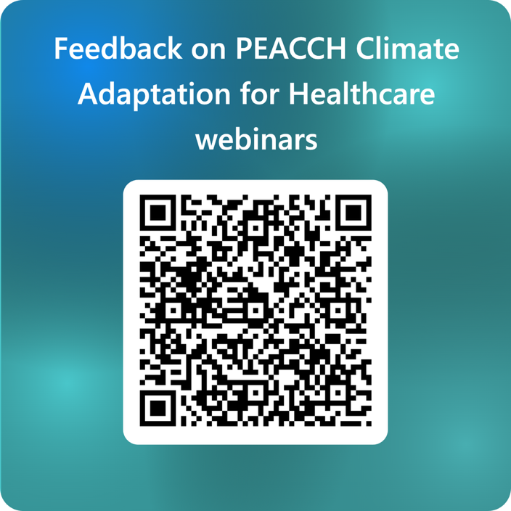
Closing remarks
Changing mood
Co-benefits and systems thinking approaches overtime
Case studies
Turn out
Next steps
This event is co-funded by EPSRC and ESRC Impact Acceleration Award: EP/X525686/1
This event is co-funded by EPSRC and ESRC Impact Acceleration Award: EP/X525686/1

Slide 6


PEACCH Adaptation webinars
17 June 2025, 1200-1300: Introduction to climate adaptation in a healthcare context. Register here
18 June 2025, 1200-1300: A closer look at heat risks in healthcare facilities, with intervention options and with a UK case study. Register here
23 June 2025, 1200-1300: A closer look at flooding and drought risk in UK healthcare facilities, with intervention options and a UK case study. Register here
25 June 2025, 1200-1330: Embedding action to adapt to climate change in your organisation - what tools are there to help you take action. Register here

