Slide 1
Flooding Response Impacts and Climate Adaptation
Jamie Fountain Resilience Manager

Slide 2
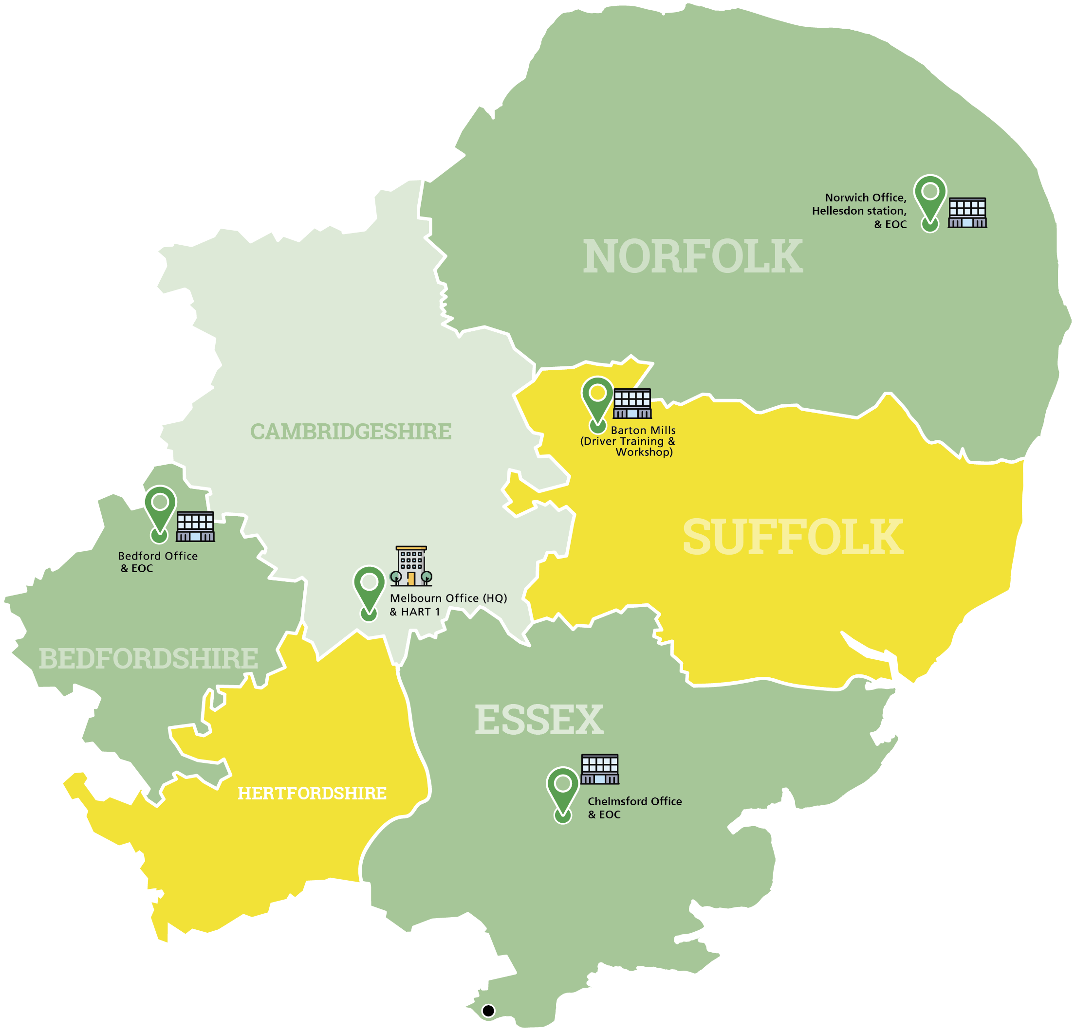
Organisation scale
6,000 + staff and 1,200 volunteers
6.4 million people / 7500 sq miles
1.3 million+ 999 calls / 3 control rooms
fleet of 800+ vehicles
17 acute trusts (A&Es) and six integrated care systems (ICSs)

Slide 3
28/11/24 Storm Conall
07/10/24 Severe Rainfall
04/10/24
03/10/24
02/10/24
01/10/24
30/09/24
24/09/24
13/03/24 A14 Groundwater Flooding
07/03/24
06/03/24
09/01/24 Storm Henck
08/01/24
06/01/24
05/01/24
Cambridgeshire & Peterborough Local Resilience Forum
Flooding Response Structures 2024
Notes:
15 TCGs

Slide 4
28/11/24 Storm Conall
07/10/24 Severe Rainfall
04/10/24
03/10/24
02/10/24
01/10/24
30/09/24
24/09/24
13/03/24 A14 Groundwater Flooding
07/03/24
06/03/24
09/01/24 Storm Henck
08/01/24
06/01/24
05/01/24

Slide 6
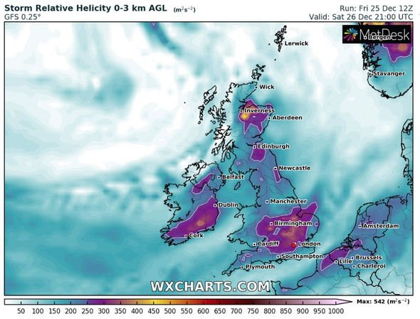

Slide 7
23 Flood Warnings
28 Flood Alerts
Buckden Marina access flooded
A14 Thrapston > Brampton closed
BAU ^30%
Flooded Care Home
Notes:
Storm Bella
23 flood warnings – immediate action required
28 flood alerts – be prepared
Multiple residential properties flooded 500 without toilets
Buckden Marina access cut off – 80 lodges
A14 Thrapston > Brampton closed
EEAST med support to op whilst seeing flood / BAU pressure 30%increase / C19 / mutual aid to LAS. Red Cross CamSAR
Care Home (Canvendish Court) 26/12/20 Call 2351 52 residents over 4 floors. Occupants 65-90family / shelter in place / LAs. FRS pumping out basement to protect electrical systems

Slide 10
Specialist Asset
Hazardous Area Response Team
Safe Working at Height
Swift Water Rescue
Urban Search & Rescue
Breathing Apparatus
Support to Security Operations
CBRN Operations
Multi Patient Incidents

Slide 11
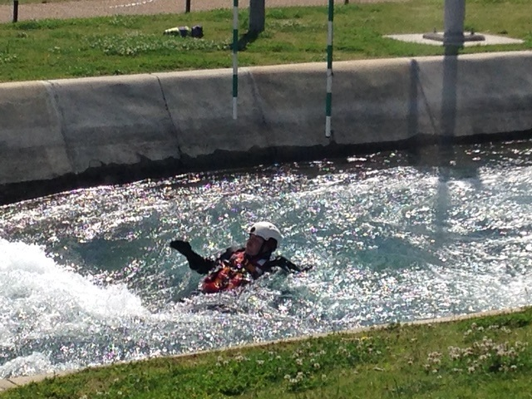
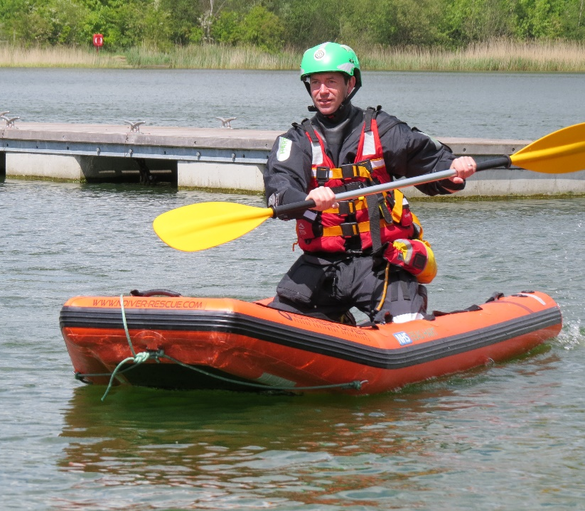
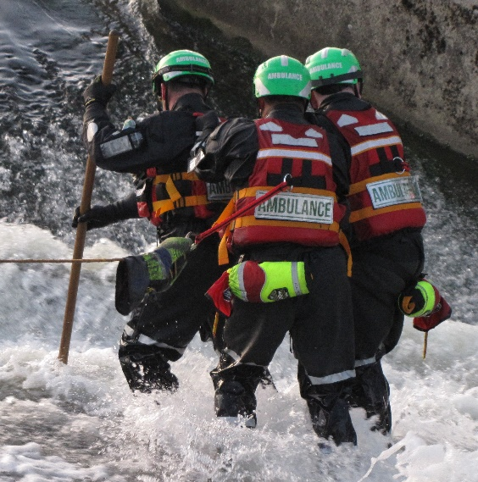
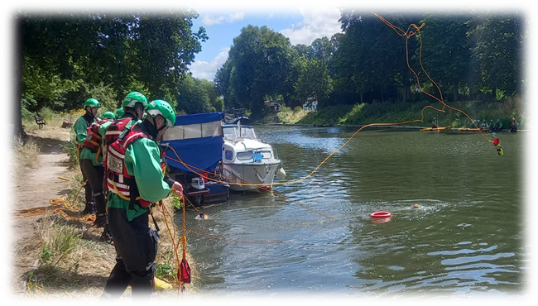

Slide 12
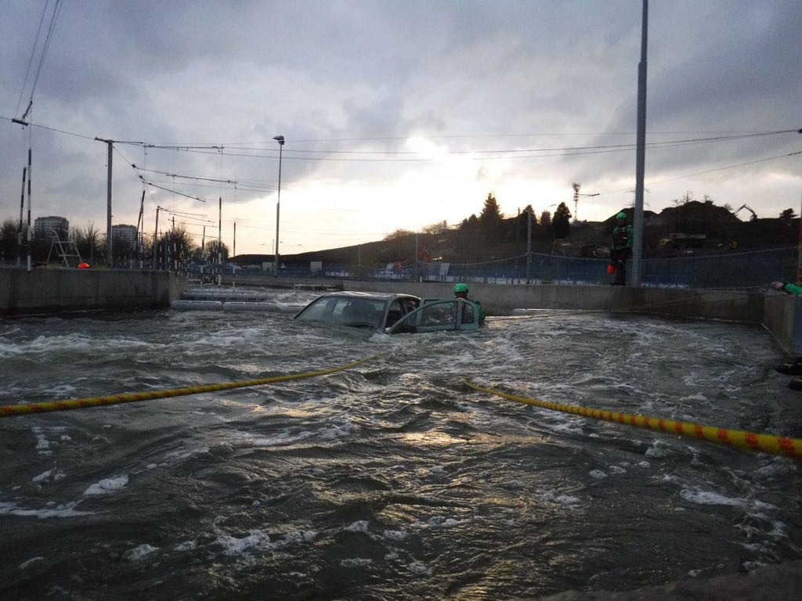
Questions

