Slide 1

Healthcare and climate change:
Droughts and Flooding
Alexis Percival, Energy and Sustainability Manager
Yorkshire Ambulance Service

Slide 2
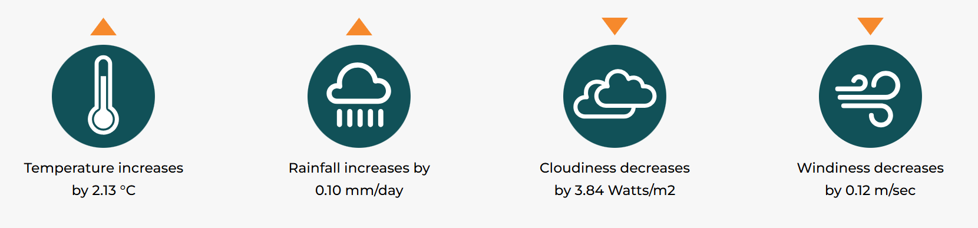
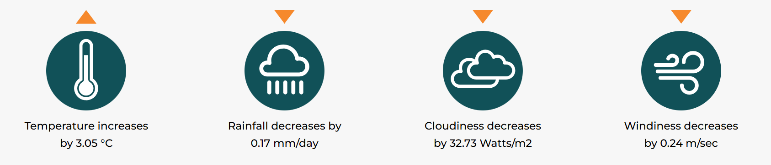
Warmer, Hotter Summers, Warmer Wetter Winters

Slide 3
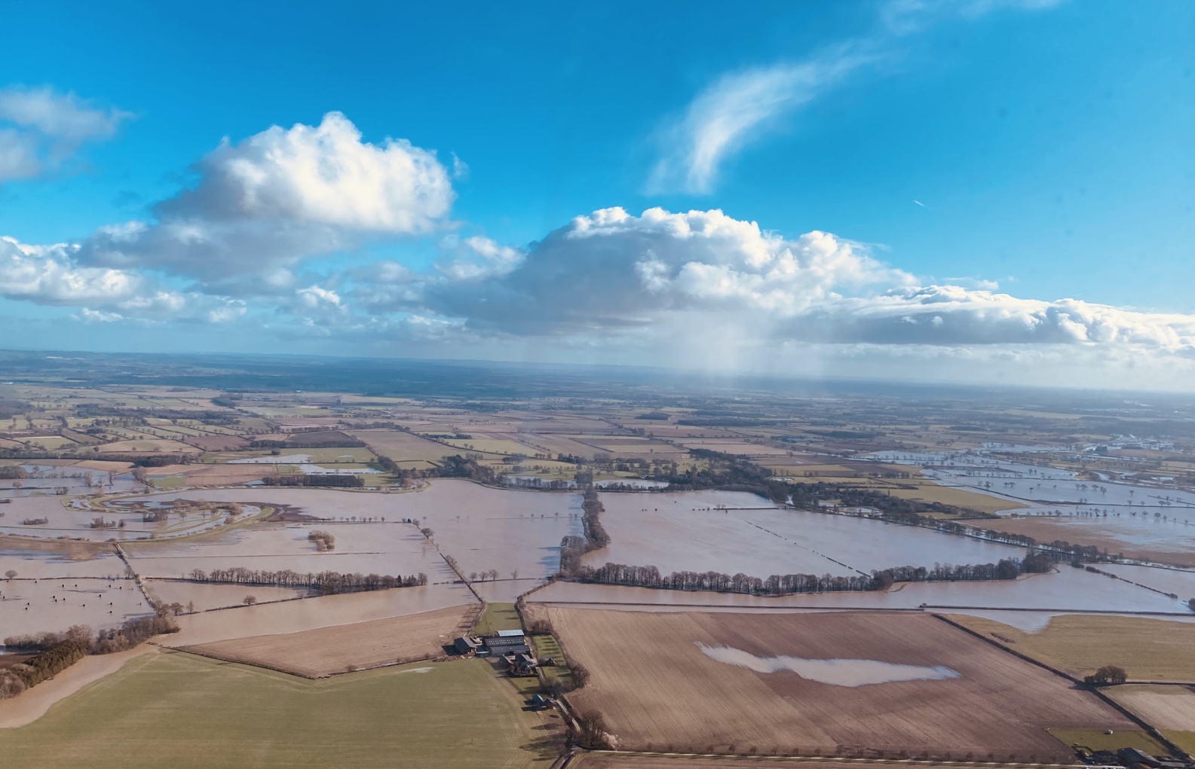
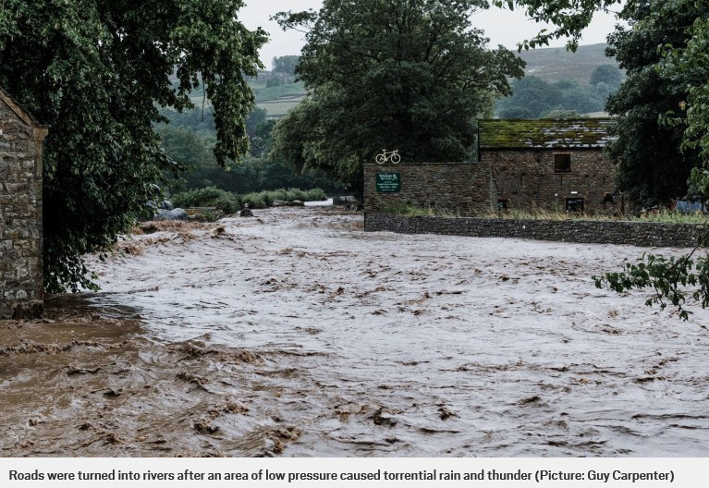
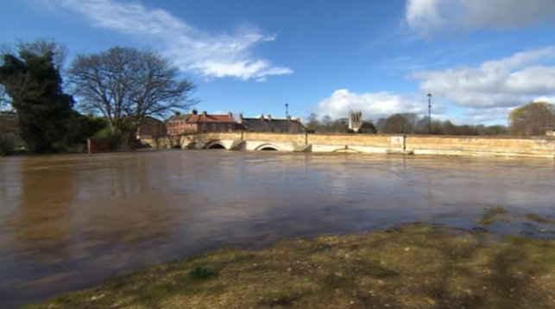
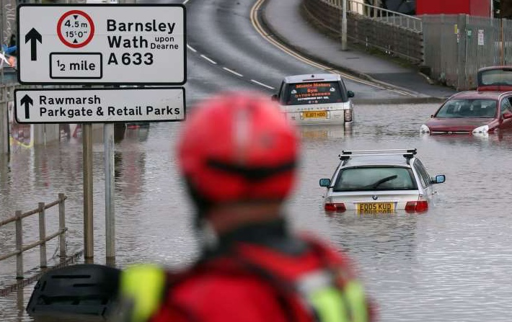
Types of Flooding
Surface water
River
Canal
Groundwater
Reservoir
Storm surge
Snow melt
Flash flood
Coastal erosion
View from Helimed 98, vew over Boroughbridge, River Swale
22 February 2020, Photo: Matt Syratt

Slide 4
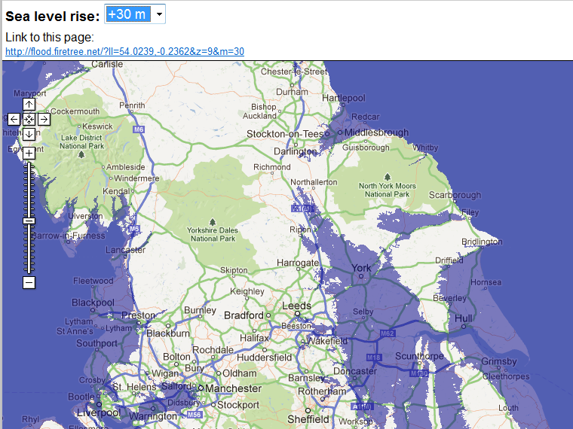
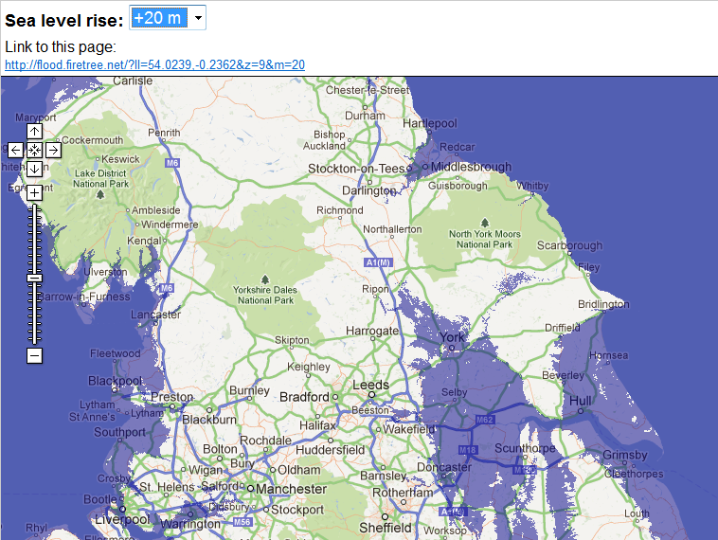
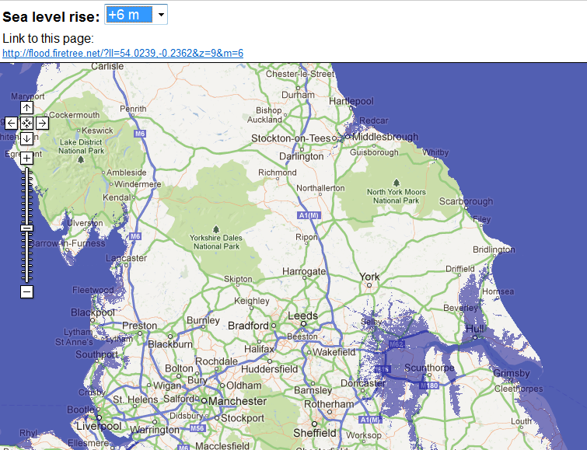
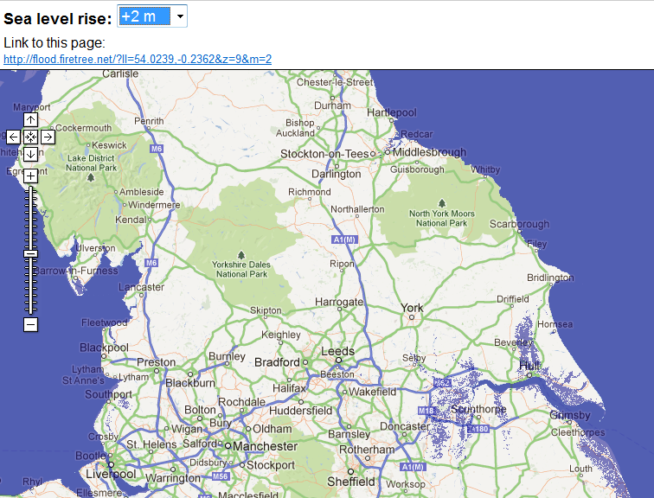
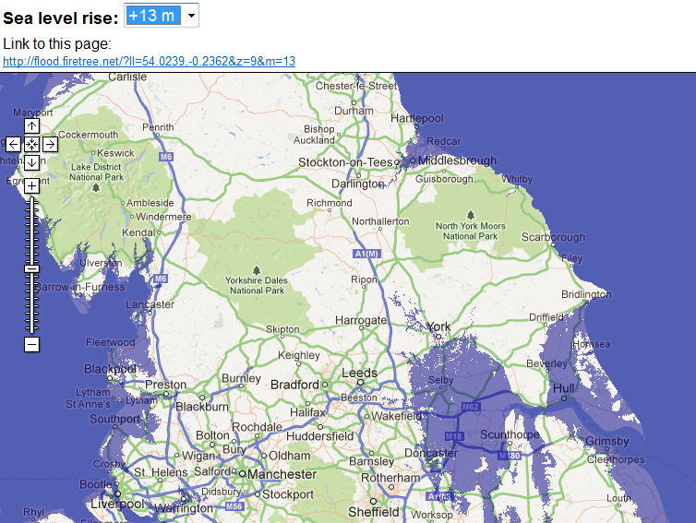
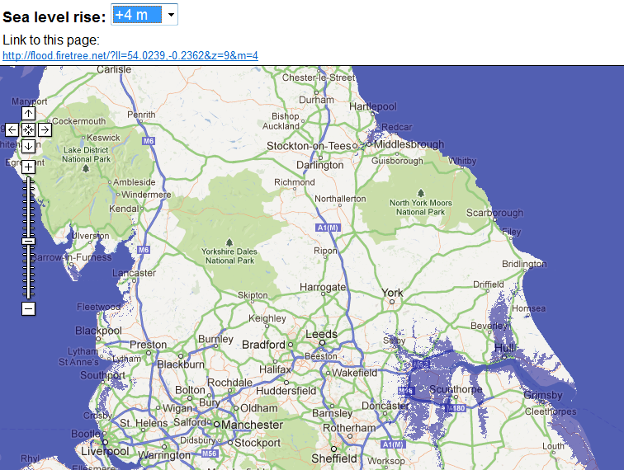
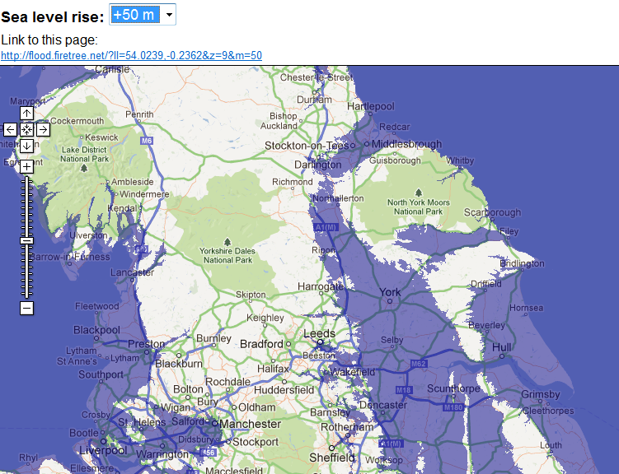
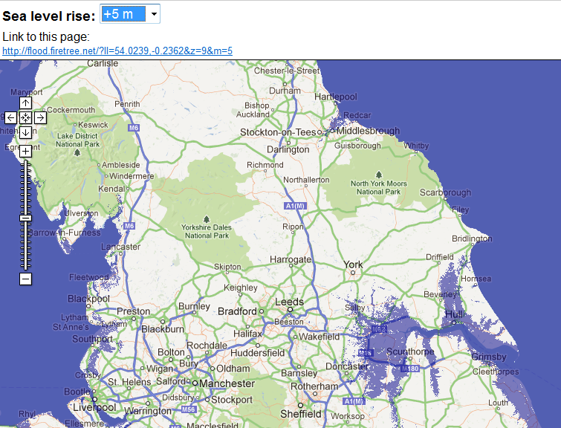
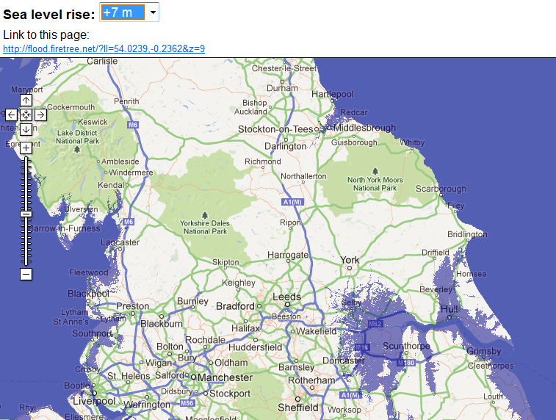

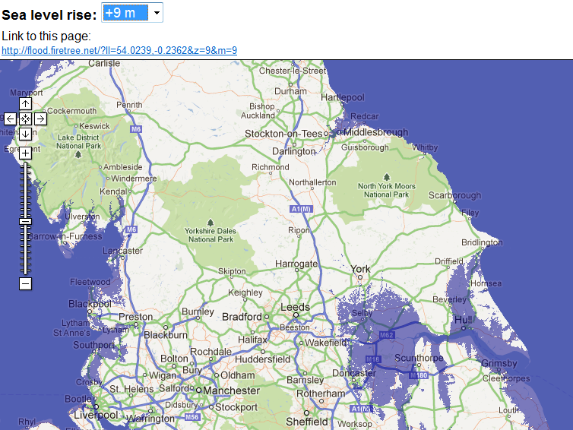
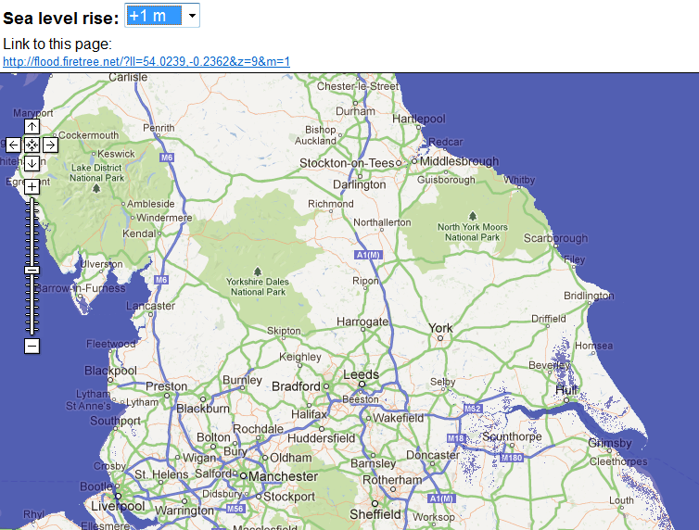
Sea Level rise

Slide 5
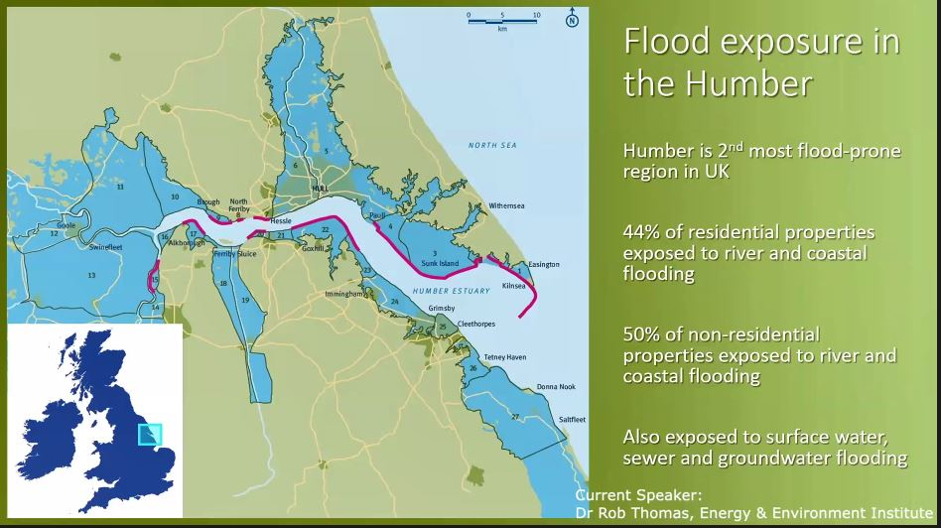
Source:

Slide 6
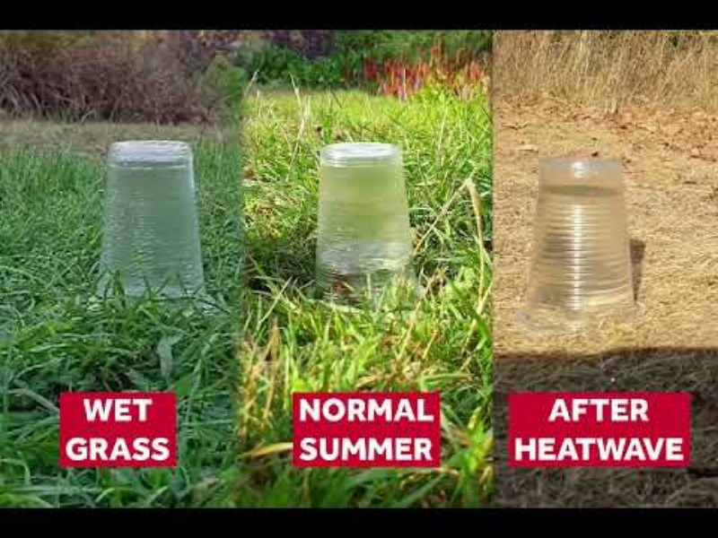
Experiment Shows Risk of Flash Flooding After Drought

Slide 7
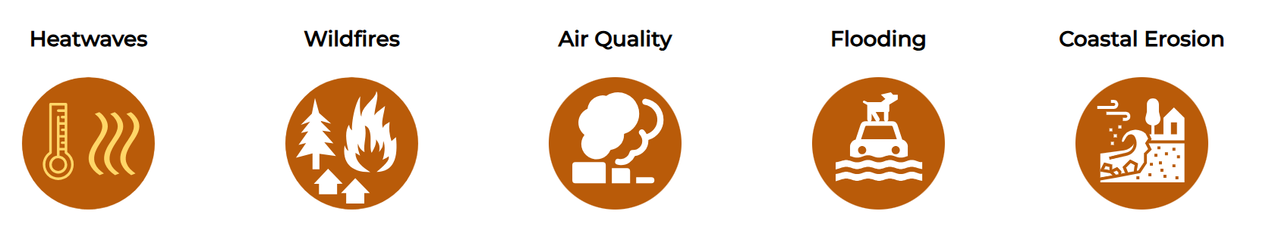
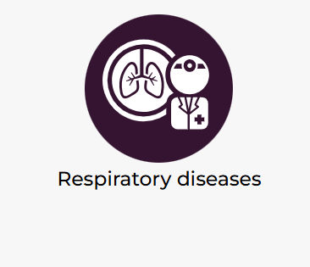
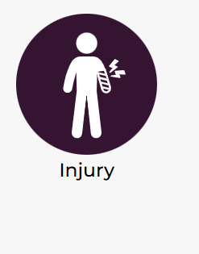
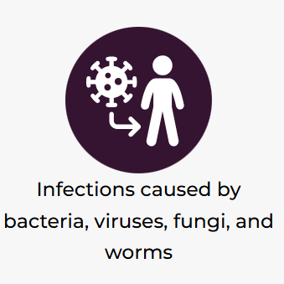

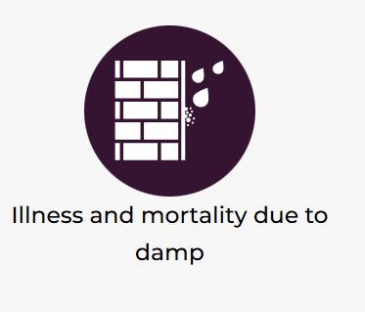

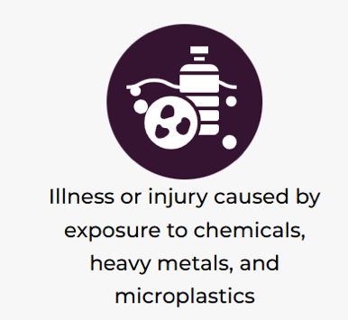
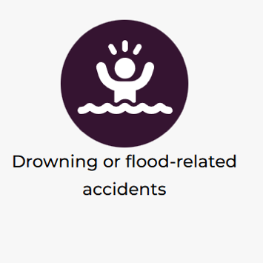

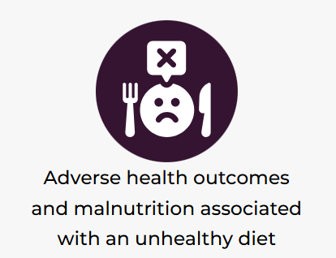
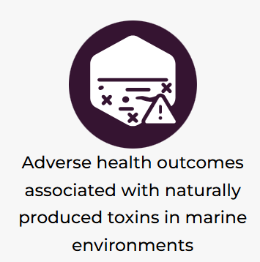
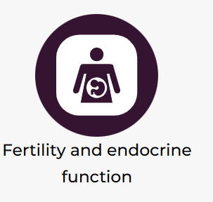


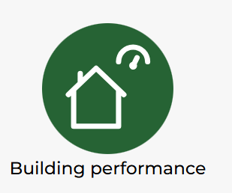

What are the potential impacts in the future?
LCAT: Local Climate Adaptation Tool

Slide 8
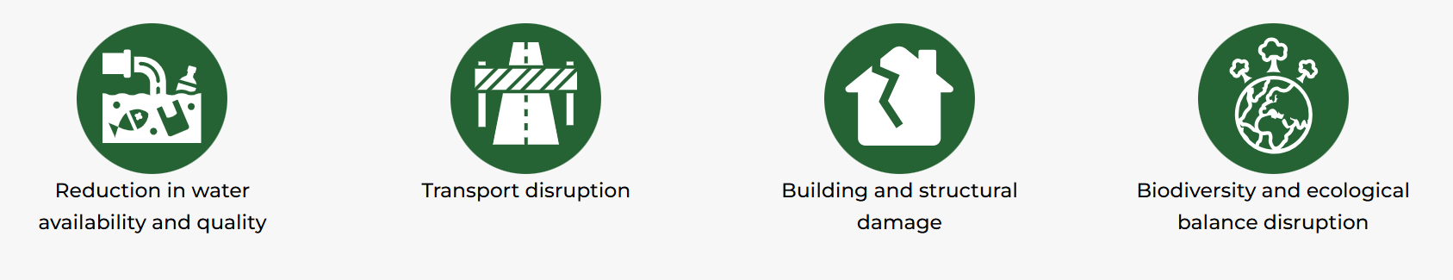
What are the potential impacts from flooding?
LCAT: Local Climate Adaptation Tool

Slide 9
Flooding potential at present
EA historic flood risk 2010 (only 80 sites) |  | River flood risk 2020 (105 sites) |  | Surface water flood risk 2020 (105 sites) |  | Reservoir flood risk 2020 | Sea flood risk 2020 | Access affected by flooding
Not in flood zone | 60% | Very Low | 74% | Very Low | 44% | 10 sites have high potential for reservoir flood risk | 10 sites have high potential for sea flood risk | 2% of sites have no access issues from flooding
Low | 6.25% | Low | 16% | Low | 26% |  |  | 98% of sites affected with the access being restricted through flooding
Moderate | 1.25% | Medium | 8% | Medium | 20%
Significant | 7.5% | High | 2% | High | 10%
The potential number of Yorkshire Ambulance Service sites affected by the different types of flooding (From YAS Climate Adaptation Plan, Source data: Environment Agency)

Slide 10
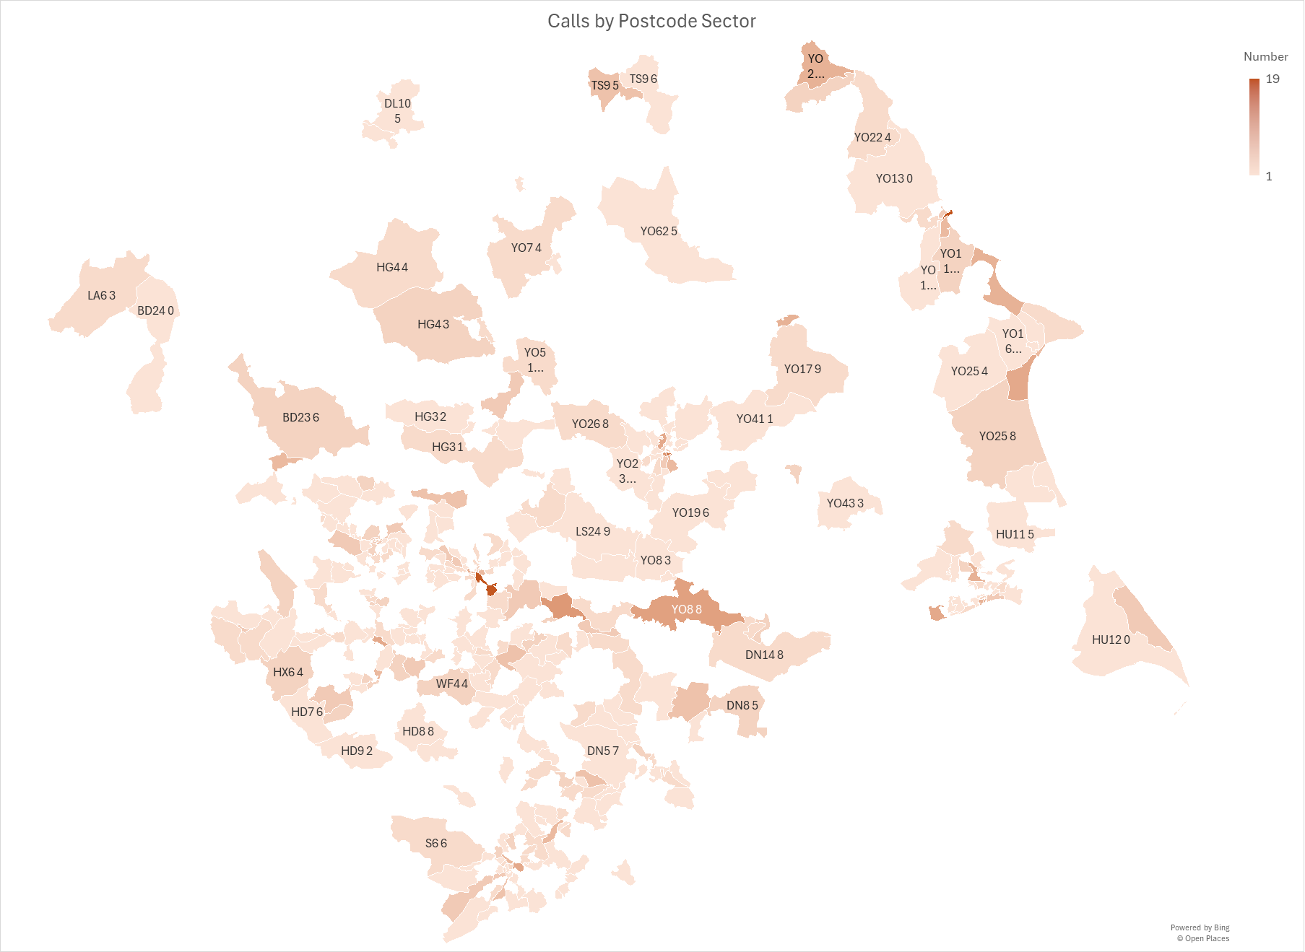
Water incidents by postcode
Top 15 water incident locations
Postcode sector | Number
YO11 1 | 20
LS10 1 | 18
YO1 9 | 16
YO1 6 | 12
WF10 2 | 10
YO15 3 | 9
YO8 8 | 9
S2 5 | 8
HU6 7 | 8
HD6 1 | 8
HU13 0 | 8
YO30 6 | 8
YO17 7 | 7
YO11 2 | 7
LS1 4 | 7
Ref: Ian Lawrence, Yorkshire Ambulance Service

Slide 11
Water incidents by month
Ref: Ian Lawrence, Yorkshire Ambulance Service

Slide 12
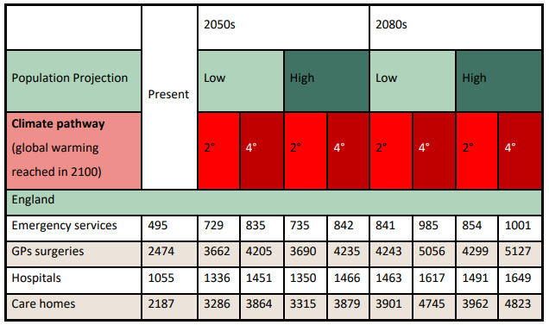
Flooding in the future
Impact of flooding on NHS properties in low and extreme temperature scenarios (source: Round Our Way)

Slide 13
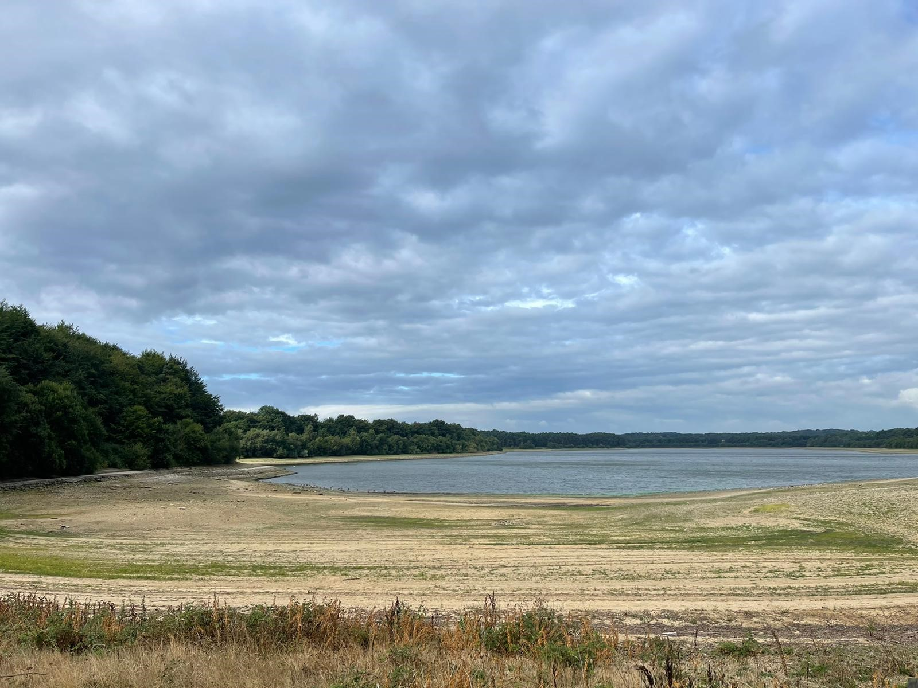
Drought
Impacts of drought on health include:
Affect quantity and quality of drinking water
Increased recreational risks
Air quality – dust, fungi
Reduce living conditions - energy, air quality, sanitation and hygiene
Mental health effects - economic and job losses
Impact on food and nutrition
Impact stability of buildings and trees
Increased incidence of illness and disease
Raise the risk of flash flooding

Slide 14
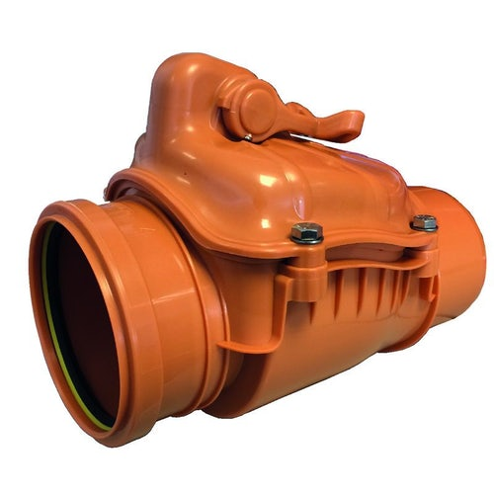
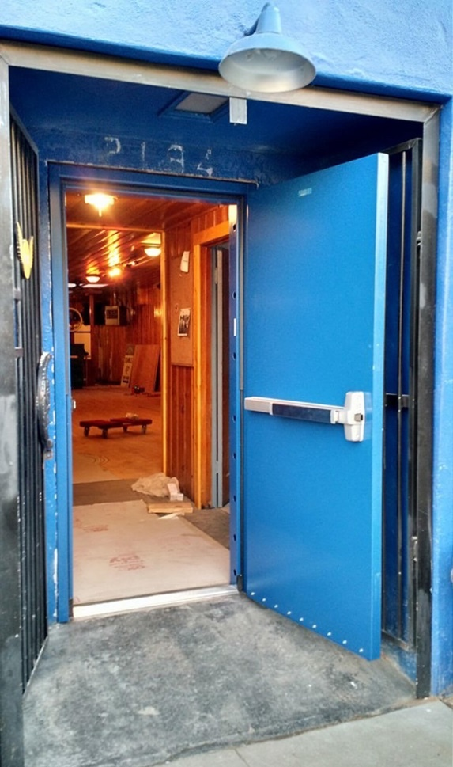
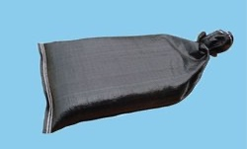
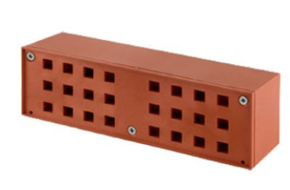
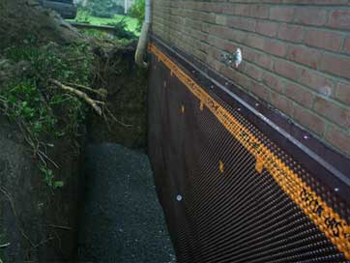
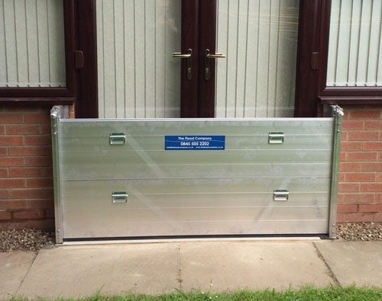
Flood protection measures
Sand bags
Automatic air bricks
Automatic valves
Barriers
Flood gates
Flood Valves

Slide 15
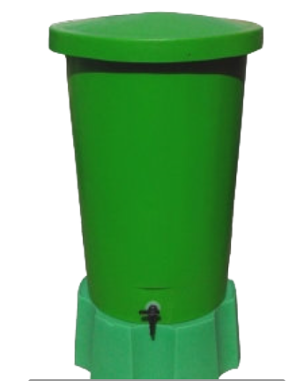
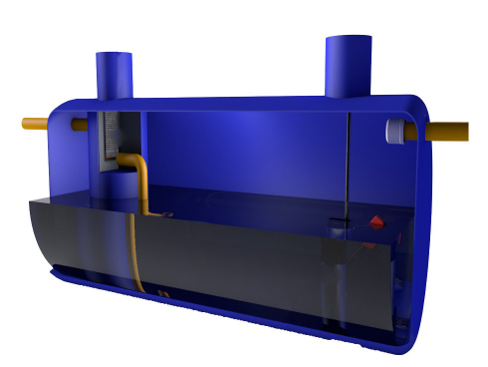
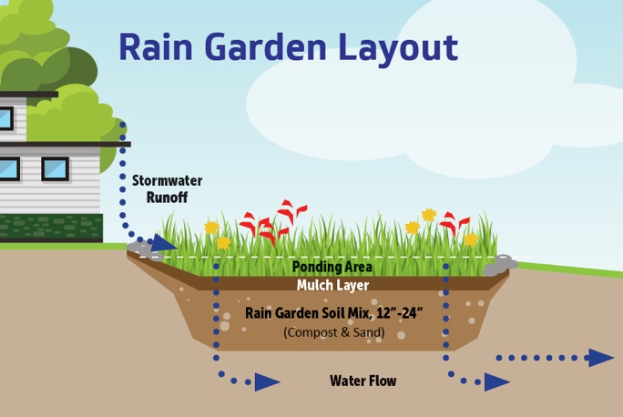
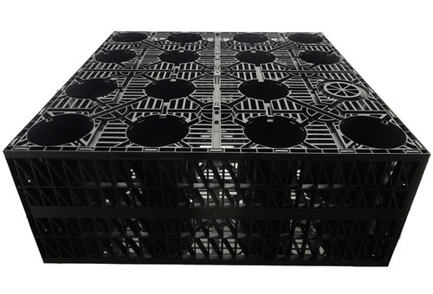
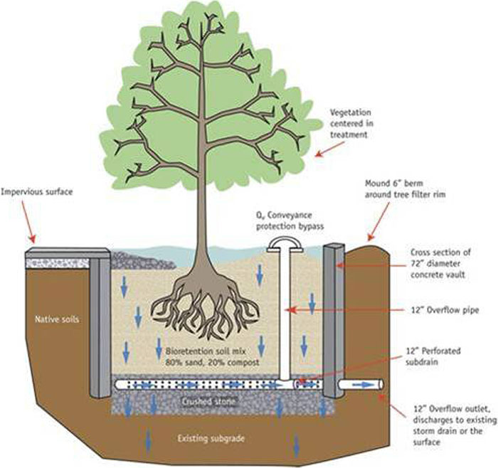

Flooding prevention measures
Tree pit
Rainwater Butt
Rainwater collection
Soakaway and attenuation crate
Block paving and permeable paving

Slide 16
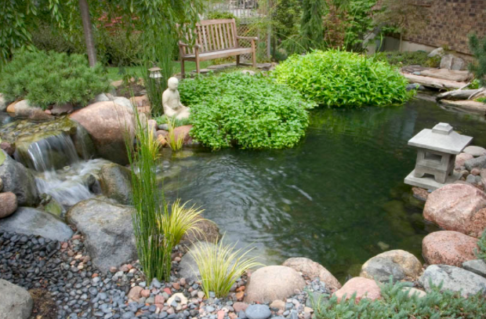
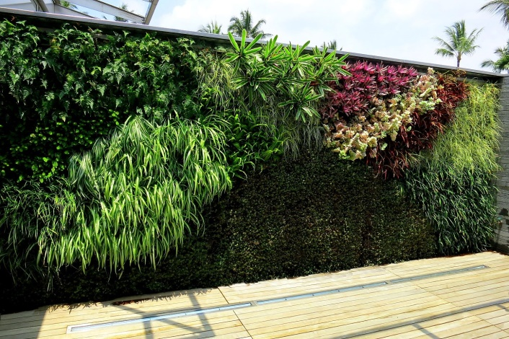
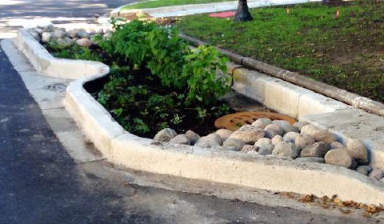
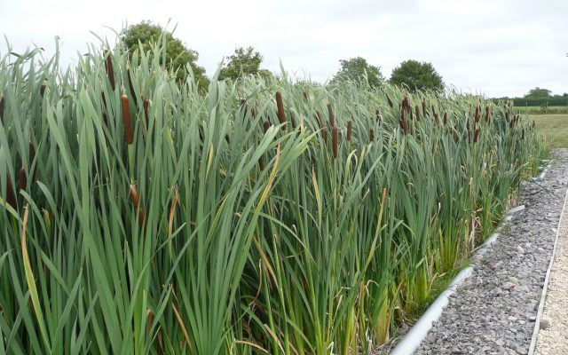
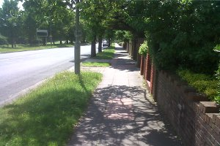

Flooding prevention measures
Ponds
Green walls
Bioswales
Reed beds
Verges
Green Roofs

Slide 17


Flood Mary
Home - Flood Mary

Slide 18

https://floodmary.com/

Slide 19

Useful flood advice links - Flood Mary
Welcome to the NEW FloodPod! - Flood Mary

Slide 20

Living With Water - Sustainable Drainage Systems (SuDS) - YouTube

Slide 21

SuDS Game | Living With Water
https://livingwithwater.co.uk/suds-game

Slide 22



Rivercraft
RiverCraft | Minecraft Education
Rivercraft: Minecraft game inspires young environmental champions - GOV.UK
The Flood Hub
https://youtu.be/Wm8RSKIHLRo

Slide 23

Webinar 4

Slide 24

Funding adaptation
Phrasing
Weave into other projects

Slide 25
Funding processes for Adaptation
Climate Adaptation plan
PSDS?
UK Infrastructure: A 10 Year Strategy
Biodiversity and BNG – LNRS, Tree Planting schemes
Business Continuity
Planned maintenance – gutters, drains etc
Car park, roof and general estates upgrades
New Hospitals programme

Slide 26
Funding Climate Adaptation
Stakeholder engagement
  Estates
  Grounds maintenance
  Fleet
  Operations
  PFI
  Community
  EPRR and Business Continuity
  LRFs
  Councils
  LNRS

