Slide 1
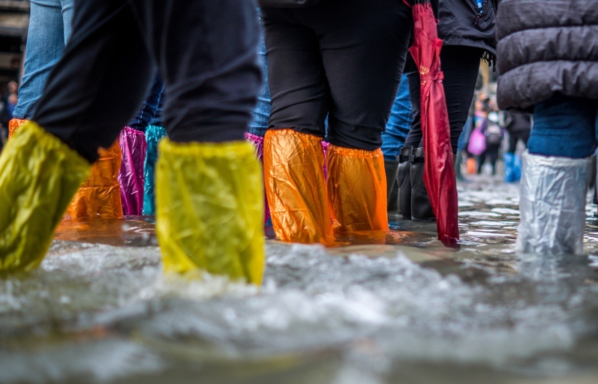
What is Flooding?
Professor Stuart McLelland
Deputy Director of the Energy and Environment Institute

Slide 2
The hydrological cycle and floods

Slide 3
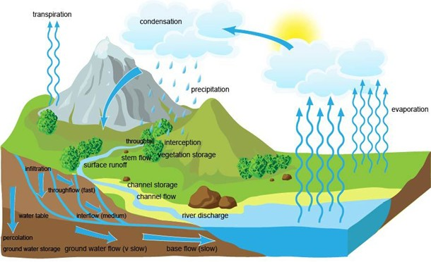
Floods occur naturally when water flows overbank or ground becomes saturated and water ponds or flows on the surface
But, flooding that impacts society can be considered more broadly as ‘water out of place’

Slide 4
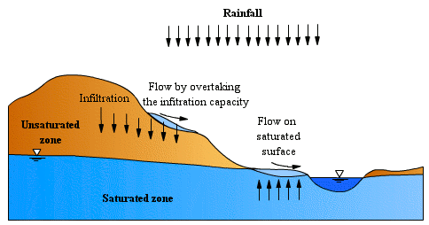
Surface water
Rain either infiltrates down or flows over the land
Surface flows are caused by rain exceeding the infiltration rate, or the ground being saturated so no infiltration occurs
http://echo2.epfl.ch/VICAIRE/mod_1a/chapt_6/main.htm

Slide 5
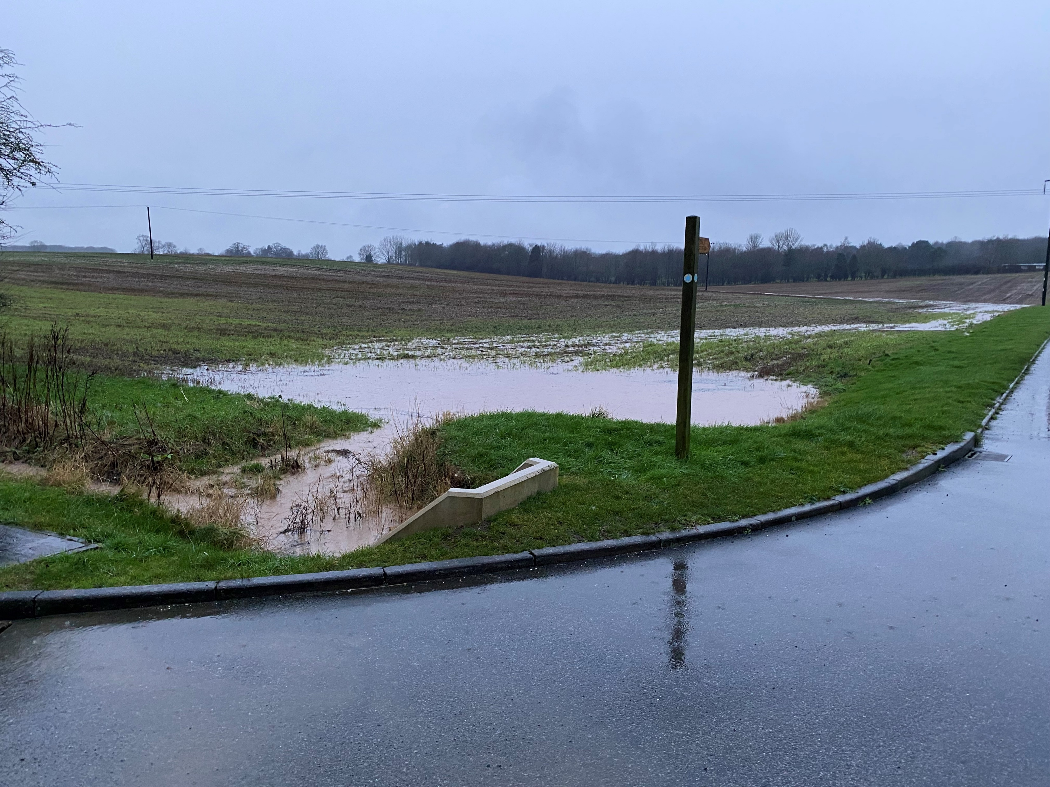
Infiltration excess overland flow
Saturation overland flow

Slide 6
Types of flooding

Slide 7
River Flooding
River flooding is when water flows overbank
Natural rivers flow overbank regularly which is why rivers have floodplains
River flooding can be contained using structures (expensive). The risk of river flooding can be managed by slowing the flow and/or storing water (i.e. using floodplains for excess water)
https://www.lincolnshirelive.co.uk/news/lincoln-news/gallery/devastating-images-show-river-welland-9014627

Slide 8
Pluvial Flooding
Pluvial flooding happens when rainfall exceeds stormwater drainage systems or the infiltration capacity of the ground
The Hull floods are an example of pluvial flooding and were caused by both rainfall exceeding the infiltration capacity of the ground throughout the catchment and also the urban drainage system was overwhelmed in some areas and failed in other places
Pluvial flooding in urban areas is managed using Sustainable Drainage Systems (SuDS)
https://www.hulldailymail.co.uk/news/hull-east-yorkshire-news/hull-2007-floods-how-city-7238878

Slide 9
Groundwater Flooding
Flood water can come from underground sources
Can be less obvious since can happen in building basements without evidence of surface water
Groundwater flooding may be difficult to avoid since flow pathways and storage are underground and cannot easily be changed
https://thefloodhub.co.uk/am-i-at-risk/

Slide 10
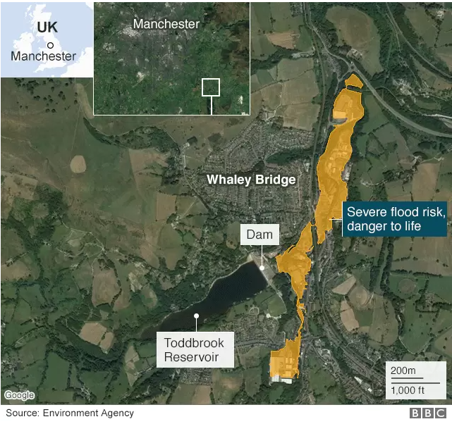
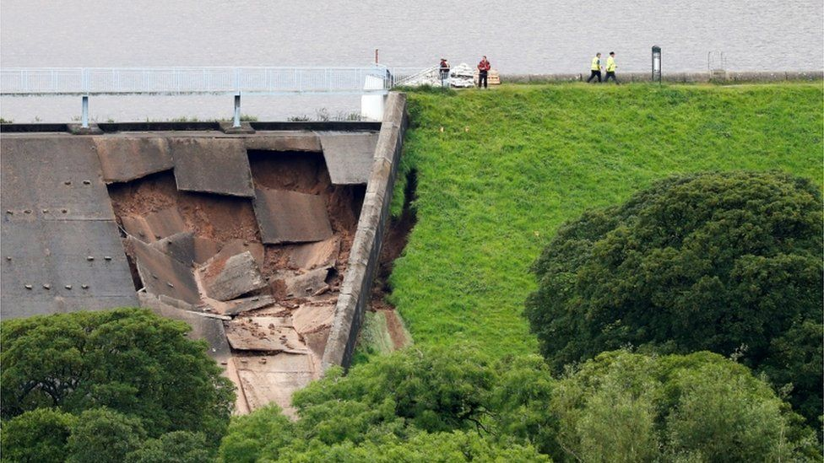
Reservoir Flooding
Risk of collapse/overflow from water storage bodies
https://www.bbc.co.uk/news/uk-england-derbyshire-49189955

Slide 11
Coastal Flooding
Flooding at the coast can be caused by high tides, storm surges and/or wave action
https://www.hulldailymail.co.uk/news/hull-east-yorkshire-news/cop26-parts-hull-could-underwater-6155528

Slide 12
Causes of flood risk change

Slide 13
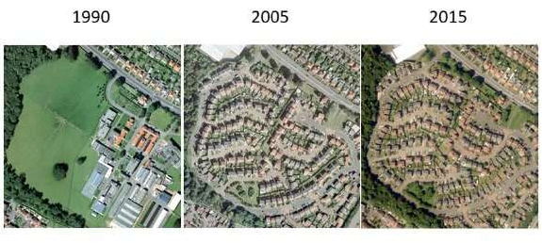
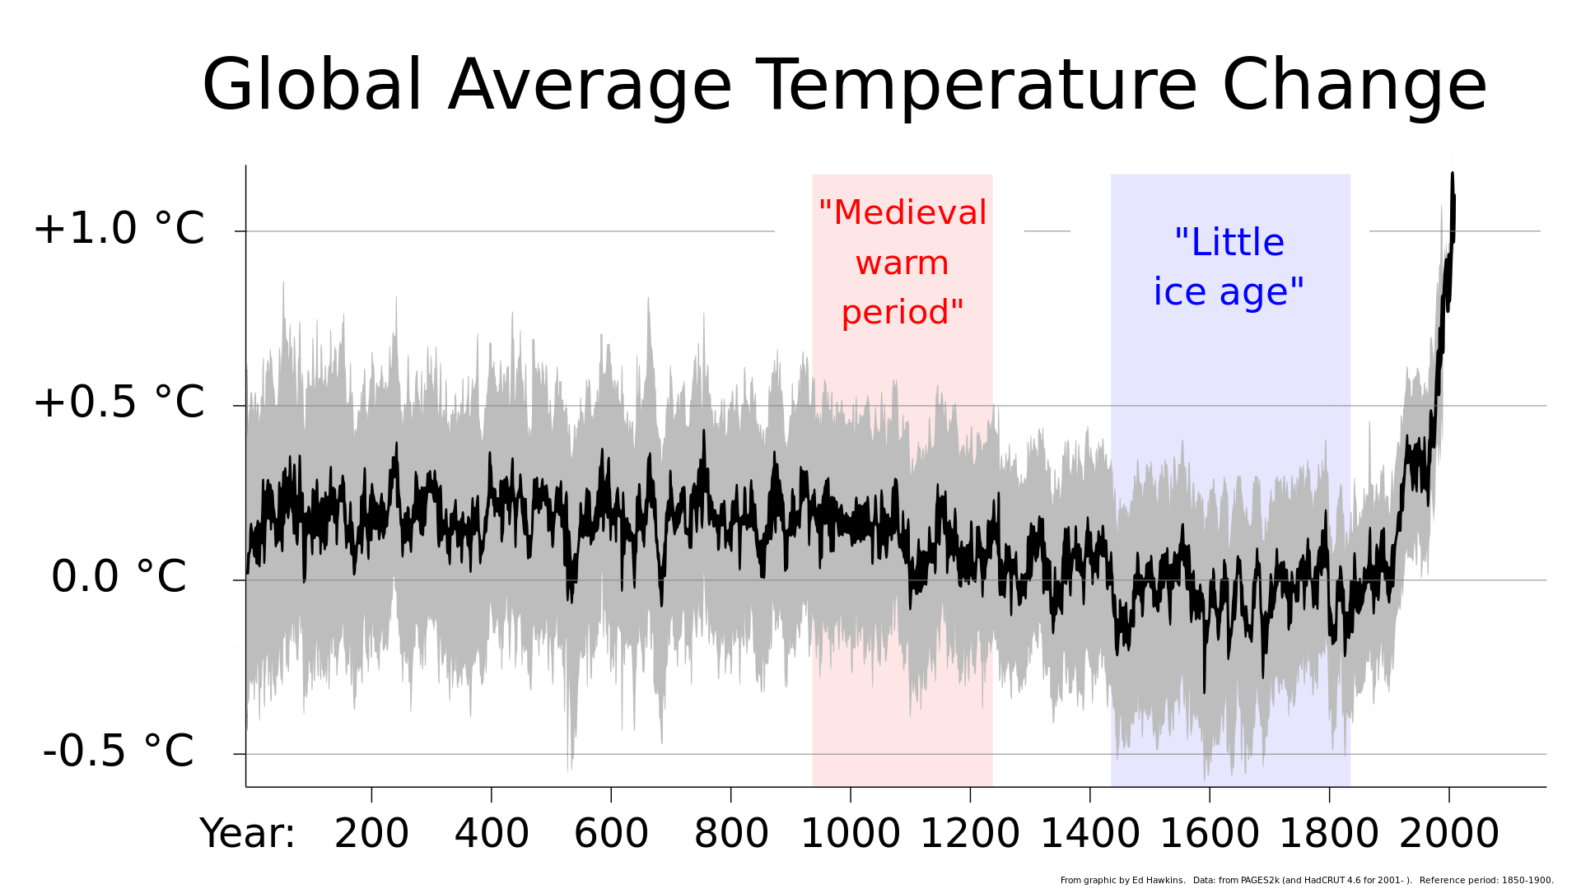
Two causes of flood risk change
Changes in land use and river management
Climate Change
https://phys.org/news/2019-10-urbanisation-edinburgh-hectares-green-year.html
https://www.climate-lab-book.ac.uk/2020/2019-years/

Slide 15
Climate change
Changes in rain from individual storms
Changes in patterns of rainfall
Changes in total amounts of rainfall
Changes in water balance
Lots of change but all likely to increase risks…

Slide 16
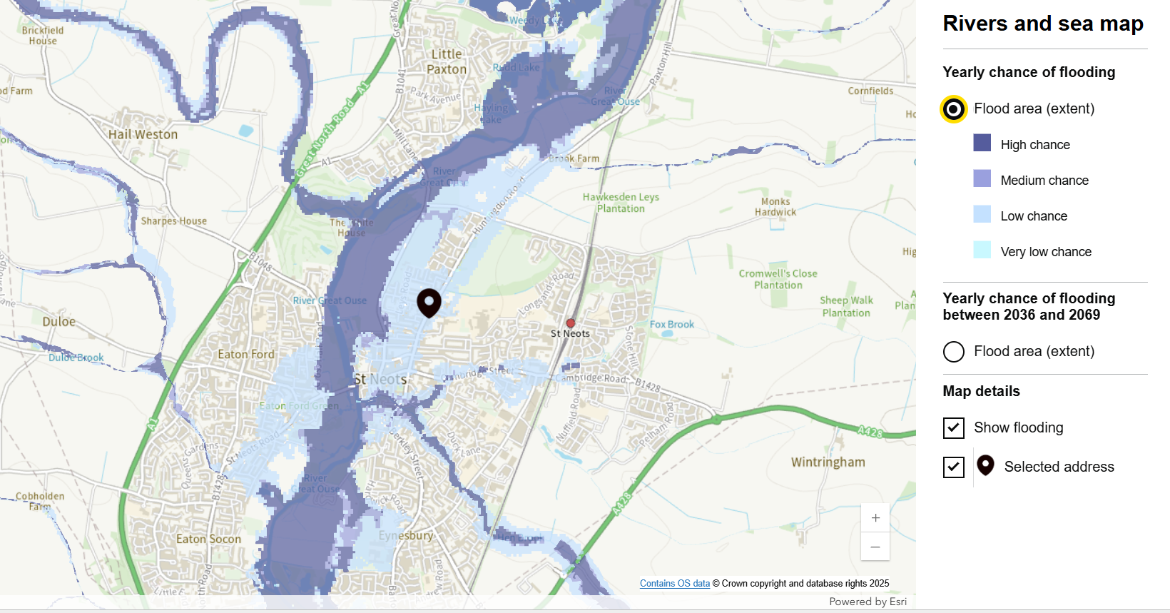
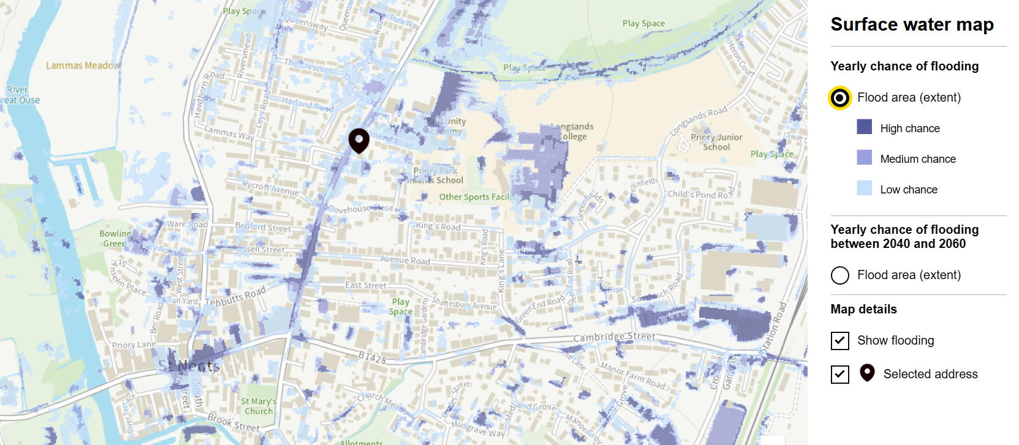
Flood risk maps
https://www.gov.uk/check-long-term-flood-risk

