Slide 1






PEACCH Climate Adaptation in Healthcare Webinar Series
This event is co-funded by EPSRC and ESRC Impact Acceleration Award: EP/X525686/1
This event is co-funded by EPSRC and ESRC Impact Acceleration Award: EP/X525686/1

Slide 2




PEACCH Webinars
1. Intro to Climate Adaptation in Healthcare
17 June 2025, 1200-1300:
2. A closer look at heat risks
18 June 2025, 1200-1300:
3. A closer look at flooding / drought risk
23 June 2025, 1200-1300
4. Tools for embedding adaptation action
25 June 2025, 1200-1330:

Slide 3

Housekeeping
Sessions are being recorded
Feel free to introduce yourself on the chat
Keep your questions until the end of the session- use the Q&A function (these will not be in the final published version)

Slide 4
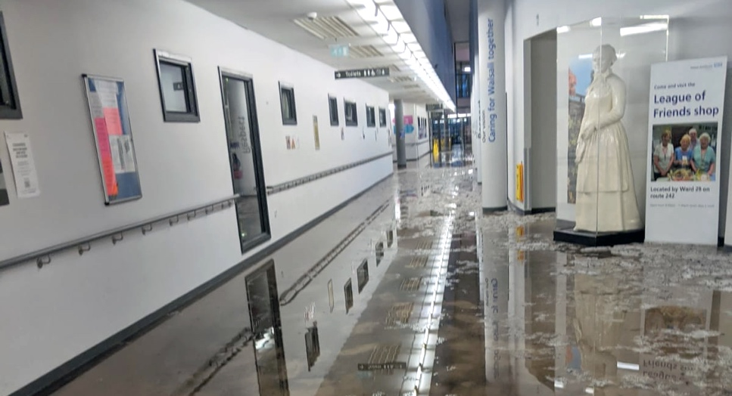
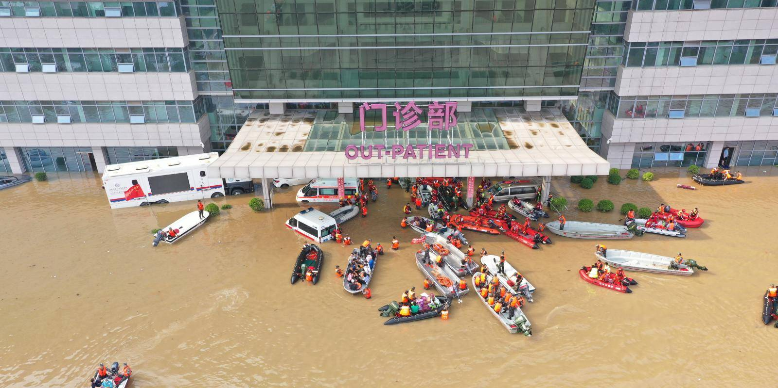
Webinar 3: Water Risk Focus
Speaker | Topics
Louise Elstow | Welcome, introduction to PEACCH and the session
Stuart McLelland | Causes and Consequences of Flooding
Alexis Percival | Flooding and drought: What to expect from changes in water – too much, too little and low quality water – and how this could impact on the health service. An overview of physical interventions for flooding and drought risks and key projects engaging with water risks.
Jamie Fountain | East of England Ambulance Service Trust Case study: An overview of the impact of flooding at St Neots Ambulance station and actions EASST is taking to address these to reduce future risks.
Louise Elstow | Facilitated Q&A session Reminder about final session

Slide 5

Causes and Consequences of Flooding
Stuart McLelland, Professor of Water Sciences
University of Hull

Slide 6

Healthcare and climate change:
Droughts and Flooding
Alexis Percival, Energy and Sustainability Manager
Yorkshire Ambulance Service

Slide 7

Healthcare and climate change:
Droughts and Flooding
Jamie Fountain, Resilience Manager
East of England Ambulance Service

Slide 8

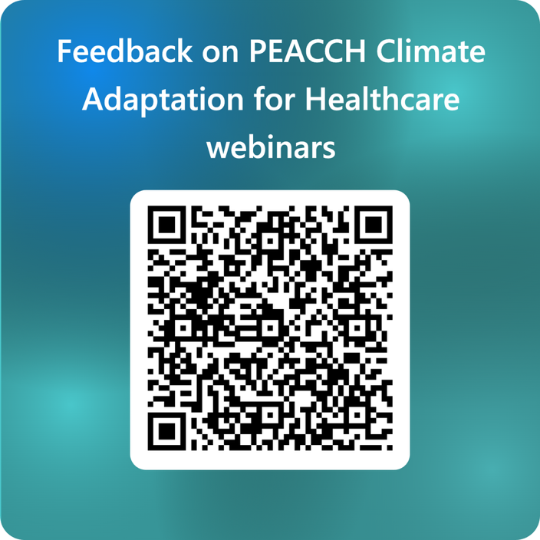
Closing remarks
Q&A
Thanks to the speakers
Feedback on the series
Next session coming up
This event is co-funded by EPSRC and ESRC Impact Acceleration Award: EP/X525686/1
This event is co-funded by EPSRC and ESRC Impact Acceleration Award: EP/X525686/1

Slide 9


PEACCH Adaptation webinars
17 June 2025, 1200-1300: Introduction to climate adaptation in a healthcare context. Register here
18 June 2025, 1200-1300: A closer look at heat risks in healthcare facilities, with intervention options and with a UK case study. Register here
23 June 2025, 1200-1300: A closer look at flooding and drought risk in UK healthcare facilities, with intervention options and a UK case study. Register here
25 June 2025, 1200-1330: Embedding action to adapt to climate change in your organisation - what tools are there to help you take action. Register here

