Slide 1
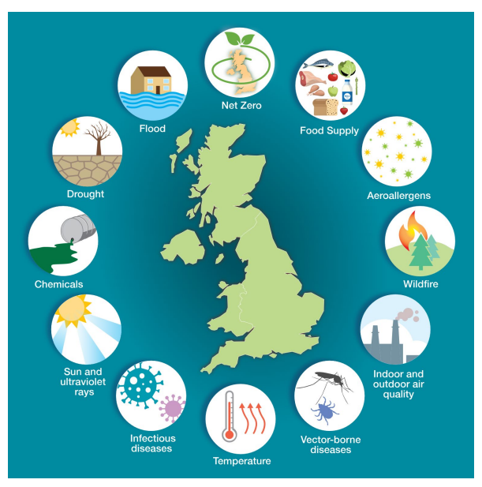
Adapting to Heat
Care without Carbon, Sussex Community NHS Foundation Trust

Slide 3
Climate adaptation:
understanding the problem (and communicating it)

Slide 4
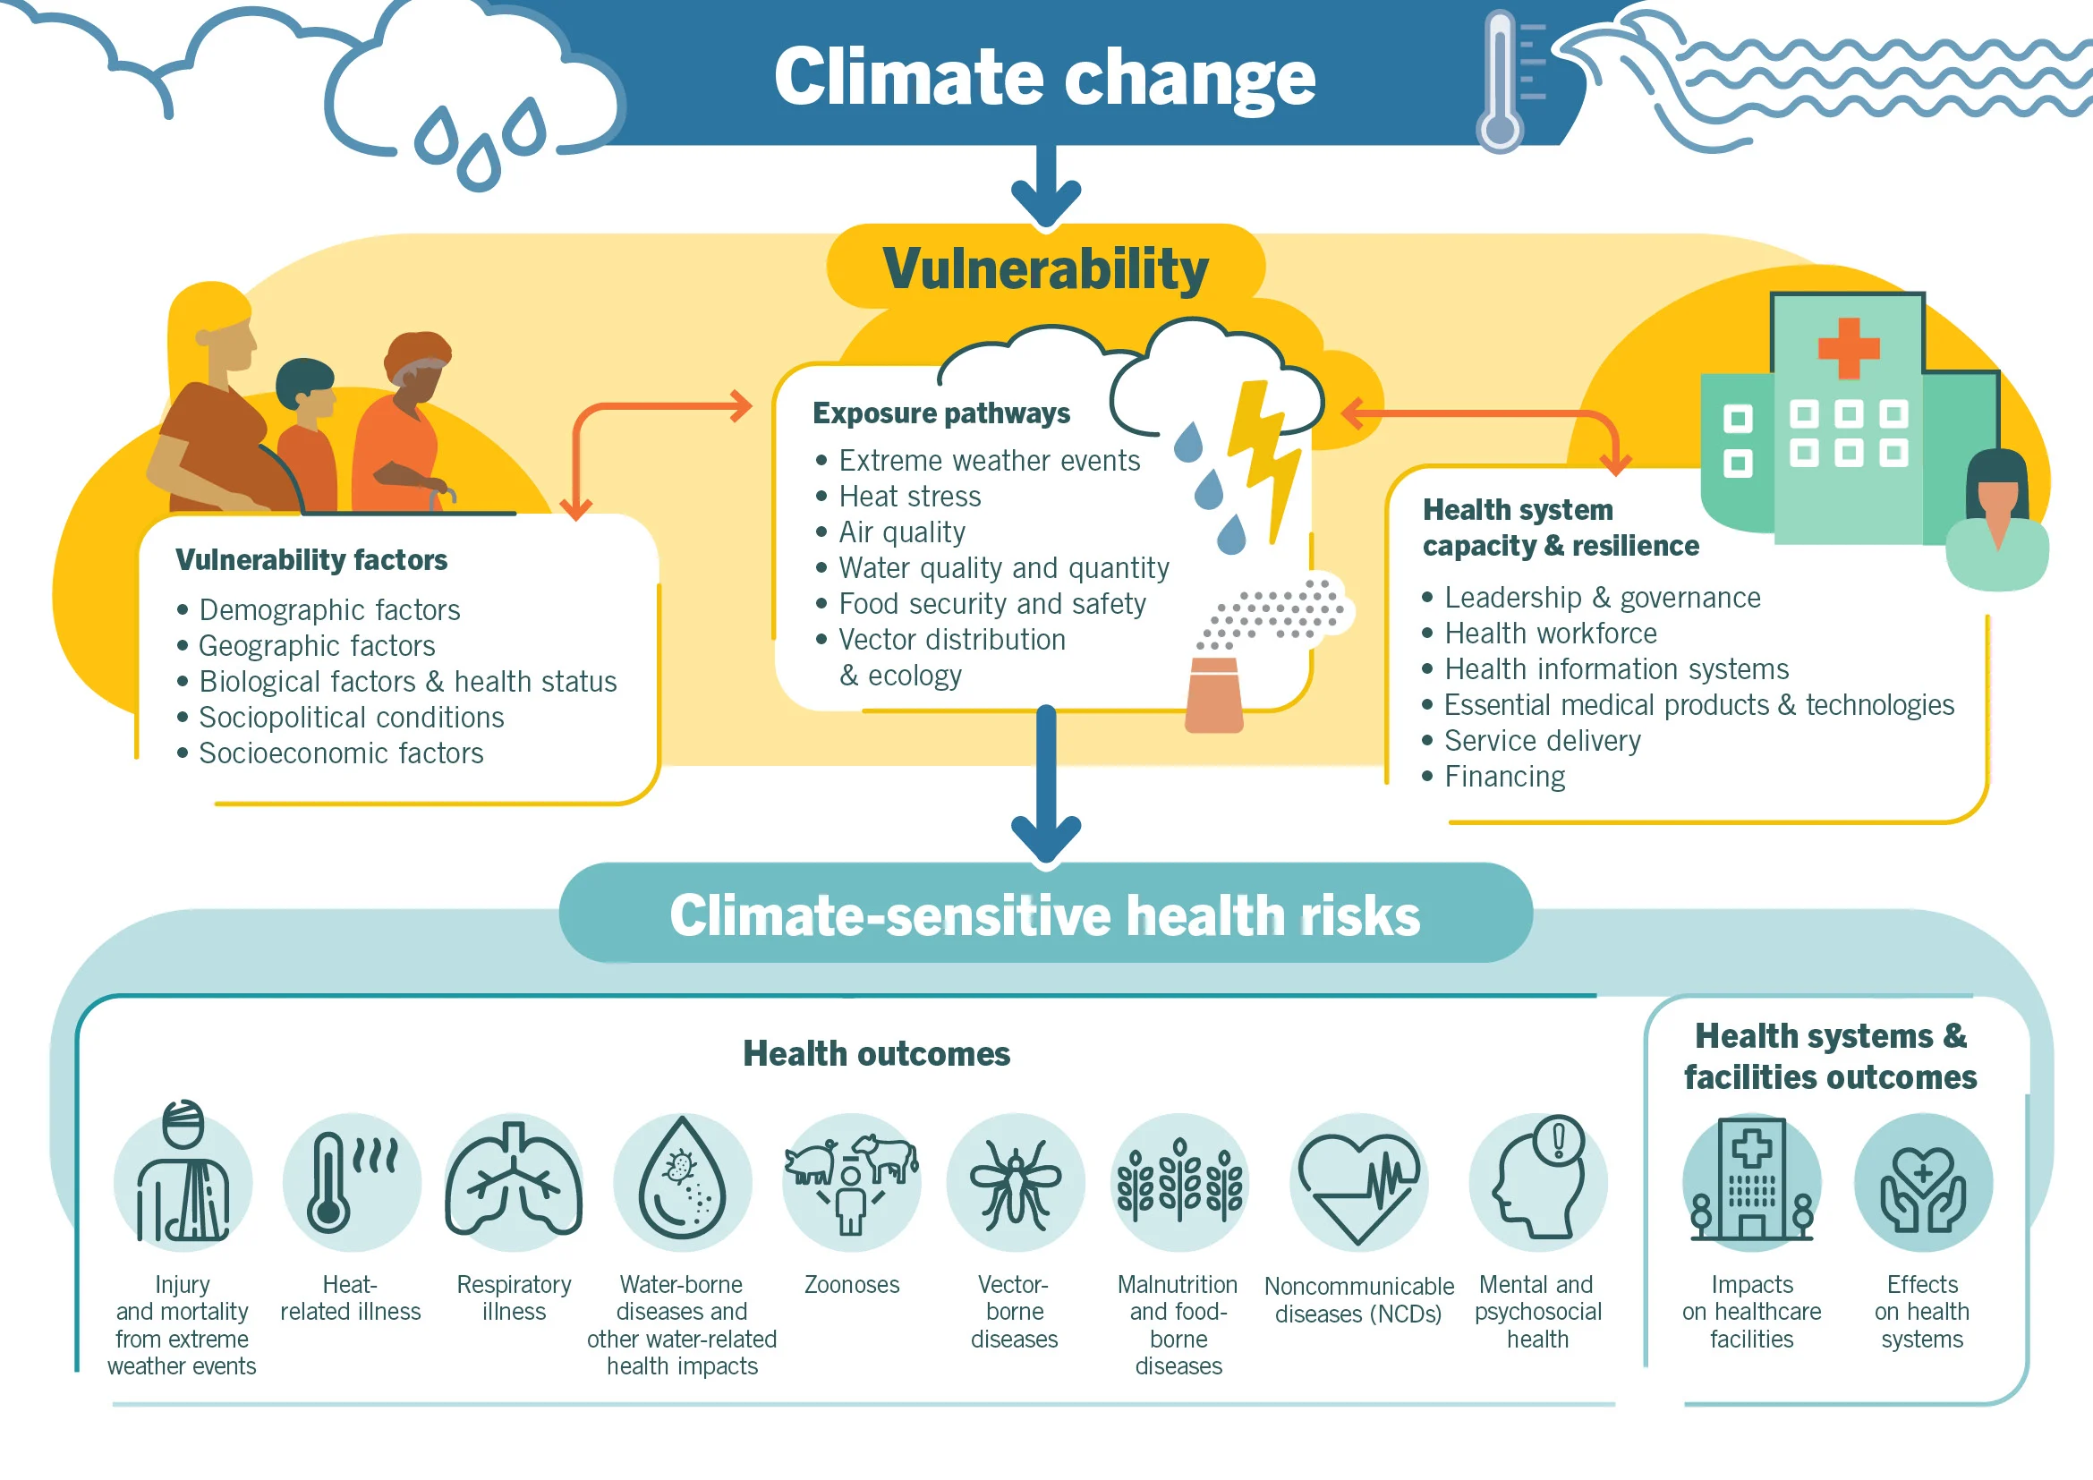
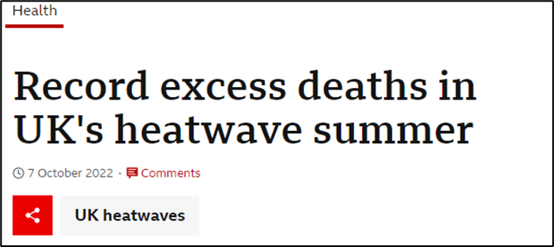
At SCFT…
Last Summer…
Older people are particularly vulnerable to climate impacts.
Ageing population in Sussex means that we will see higher rates of over-heating mortality.
Coastal locations vulnerable to damage from storms and flooding, risking disruption to infrastructure e.g. roads and affecting our ability to deliver care

Slide 5
Climate change: what does this mean for a vulnerable community trust patient?
Case study: John
John – aged 80, male
Multiple co-morbidities
Polypharmacy
Lives alone in his own home in a rural village near Horsham, rarely goes out
Community nurses visit 3x per week
Ashdown Forest, 2019

Slide 6
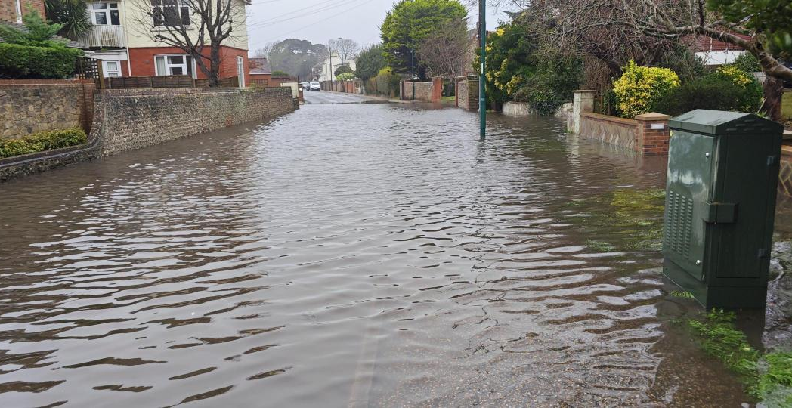
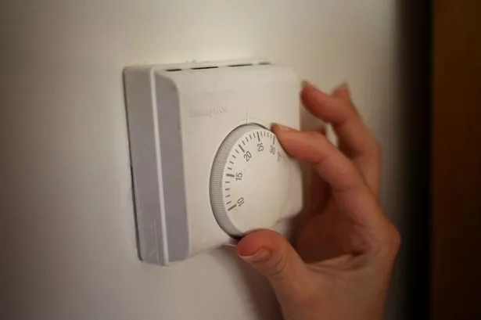
Increased risk during a heatwave
Exposure to higher temperatures in North-West Sussex
Dehydration, heat stroke
Worsening of underlying conditions & hospitalisation
Falls & physical injury
What does climate change mean for a vulnerable SCFT patient?
Case study: John
Increased risk during flooding
Unable to evacuate urgently
Unable to access health & care services
Damp & mould worsening health conditions
Longer term/over time:
Worsened health conditions, more difficult to treat
Increased physical disability
Increased care & nursing needs
Earlier death
Increased risk during inflation
Malnutrition, muscle wastage
Worsening of underlying conditions & hospitalisation
Ashdown Forest, 2019
Notes:
Location -> exposure to higher temperatures
Age and medications -> dehydration and heat stroke
Multiple co-morbidities -> becoming unwell or suffering falls & physical injury
Low mobility and social isolation -> unable to evacuate
Cut-off from medical and care attention he relies upon
Age and medical conditions – more vulnerable to his damp and mouldy home post flood
Social isolation -> mental health impacts, help coping after event

Slide 7
Our duty to our patients
Continuity of Care: Extreme weather (e.g., flooding, heatwaves) disrupts access to services for vulnerable patients.
Health Impacts: Rising temperatures and air pollution increase risks of respiratory and heat-related illnesses.
Service Accessibility: Flooding and adverse weather hinder patient access to clinics and services.
Climate change: what does this mean for a community trust?
Impacts on our patients, staff & services
Our duty to our staff
Well-Being and Safety: Heatwaves and extreme weather affect staff health, morale, and performance.
Commuting Challenges: Adverse weather increases stress and absences.
Training and Preparedness: Staff must be equipped to respond to changing conditions and maintain care continuity.
How we deliver care
Travel Disruptions: Flooded roads and damaged infrastructure limit staff access to patient homes and delay care.
Estates Resilience: Hospitals, Clinics and offices face risks from flooding, storms, and overheating, impacting service delivery.
Supply Chains: Climate-related disruptions threaten timely delivery of medical supplies and equipment.

Slide 8
Increasing impacts on infrastructure and service delivery
CWC with NHS Sussex commissioned a high-level Climate Impact Assessment report to understand the expected change and impacts of climate change across Sussex. The report focuses on understanding the climate impacts in Sussex over the period from 2030 to 2080. It examines the physical impacts to buildings, the interruptions to services, and the health risks for the population.
Understanding the problem:
Sussex Climate Impact Assessment (2023)

Slide 9
Climate adaptation: working towards solutions

Slide 10
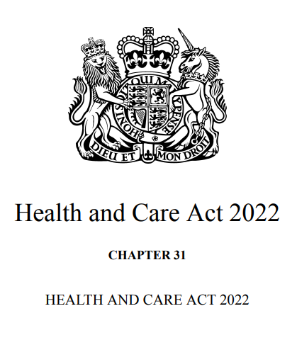
NHS became the first health system to embed net zero into legislation, through the Health and Care Act 2022
The Act requires commissioners and providers of NHS services specifically to address the net zero emissions targets. It also covers measures to adapt to any current or predicted impacts of climate change identified within the 2008 Climate Change Act.
Working towards solutions: compliance and accountability
The Delivering a Net Zero National Health Service report is now issued as statutory guidance and sets out what the NHS must do to comply with the Health and Social Care Act 2020.
The guidance provides a commitment that the NHS will build resilience and adaptation into the heart of the net zero agenda and will use the third Health and Social Care Sector Climate Change Adaptation report to highlight this approach.
NHS England Green Plan guidance 2025 provides guidance for trust and system Green Plans.
NHS Standard Contract 25/26 requirement 18.3.2.7 to adapt the Provider’s Premises and the manner in which Services are delivered to reduce risks associated with climate change and severe weather.
Recent NHS Climate Risk Assessment tool and NHS Climate Adaptation Framework released

Slide 11
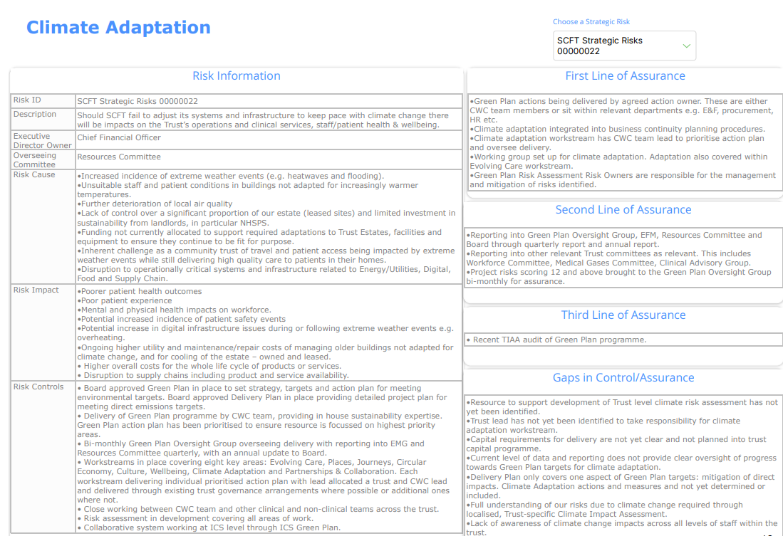
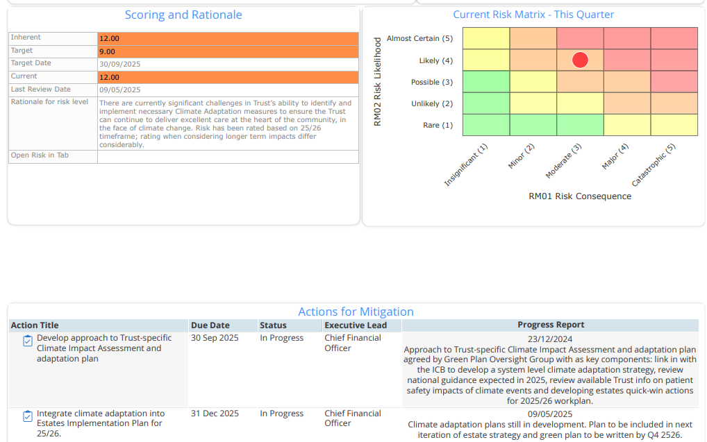
Integrating into our Board Assurance Framework: a thematic risk for climate adaptation

Slide 12
Which sites are at risk? Initial analysis of Trust estate highlighting key sites at risk of heatwave and flooding. This used data from:
Sussex Climate Impact Assessment plus other mapping data e.g. Environment Flood risk
Site-level Heat Decarbonisation Plans undertaken in 2023/4 which included climate adaptation as part of the brief
Records of Trust overheating incidents
Local knowledge
Geographical mapping of heat and flood risk.
Where should we focus our efforts? Currently incorporating this work into a Trust wide Suitability of the Estate analysis, supporting prioritisation of adaptation improvements in line with patient, service and wider estate vulnerabilities.
How do we adapt our buildings? Aim to develop adaptation measures for the highest priority sites, maximising co-benefits. This will include consideration of both active and passive cooling measures.
Understanding the impacts on our patients: our estate
Passive Measures may include:
External shading (trees, blinds, brise soleil)
Improve insulation or glazing.
Install reflective roofing materials.
Active Measures may include:
Upgrade HVAC systems.
Increase natural or mechanical ventilation.
Install air conditioning (if other measures are not viable)

Slide 13
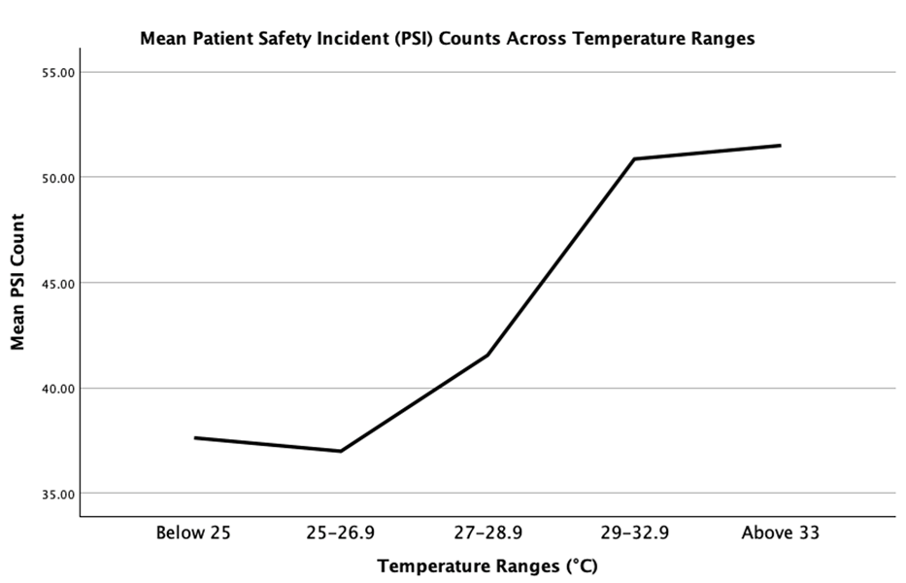
Medical student project examining the impact of 2022 heatwave on patient safety incident reports
Service evaluation project looking at incident reporting data during the 2022 Heatwave found that reports significantly increased above a temperature threshold of 27’C. [note this is not published data]
Understanding the impacts on our patients: our services
Anecdotal evidence from staff suggested impacts being felt on clinical services – cancelled appointments, increase in PSIs. We wanted to see if we could evidence this.

Slide 14
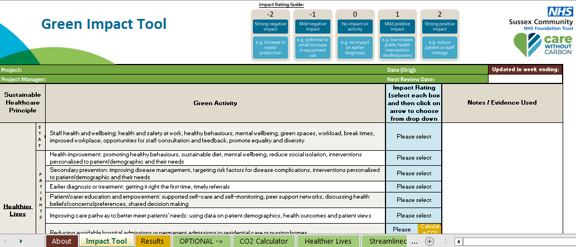
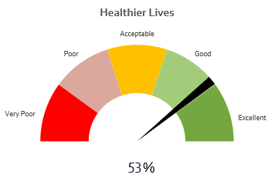
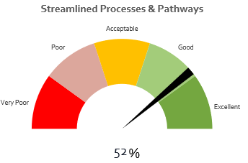
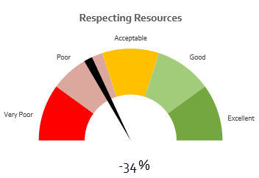
Working towards solutions:
SHIA Tool
Our Sustainable Healthcare Impact Assessment (SHIA) tool, aims to support the integration of sustainability principles – including climate adaptation – into decision making across the Trust. It’s designed to be completed at the beginning of a project or as part of a business case to think through sustainability implications/impacts and highlight opportunities for improvement.
The tool will be held on the CWC website and be available to all NHS Sussex providers, with potential for national use in future in collaboration with Greener NHS (NHSE).
Results
Results dashboard
- Key risks, opportunities and next steps
kgCO₂e saved

Slide 15
Climate adaptation: what’s next?

Slide 16
Competing NHS priorities: delivering critical services, significant £ pressures, existing frontline pressures, net-zero, shifting care to the community – again…how can we ensure adaptation (and mitigation) requirements are integrated into BAU?
Trust vs. system vs. geographical approach – most effective adaptation requires partnership approach – not always possible depending on approach in local area – how can we link in with councils and other stakeholders more?
Lots of detailed information out there but disconnect between climate adaptation research, policy and delivery on the ground – how can we help to bridge the gap?
Balance between climate adaptation and mitigation – how can we develop approaches that tackle both together?
Challenges (or opportunities?)

Slide 17
Tackle immediate priorities: improve our data and identify quick wins – working with EPRR teams and estates.
Roll out SHIA tool within Sussex to get climate adaptation considered as part of BAU for trust projects and business cases.
Engage with our patients through our Net Zero Patient Engagement Group in Sussex
Continue our engagement with wider partners locally: in particular local authorities responsible for climate adaptation and public health – how can we work together on this?
Map our most vulnerable patients and communities.
Make a plan! Use the Green Plan refresh (system and trust) to set out clear strategy for climate adaptation and plan for next three years, using existing tools and guidelines where possible.
Explore further opportunities for research and innovation around climate and health to bridge gap between research and delivery on the ground.
Next steps

Slide 18
What’s next:
Research & Innovation
Launched May 2025
Vision: Assess and realise the health co-benefits of the net zero transition and the reduction in health risks, associated with extreme heat for vulnerable communities, for whom evidence is lacking.
Focus on interventions in the built and natural environment of high-risk settings (homes, care settings, prisons, hospitals) affected by net zero policies and related health co-benefits.
Our role: study location, staff and patient engagement, living lab

Slide 19
Susie Vernon
Associate Director Sustainability, Care Without Carbon
Sussex Community NHS Foundation Trust
our health | our environment | our commitment
carewithoutcarbon.org

