Slide 1
WB2.3 Interventions for heat
Alexis Percival, Energy and Sustainability Manager
Yorkshire Ambulance Service

Slide 2
Physical interventions to adapt to heat
Avoidance
Physical
Awareness
Engineering
Nature based solutions

Slide 3
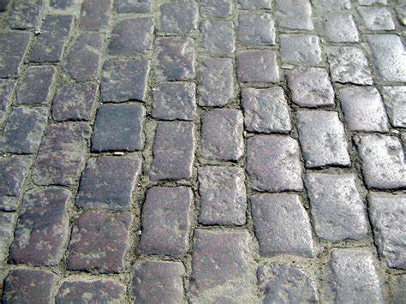
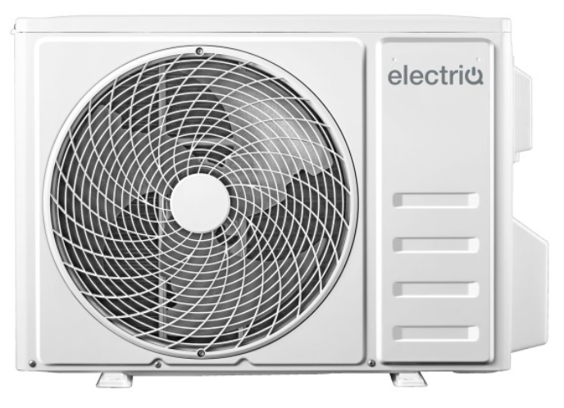
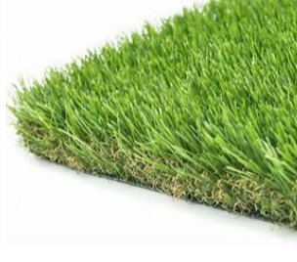
Avoidance
Stop heat generation and accumulation in the first place
Hard surfaces – tarmac, concrete, block paving
Heat vents like AC units and heating systems
Synthetic and plastic surfaces

Slide 4
Physical interventions - Awareness
Public health alerts
Restrict physical activity to the coolest period of the day
Seek out air-conditioned buildings when possible
Drink fluids frequently without waiting for the feeling of thirst
Wear breathable, light-coloured clothing and a well-ventilated, wide-brimmed hat
Know your community heat response or heat alert plan
Cool spaces for public buildings
Community intervention
Water – Drinking fountains, spray, wet flannels

Slide 5
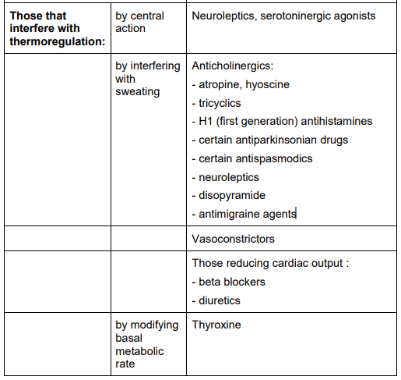
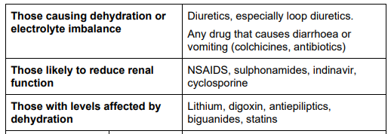
Physical interventions - Awareness
Awareness of the impact of drugs in heat

Slide 6
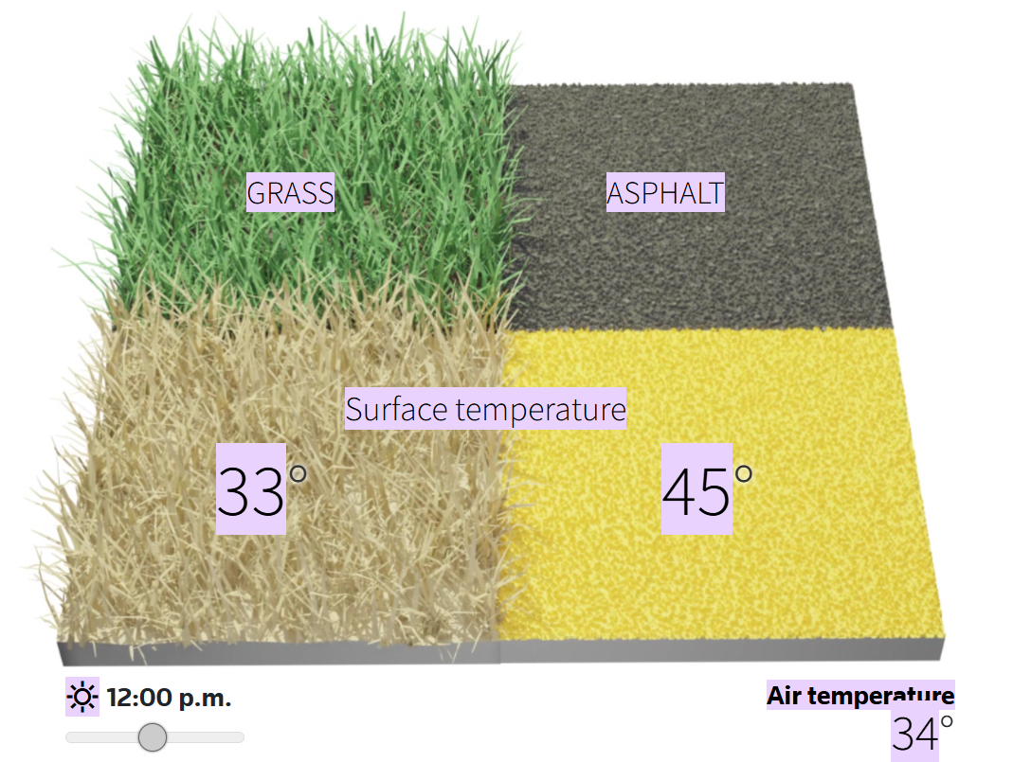
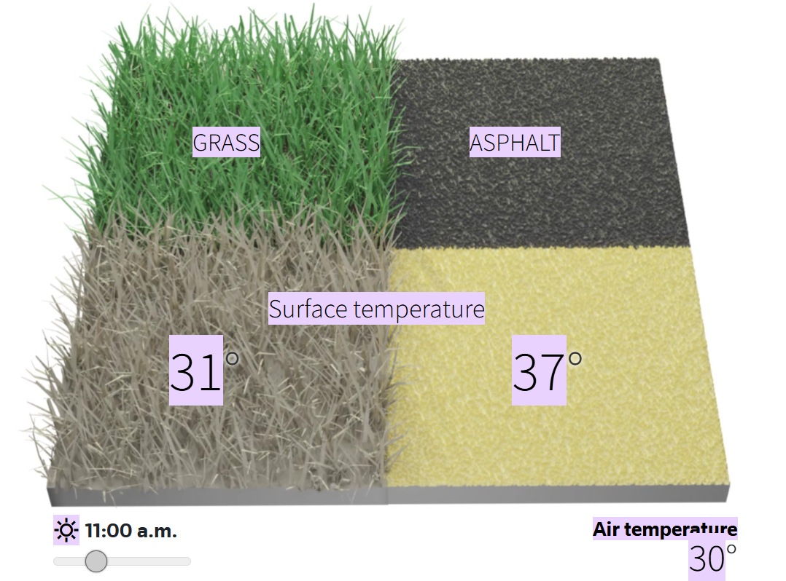
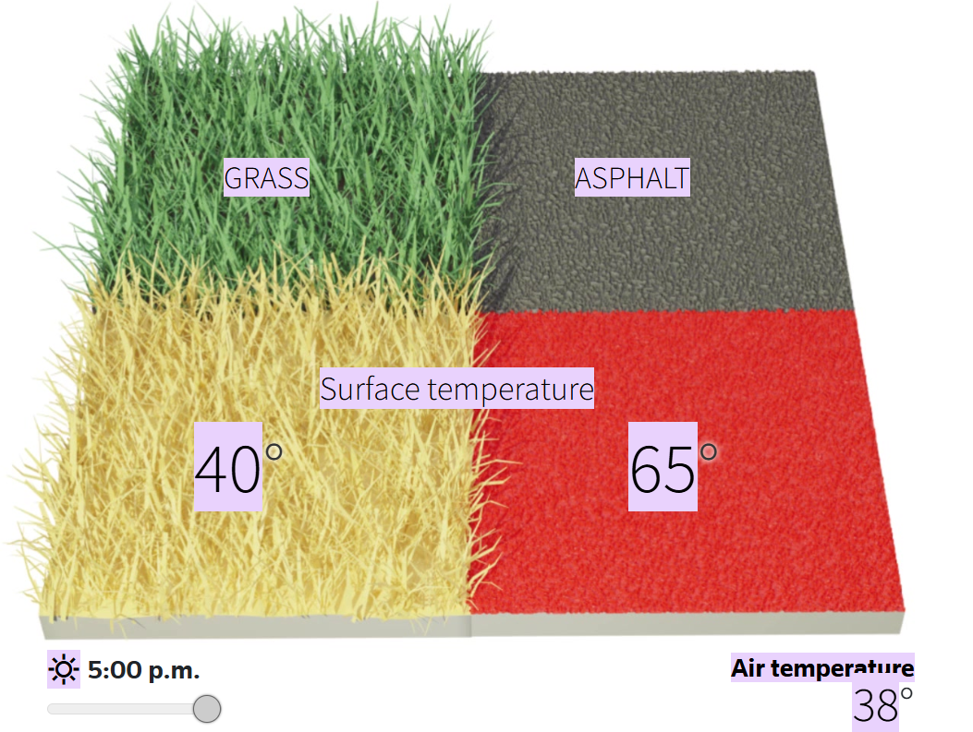
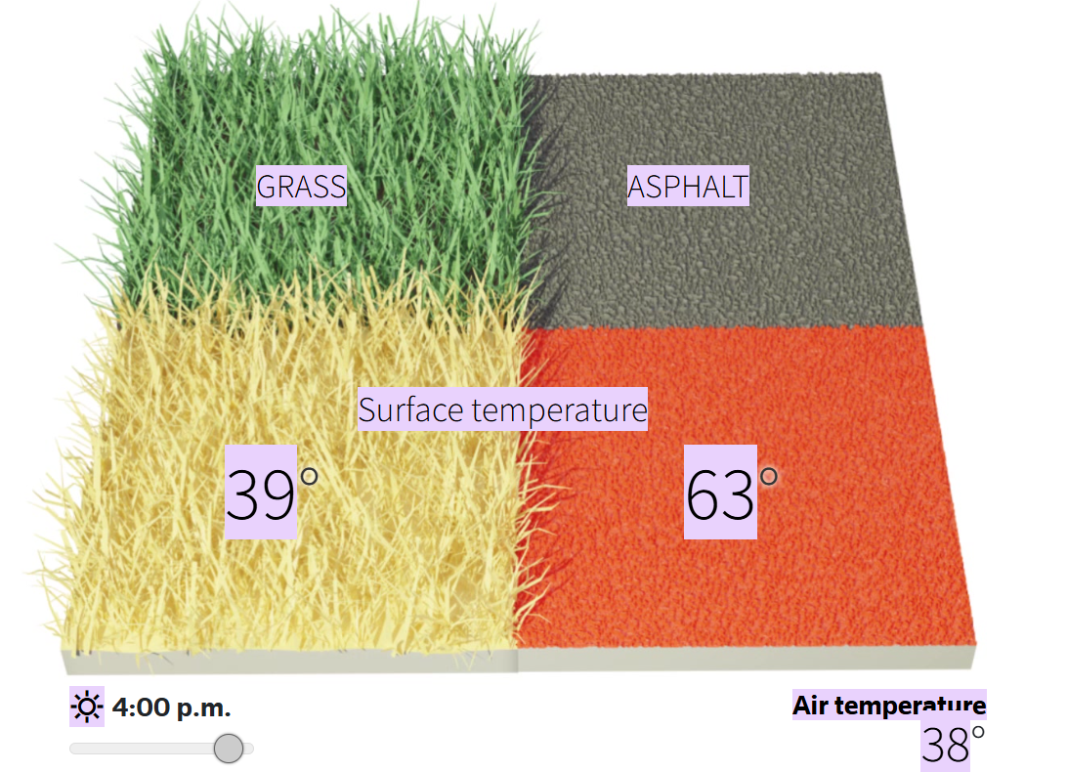
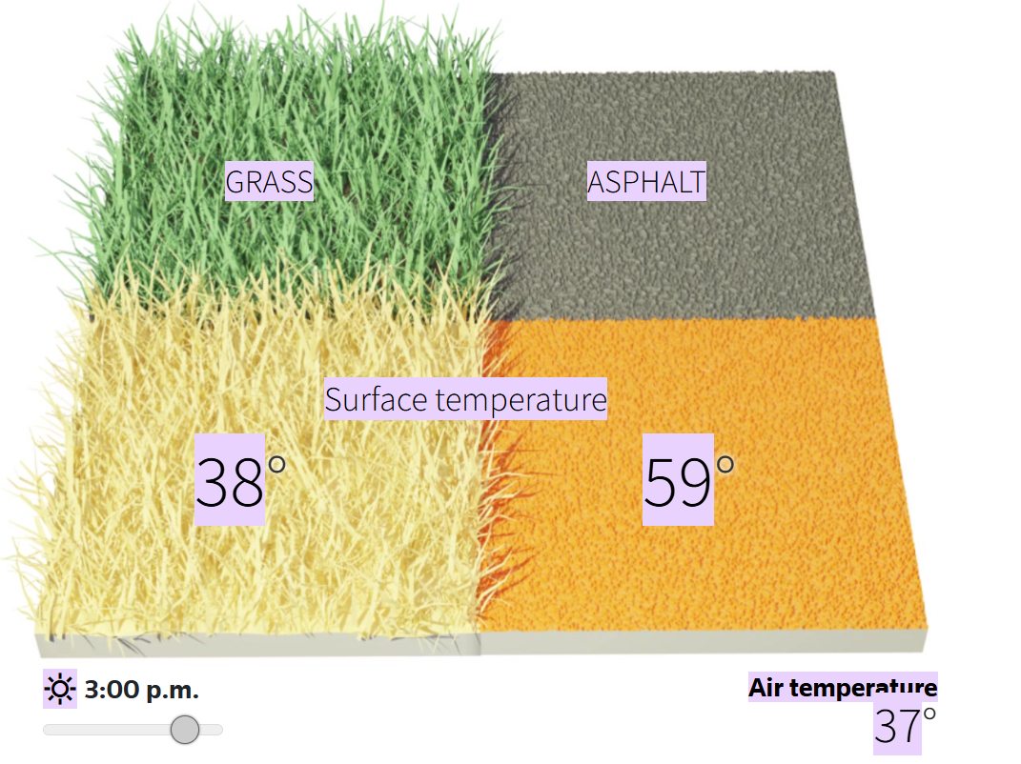
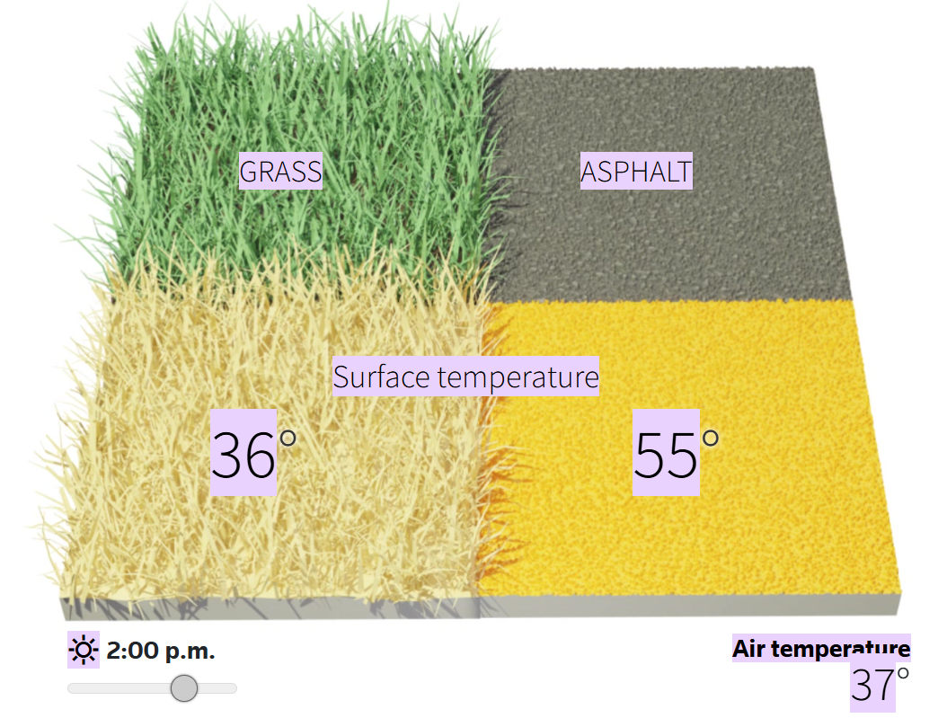
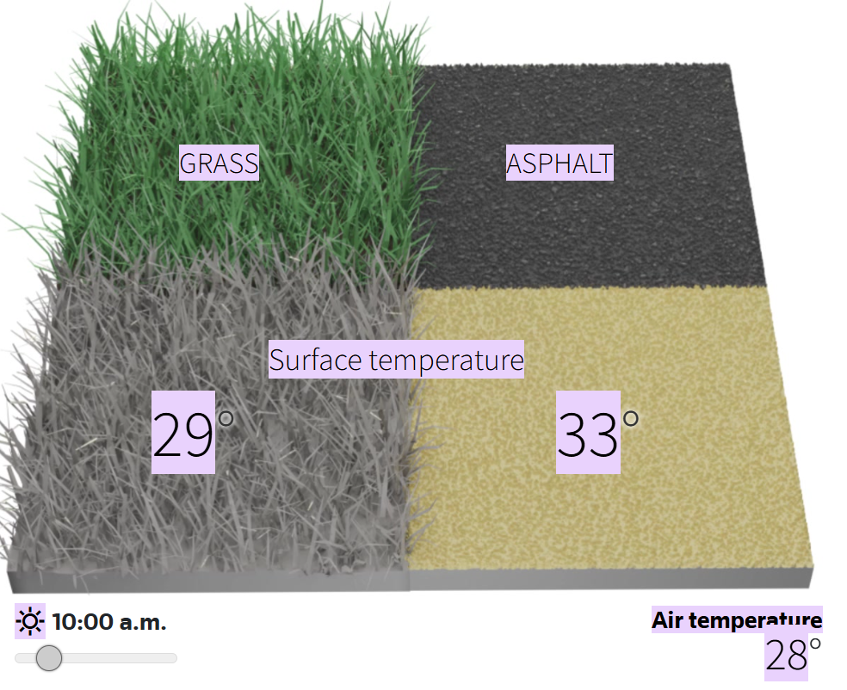
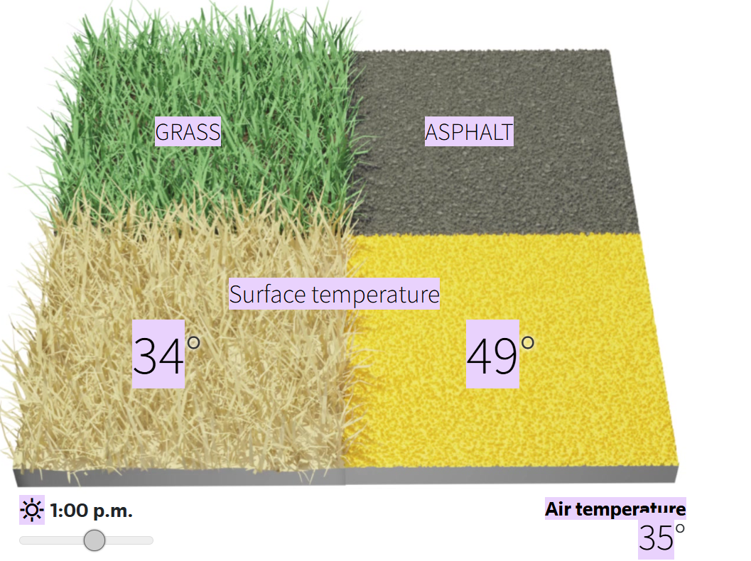
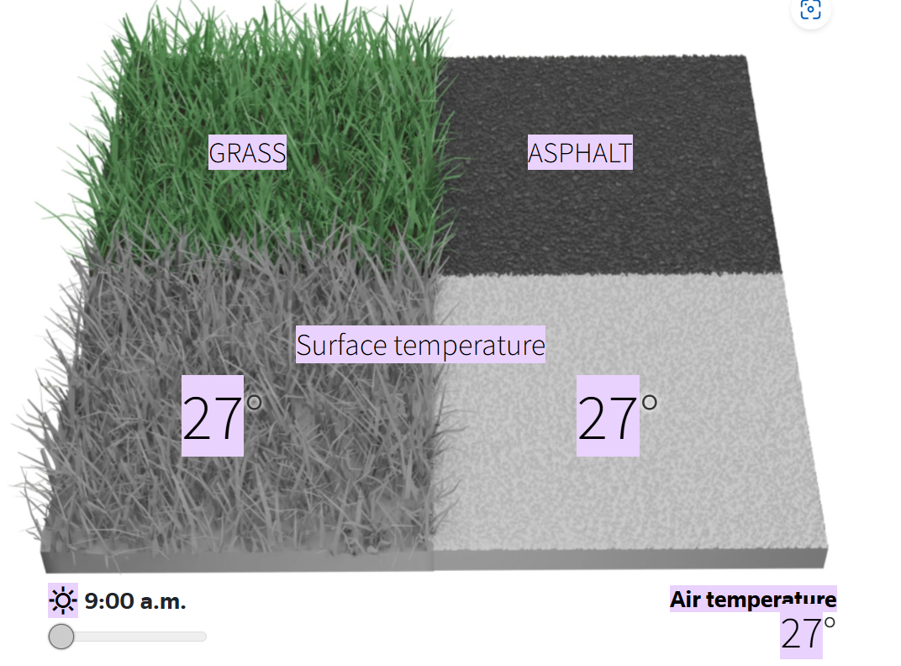
How concrete, asphalt and urban heat islands add to the misery of heat waves

Slide 7
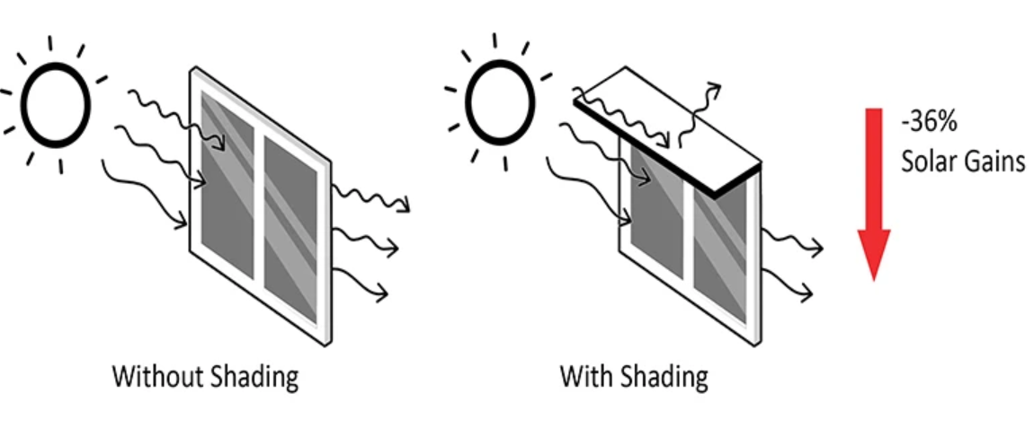
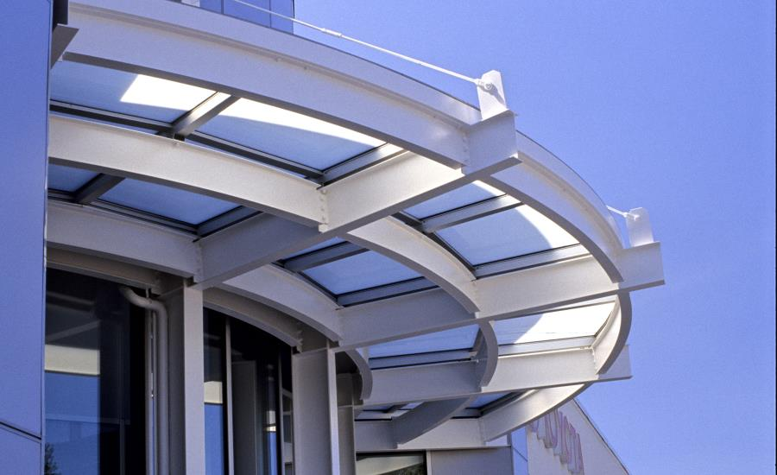
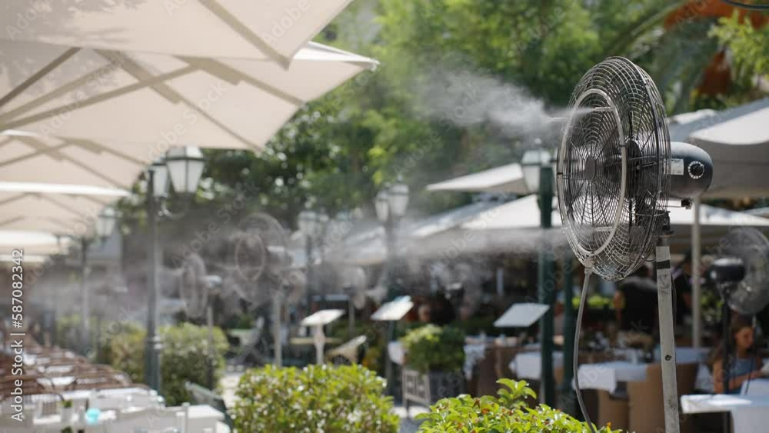
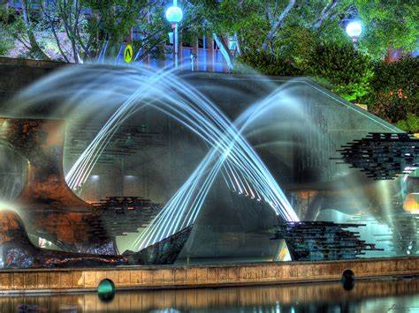
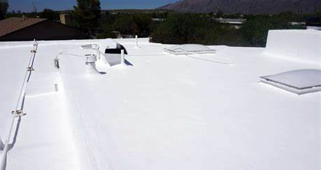
Physical interventions
Shading
Water sprays in public spaces
Water fountains
Painting roofs white

Slide 8
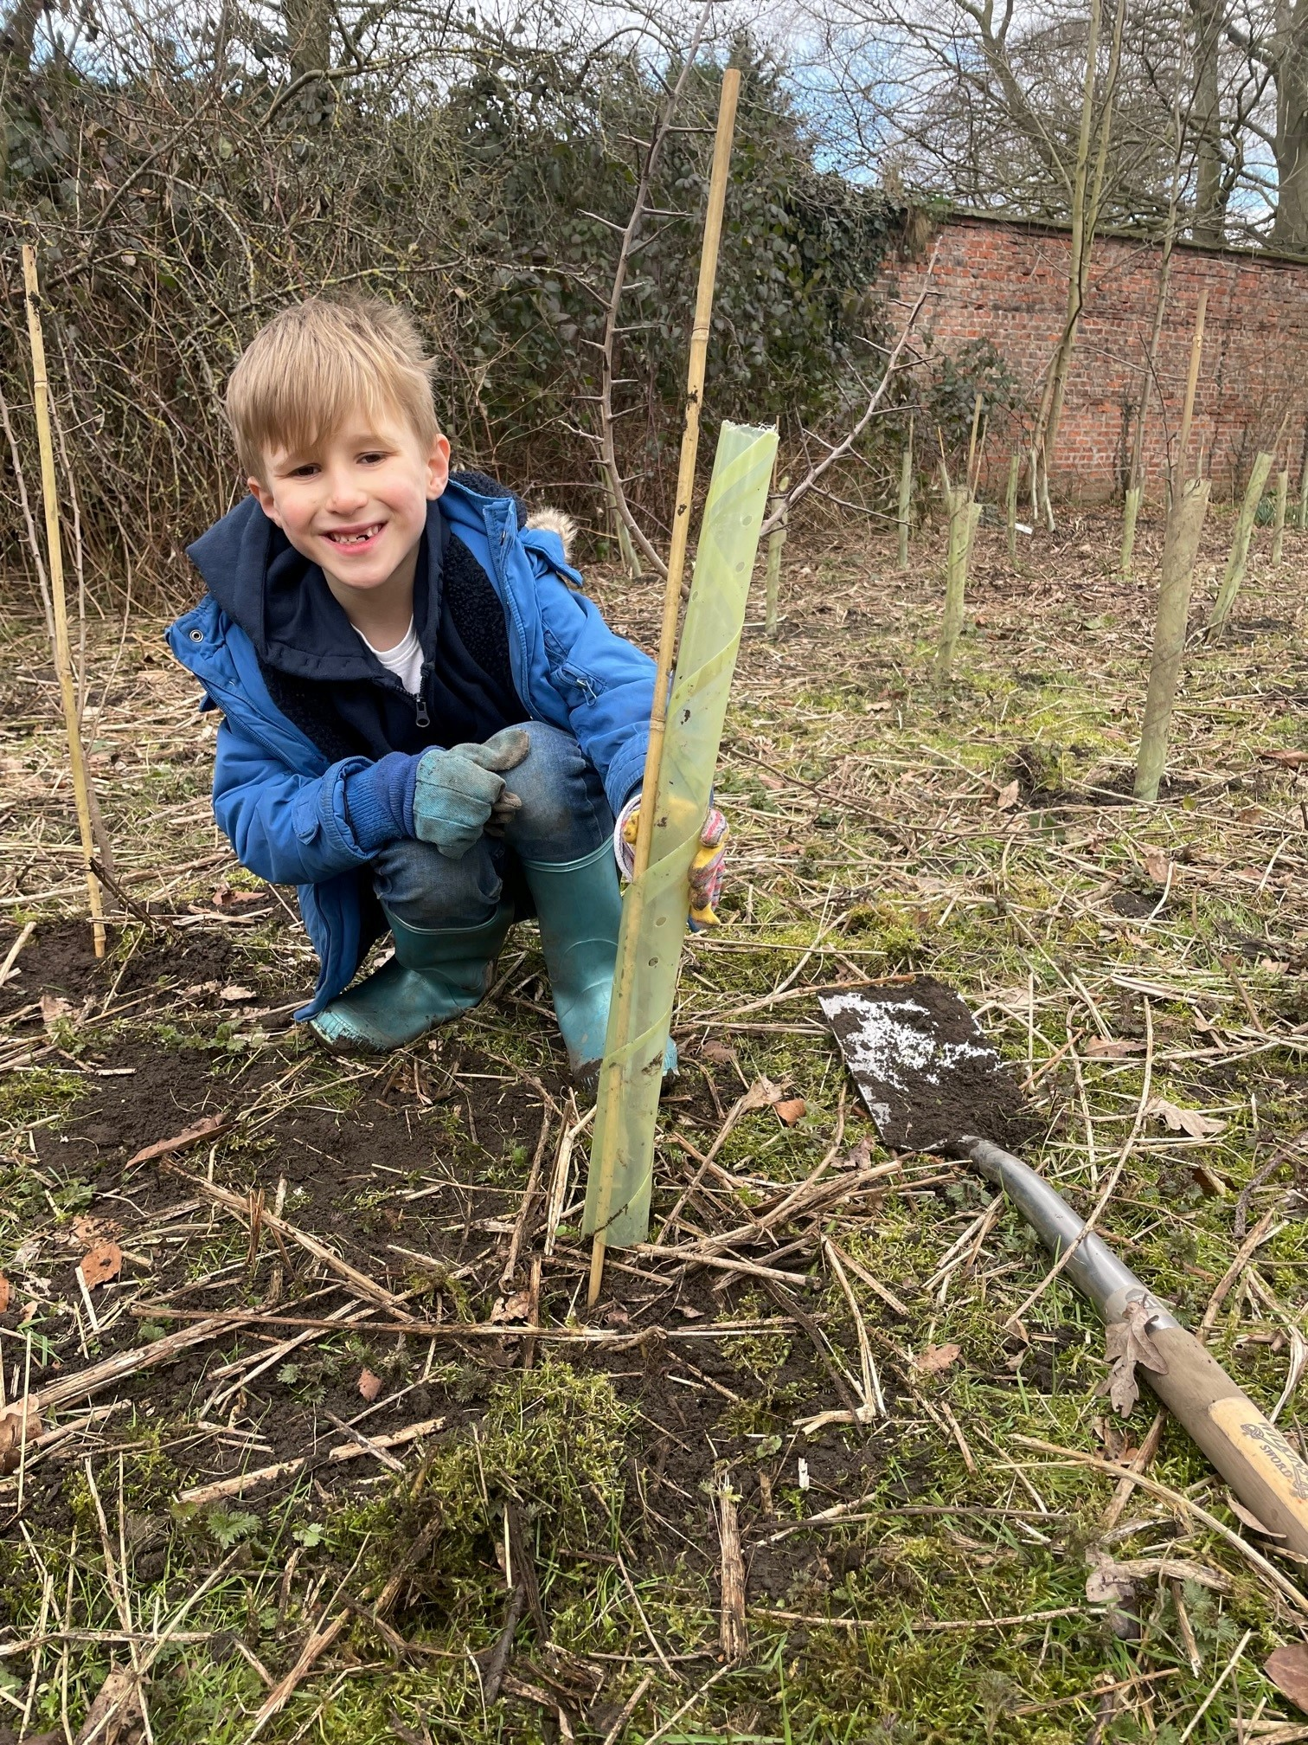
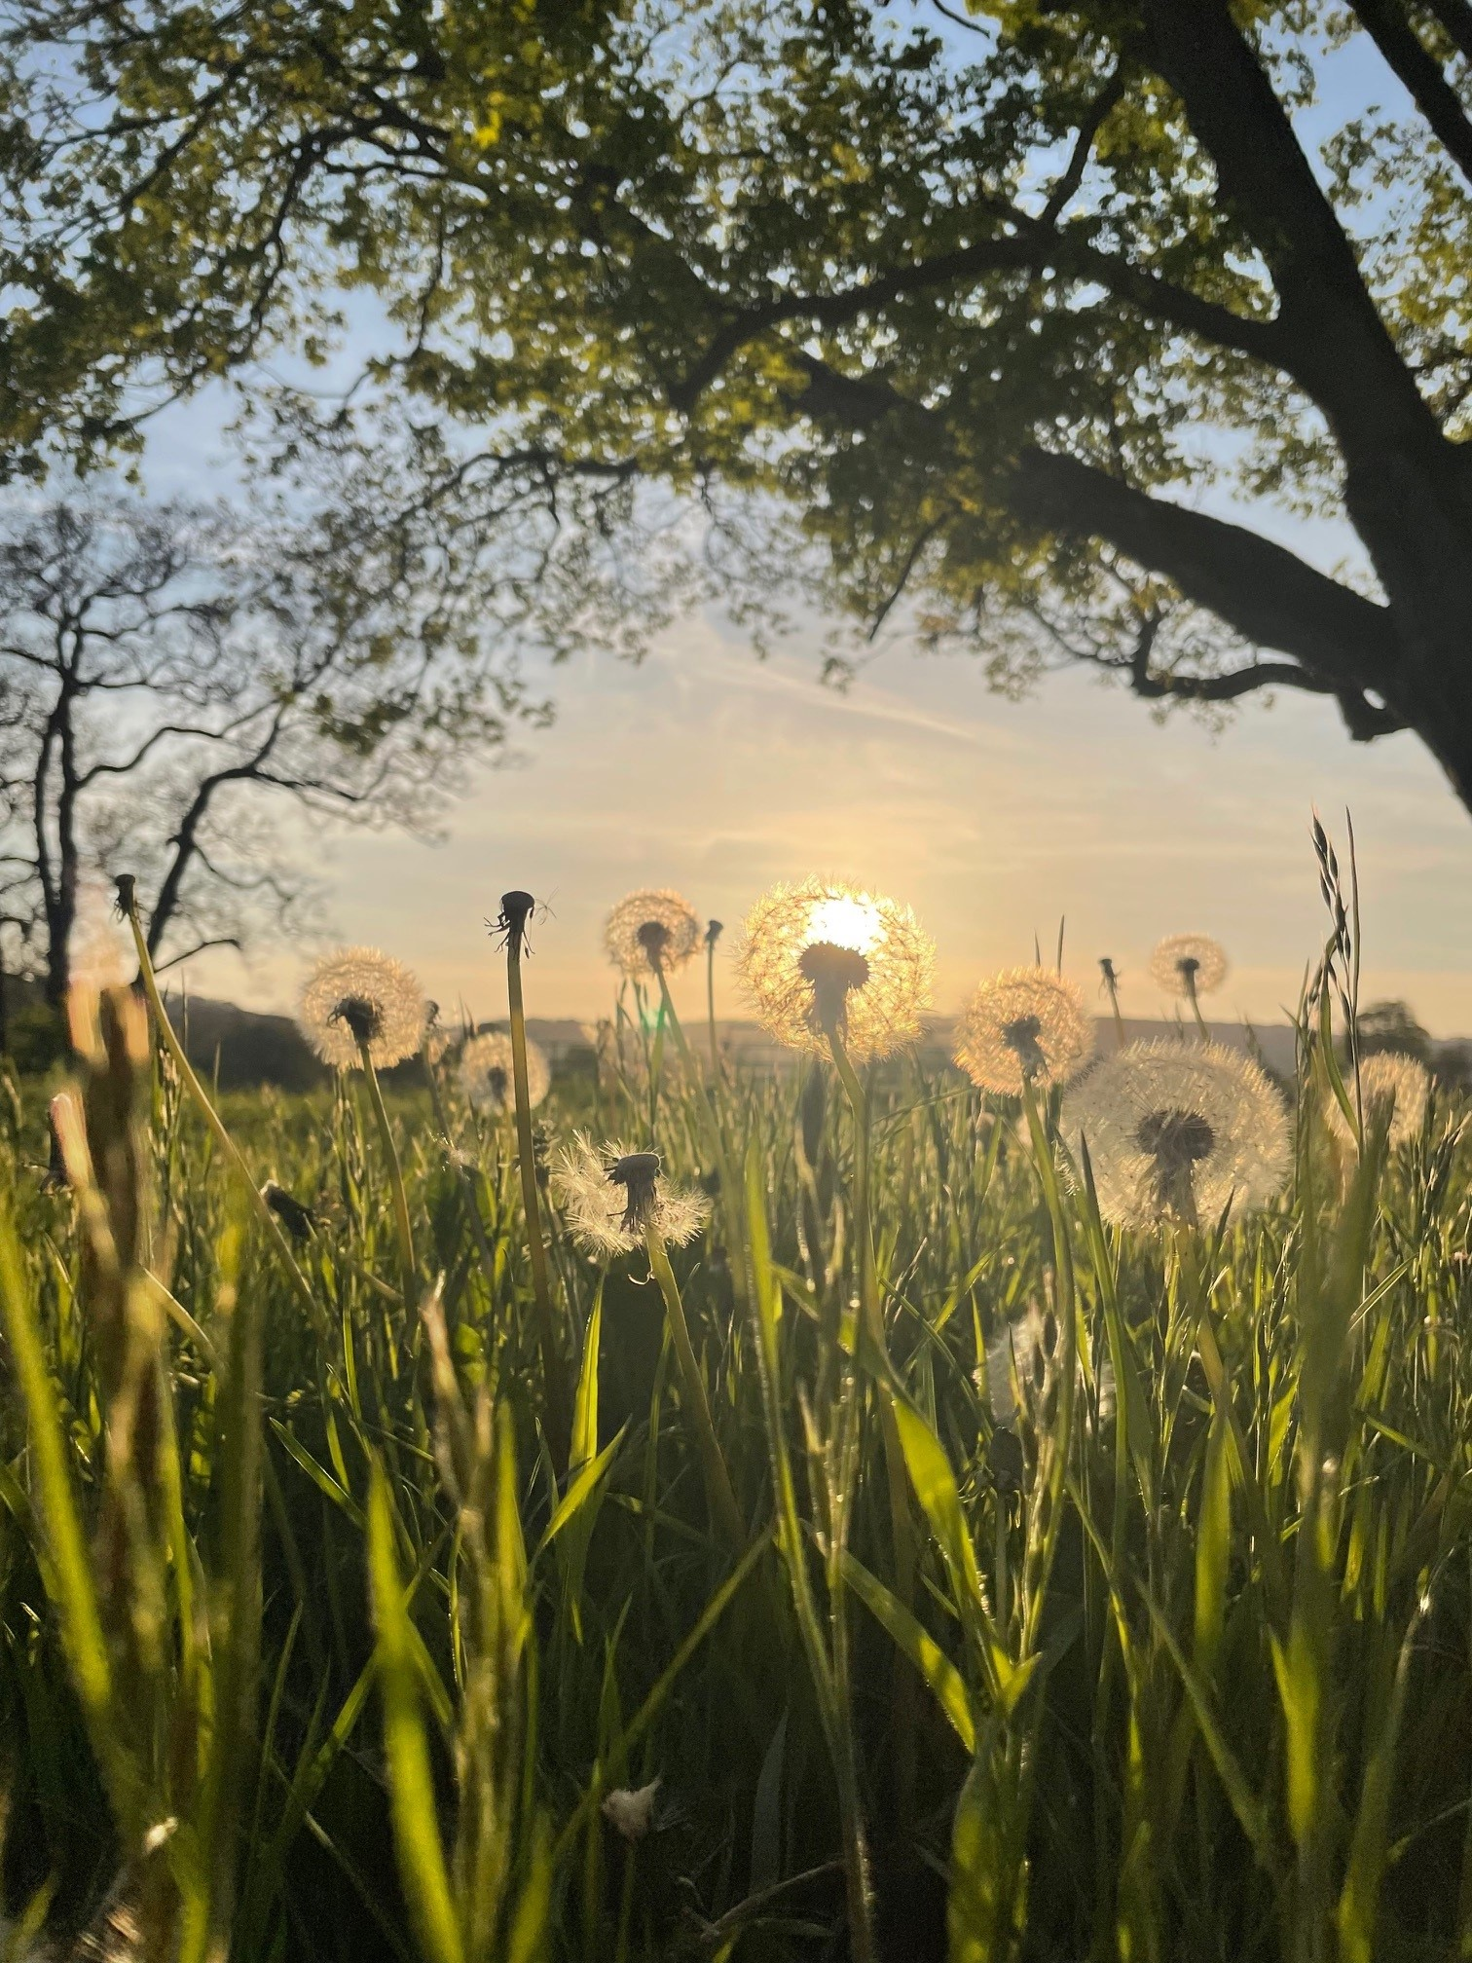
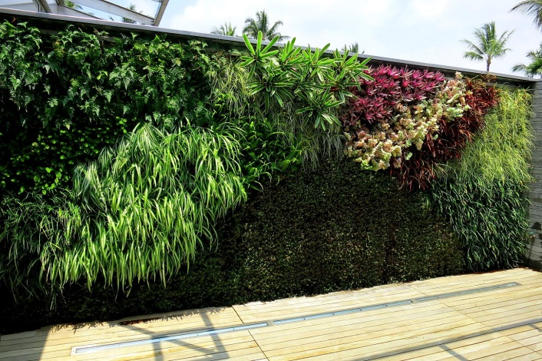
Nature based solutions
Green Roof
Ponds
Planting trees and hedges
Trees and green space
Green walls

