Slide 1






PEACCH Climate Adaptation in Healthcare Webinar Series
This event is co-funded by EPSRC and ESRC Impact Acceleration Award: EP/X525686/1
This event is co-funded by EPSRC and ESRC Impact Acceleration Award: EP/X525686/1

Slide 2
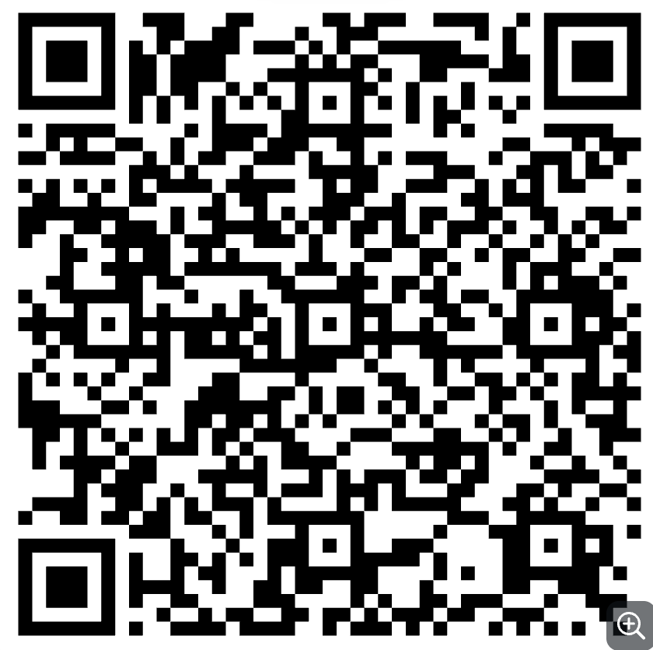
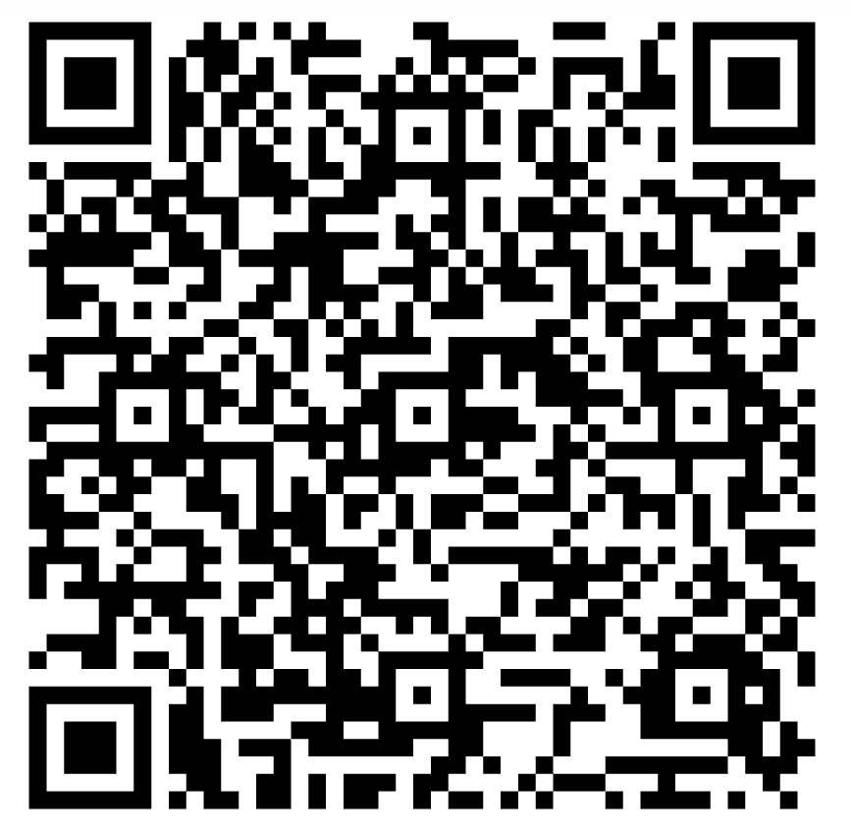
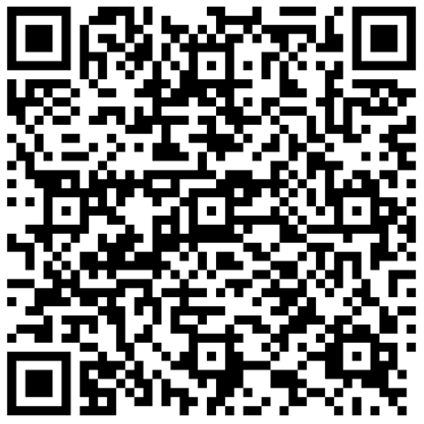
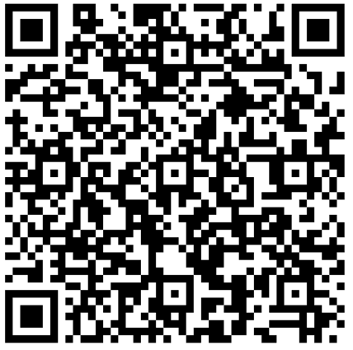
PEACCH Webinars
1. Intro to Climate Adaptation in Healthcare
17 June 2025, 1200-1300:
2. A closer look at heat risks
18 June 2025, 1200-1300:
3. A closer look at flooding / drought risk
23 June 2025, 1200-1300
4. Tools for embedding adaptation action
25 June 2025, 1200-1330:

Slide 3
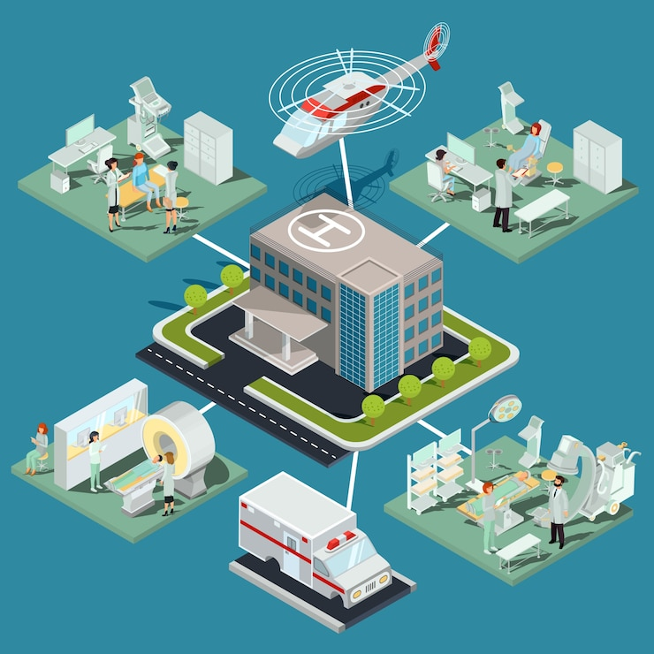
Housekeeping
Sessions are being recorded
Feel free to introduce yourself on the chat
Keep your questions until the end of the session- use the Q&A function (these will not be in the final published version)

Slide 4
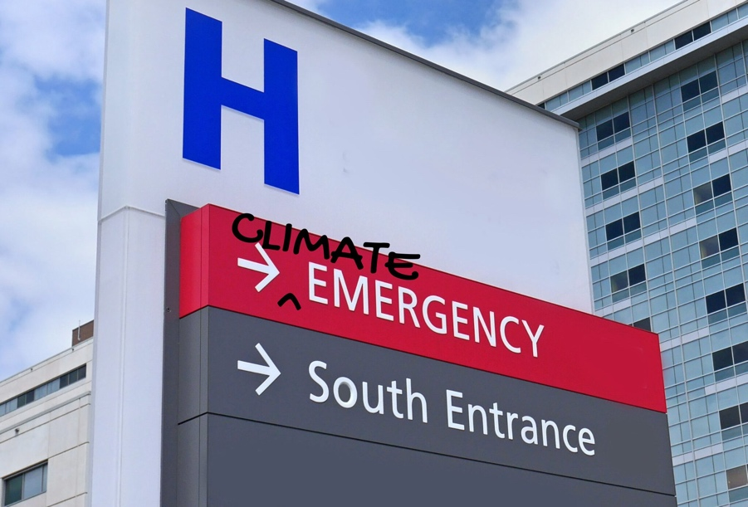
Webinar 2: Heat focus
Speaker | Topics
Louise Elstow | Welcome, introduction to PEACCH and the session
Federica Pascale | An introduction to climate-change-driven heat risk: An overview of what to expect from heat and its impacts in healthcare settings, plus tools for understanding heat risk at a site level
Alexis Percival | An overview of physical interventions for heat risks
Susie Vernon | Sussex Community NHS Trust Case Study: Findings from research on impacts on their patients and staff of 2022 heatwave, use of an Impact Assessment, and an overview of interventions considered or implemented
Louise Elstow | Facilitated Q&A session Session close

Slide 5

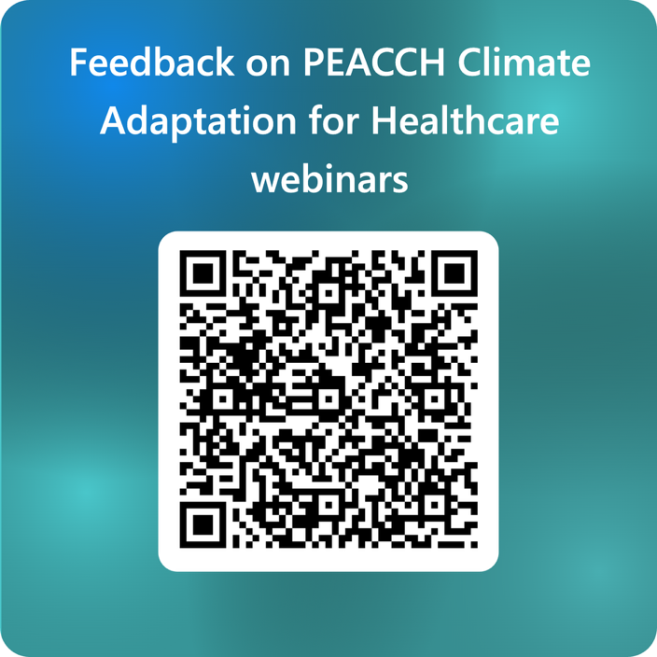
Closing remarks
Q&A
Thanks to the speakers
Feedback on the series
Next session coming up
This event is co-funded by EPSRC and ESRC Impact Acceleration Award: EP/X525686/1
This event is co-funded by EPSRC and ESRC Impact Acceleration Award: EP/X525686/1

Slide 6


PEACCH Adaptation webinars
17 June 2025, 1200-1300: Introduction to climate adaptation in a healthcare context. Register here
18 June 2025, 1200-1300: A closer look at heat risks in healthcare facilities, with intervention options and with a UK case study. Register here
23 June 2025, 1200-1300: A closer look at flooding and drought risk in UK healthcare facilities, with intervention options and a UK case study. Register here
25 June 2025, 1200-1330: Embedding action to adapt to climate change in your organisation - what tools are there to help you take action. Register here

