Slide 1
Healthcare impacts of climate change
Alexis Percival, Energy and Sustainability Manager
Yorkshire Ambulance Service

Slide 2
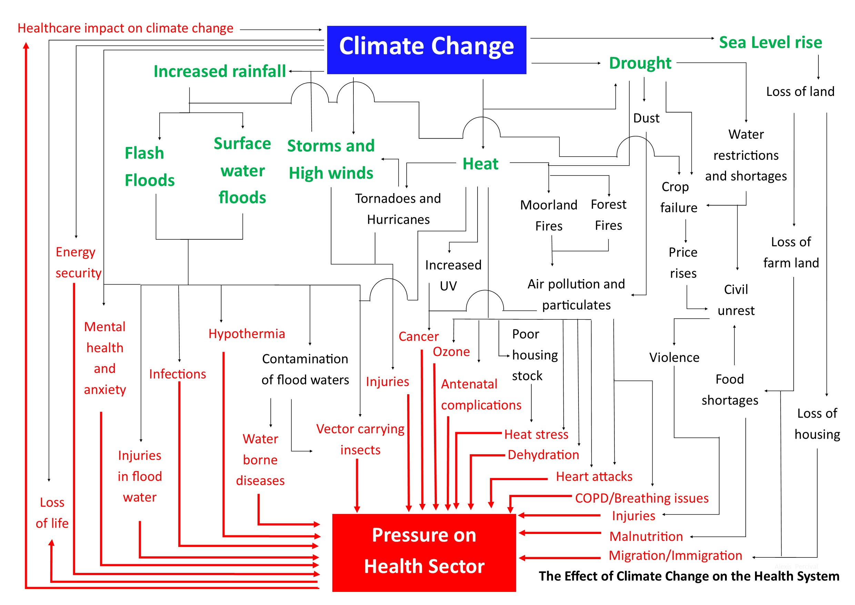
Key climate-driven impacts on healthcare

Slide 3
Impacts on the health service felt now
Heat waves
Pressure on service
Wildfires
Breathing problems, smoke inhalation
Floods
Access to patients, emergency response times, driving through flood waters, staff access, danger, system pressure
Sea level rise and storm surges
Pandemics
COVID, MERS, SARS, Monkeypox, Bird Flu
Movement of people
Increased pressure on health system
Climate Anxiety/Mental Health

Slide 4
 | Existing Global policies
 | Global temperature rise: 2-3.7ºc
 | Summer 2070 | Winter 2070 | Annual 2070
Temp | Increase by 3.3ºC | Increase by 2.06ºC | Increase by 2.81ºC
Rainfall | Decrease by 0.46mm/day | Increase by 0.12 mm/day | Decrease by 0.13mm/day
Cloudiness | Decreases by 38.74 Watts/m2 | Decreases by 4.84 Watts/m2 | Decrease by 20.12 Watt.m2
Windiness | Decreases by 0.17m/sec | Increases by 0.03m/sec | Decreases by 0.1m/sec
 | Worse case scenarios
 | Global temperature rise: 3.2-5.4ºC
 | Summer 2070 | Winter 2070 | Annual 2070
Temp | Increases by 5.11ºC | Increases by 3.39ºC | Increases by 4.23ºC
Rainfall | Decrease by 0.54mm/day | Increase by 0.32mm/day | Decrease by 0.13mm/day
Cloudiness | Decreases by 48.74 Watts/m2 | Decreases by 5.88 Watts/m2 | Decrease by 24.65 Watt.m2
Windiness | Decreases by 0.30 m/sec | Increases by 0.23m m/sec | Decreases by 0.06m/sec

Slide 5
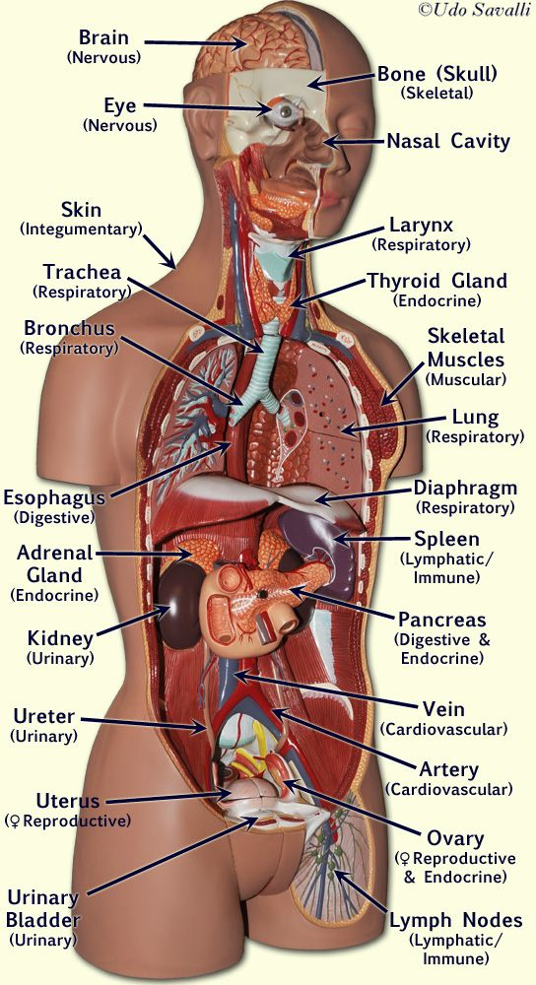
Mental Health issues
Skin cancer
Impact of Climate Change on the human body
Heart Attacks
Breathing issues
COPD
Asthma
Insect vector carrying diseases
Malnutrition
Dehydration and kidney issues
Foetal abnormalities
Pandemics and infectious diseases

Slide 6
Potential impacts: Short term – next 5 to 10 years
LCAT: Local Climate Adaptation Tool

Slide 7
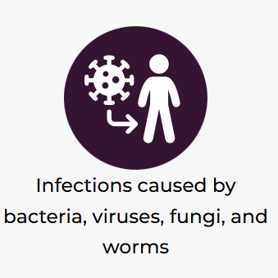
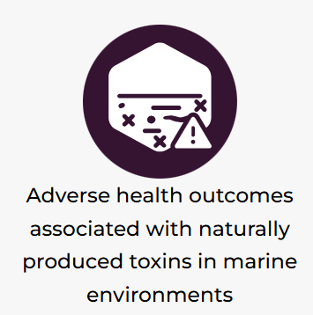
Potential impacts: Medium term -10 to 24 years
LCAT: Local Climate Adaptation Tool

Slide 8
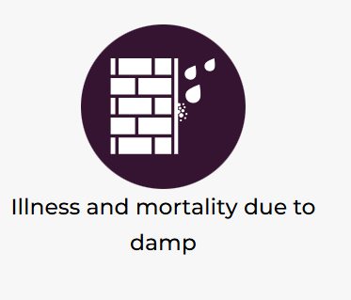
Potential impacts: Long term 25+ years
LCAT: Local Climate Adaptation Tool

Slide 9
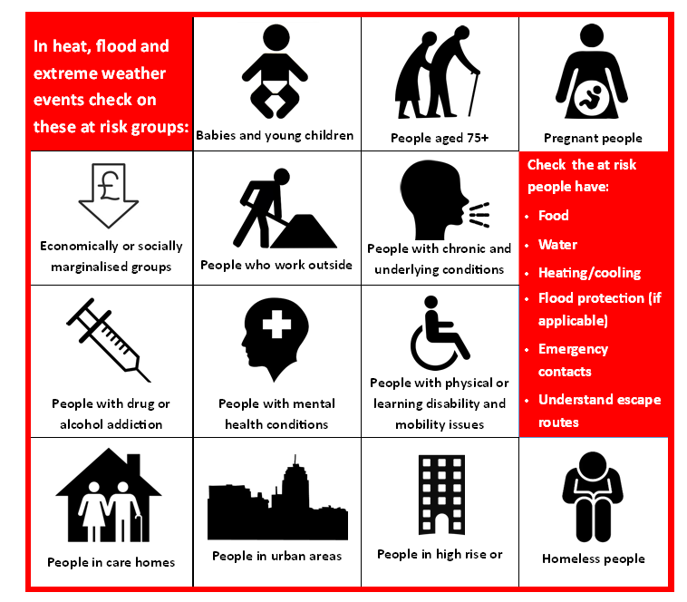
Vulnerable groups
ALL OF US

