Slide 1






PEACCH Climate Adaptation in Healthcare Webinar Series
This event is co-funded by EPSRC and ESRC Impact Acceleration Award: EP/X525686/1
This event is co-funded by EPSRC and ESRC Impact Acceleration Award: EP/X525686/1

Slide 2




PEACCH Webinars
1. Intro to Climate Adaptation in Healthcare
17 June 2025, 1200-1300:
2. A closer look at heat risks
18 June 2025, 1200-1300:
3. A closer look at flooding / drought risk
23 June 2025, 1200-1300
4. Tools for embedding adaptation action
25 June 2025, 1200-1330:

Slide 3

Housekeeping
Sessions are being recorded
Feel free to introduce yourself on the chat
Keep your questions until the end of the session- use the Q&A function (these will not be in the final published version)

Slide 4


Webinar 1 Programme
Speaker | Topics
Louise Elstow | Welcome, introduction to PEACCH and the session
 | An introduction to climate adaptation: What is it and what is it not? How does it differ to mitigation and the possibility for mutually beneficial action? What kinds of interventions can we make in order to adapt and who might be involved?
Alexis Percival | A focus on adaptation in the health sector: What are the key climate-driven risks for the NHS? Why is it critical to think about climate adaptation in the NHS – what are the potential impacts in the short, medium and long term?
Federica Pascale | Healthcare Adaptation Research: An overview of research projects investigating climate adaptation in healthcare
Neil Cartwright | UK Healthcare Adaptation Policy: An introduction to the healthcare climate adaptation policy landscape in the UK
Louise Elstow | Facilitated Q&A session Session close

Slide 5
An introduction to Climate Adaptation
Dr Louise Elstow,
Centre for Sustainable Development, Cambridge University

Slide 6

What is climate change?
Climate change refers to long-term shifts in temperatures and weather patterns.
These can be natural (e.g sun’s activity or large volcanic eruptions), but since the 1800s, human activities have been the main driver, primarily due to the burning of fossil fuels like coal, oil and gas.
Increasing greenhouse gas emissions from human activity act like a blanket wrapped around the earth, trapping the sun’s heat and raising temperatures.
Carbon dioxide and methane are the main greenhouse gases causing climate change.
https://www.un.org/en/climatechange/science/key-findings

Slide 7

What about climate adaptation?
Taking actions to reduce the negative impacts of climate change and build resilience to climate-related shocks and stresses.
These actions can include changes in processes and practices as well as physical changes to the environment to better manage climate impacts.
Adaptation can mean mitigating potential damages as well as seizing opportunities as a result of climate change.
https://unfoundation.org/blog/post/climate-adaptation-is-key-to-a-climate-resilient-future-but-what-does-it-mean/

Slide 8
Climate-driven risks to UK
Floods
Wildfires
Increased general temperatures
Heatwaves
Storms and extreme wind
Air quality issues
Droughts and water scarcity
Extreme rain
Sea levels rising

Slide 9
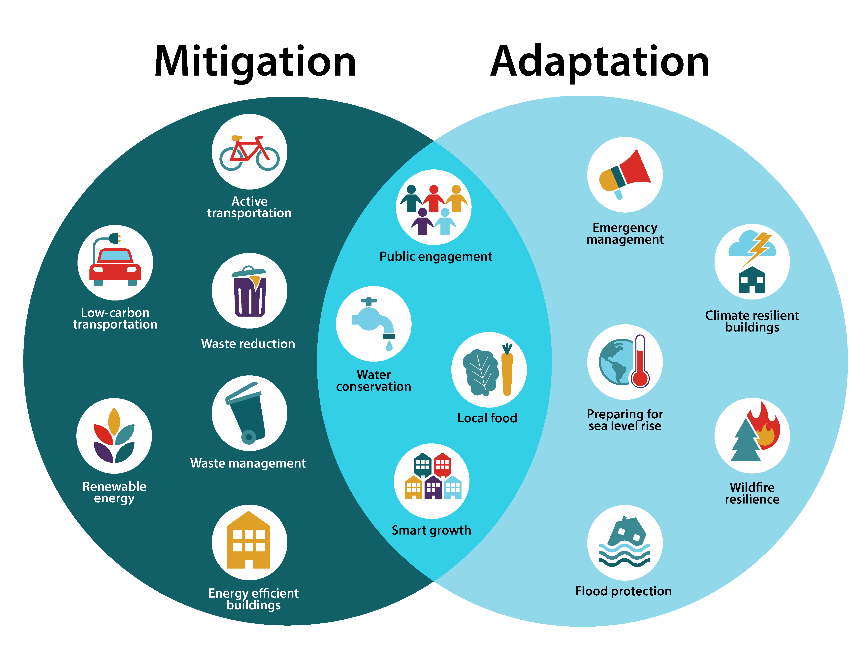
Climate adaptation vs mitigation
Big Overlap!
Adaptation means anticipating the adverse effects of climate change and taking appropriate action to prevent or minimise the damage they can cause, or taking advantage of opportunities that may arise.
Mitigation means making the impacts of climate change less severe by preventing or reducing the emission of greenhouse gases (GHG) into the atmosphere.
https://www.eea.europa.eu/en/about/contact-us/faqs/what-is-the-difference-between-adaptation-and-mitigation European Environment Agency, 2024
Source: https://tree-nation.com/it/progetti/inside-tree-nation/articolo/18356-what-is-climate-adaptation

Slide 10
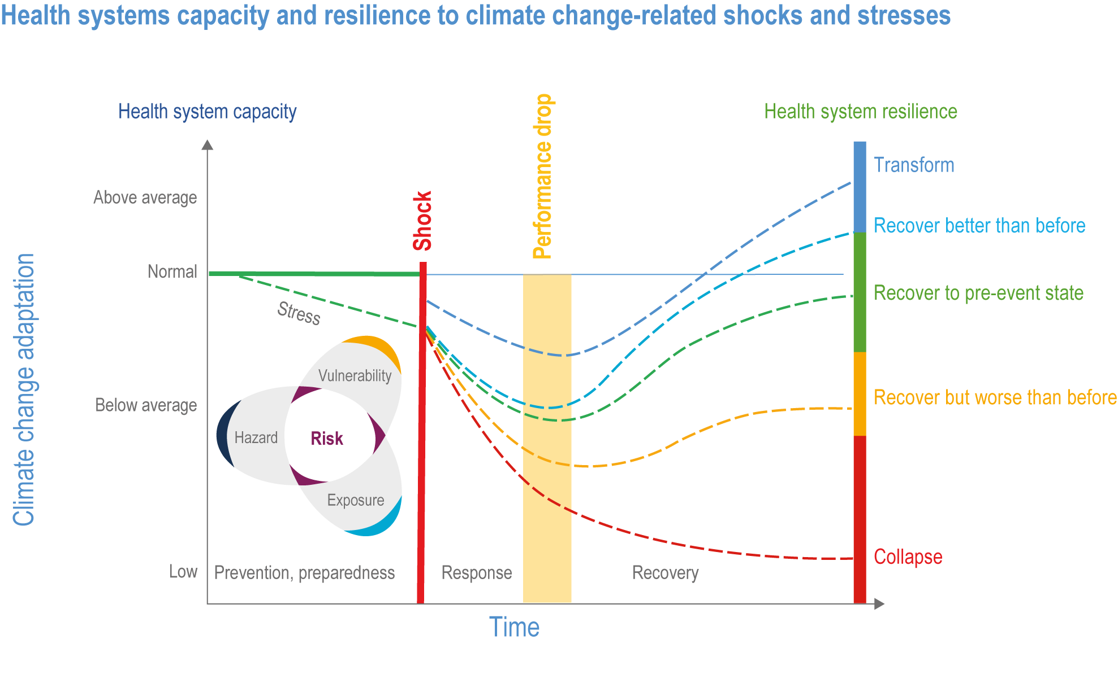
https://www.ipcc.ch/report/ar6/wg2/chapter/chapter-7/
IPCC (2022). Climate Change 2022: Impacts, Adaptation and Vulnerability. Ch7: Health, Wellbeing and the Changing Structure of Communities, figure7.15
Notes:
We’ll come to the risk diagram in a second….

Slide 11
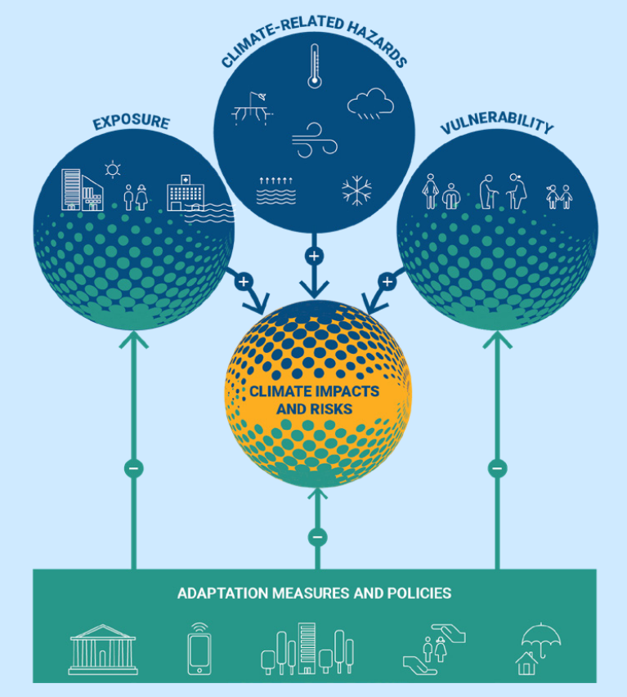
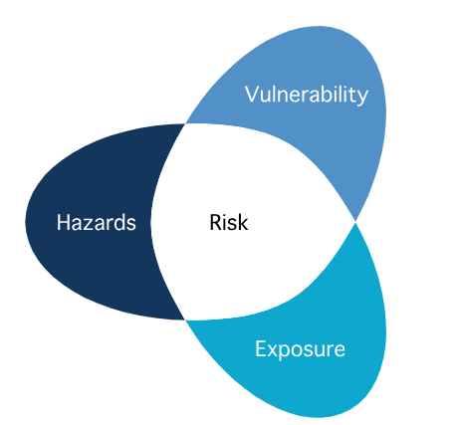
Managing climate driven risks
Source: EEA’s (2023) Urban adaptation in Europe: what works? Report
Source: IPCC AR5 conceptual framework
Adaptation policies and interventions (measures) aim to increase climate resilience by reducing exposure, vulnerability or reducing the resulting impact
Notes:
It can be helpful to think about climate driven risks within a risk management framework – this puts it into a familiar space – climate driven risks are like any other risk. We have systems of managing those risks already. Makes it less new and scary.
A risk is a combination of:
A hazard - a thing that has the potential to cause harm
Exposure to that harm – if that harm were realised, where or what would be exposed to it?
Vulnerability – if that harm were realised are there particular things or people which would be more susceptible to being harmed?

Slide 12
What does physical adaptation look like?
Moving critical services or functions out of harm
Reinforcing critical functions/services
Redundancy and back-up systems
Improved glazing/insulation
Amending layouts
Designing-in reconfiguration
Reducing glare
Easy clean up/recovery
Green roofs/walls
Screens and shading
(NBS/engineered)
Other Nature Based Solutions (NBS)
Improved ventilation
(passive/active systems)
Improved drainage (NBS/engineered)
Improved water collection/use
Notes:
Points to remember:
1. Any intervention might be addressing adaptation and mitigation at the same time
2. Might be addressing multiple hazards at the same time (e.g. green roofs - act as an insulation layer, making buildings more thermally efficient (MITIGATION) and less affected by extreme temps (ADAPTATION). From an adaptation perspective they can also help reduce the effects of extreme heat and cold temperatures inside EXTREME TEMPS) as well as help slow down (EXTREME WATER VOLUME) and retain water (WATER SCARCITY).
3. Many green and NBS have additional positive impacts by making the environment more pleasant for staff and patients.

Slide 13
Kinds of interventions
Pro-active
Intervention category | Includes | Proactive Interventions | Reactive Interventions
Governance and institutional WHO Framework Component 1 | policy instruments, regulations and mechanisms to support and streamline adaptation | Clear governance structures in place for signing off plans, testing and exercising, training staff Clear policies defining and supporting adaptation Policies that identify how a climate emergency differs to a ‘normal’ one Reporting and monitoring at system level | Governance arrangements – make appropriate decisions during crisis and ensure funds are allocated where they are needed Learning lessons and implementing them ahead of the next crisis
Economic and finance (WHO Framework Component 10: sustainable climate health financing) | insurance, economic incentives and innovative financing mechanisms; | Ensuring adequate insurance cover is in place Funding schemes to support adaption purchases | Access to funding for recovery action Access to funding to address issues identified
Knowledge and behavioural change: (WHO component 2: Climate-smart health workforce, 7/8/9: Service delivery: ) | awareness raising, knowledge sharing and actions encouraging changes in consumption and lifestyle patterns. | Development, testing and exercising of emergency response plans and arrangements, business continuity plans Training staff: awareness raising for all staff (esp. public health, estates and facilities, emergency response/BCM) Engagement with utilities, social health, local authorities and other key stakeholders | Deployment of emergency response arrangements – staff and equipment Ad hoc staff response – based on either own skills or intentional dynamic decision making
Physical and technological (WHO Framework Component 6: Essential medical products & technologies) | early warning systems (EWS), mapping, physical infrastructure and other sector-specific innovations; | Infrastructure retrofits – updating old buildings/equipment New/improved green/blue infrastructure Reconfiguring or redesigning spaces Resilience built into new builds Building monitoring systems (e.g. energy, temp, air quality) Procurement of emergency response equipment EWS (e.g. disease surveillance) Protection/reinforcement of key sites and systems | Using of or access to back up systems Access to key systems in an emergency Spare equipment – e.g. water, fans Ad hoc low-cost interventions – e.g. hanging wet cloths on outsides of buildings. Opening windows/ventilation
Nature-based solutions (NBS) & ecosystem-based approaches (Plants and trees are not mentioned by WHO Framework) | measures integrating nature, including green infrastructure, tree cover, water & soil regeneration | Planting trees and plants outside for shading/cooling, water retention, water attenuation, water filtration, air quality Using green roofs and walls for managing thermal comfort in extreme weather | Less appropriate for reactive interventions
Re-active
Non-structural
Structural
Source: Louise Elstow (in development), expanded from Leitner et al 2021, and EEA, 2023, and including WHO Operational framework for building climate resilient and low carbon health systems (2023)
Notes:
You can think of these as ROUGHLY breaking down into structural and non-structural, pro-active and reactive

Slide 14

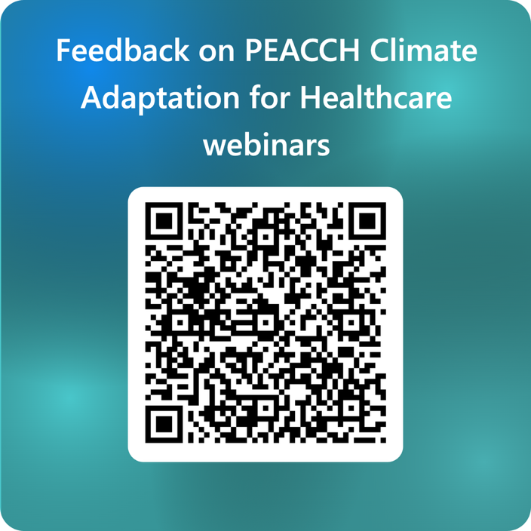
Closing remarks
Q&A
Thanks to the speakers
Feedback on the series
Next session coming up
This event is co-funded by EPSRC and ESRC Impact Acceleration Award: EP/X525686/1
This event is co-funded by EPSRC and ESRC Impact Acceleration Award: EP/X525686/1

Slide 15


PEACCH Adaptation webinars
17 June 2025, 1200-1300: Introduction to climate adaptation in a healthcare context. Register here
18 June 2025, 1200-1300: A closer look at heat risks in healthcare facilities, with intervention options and with a UK case study. Register here
23 June 2025, 1200-1300: A closer look at flooding and drought risk in UK healthcare facilities, with intervention options and a UK case study. Register here
25 June 2025, 1200-1330: Embedding action to adapt to climate change in your organisation - what tools are there to help you take action. Register here

