Slide 1

12 Principles for Adaptation-Positive Investment Decision Making
Dr Louise Elstow,
Centre for Sustainable Development, Cambridge University

Slide 2
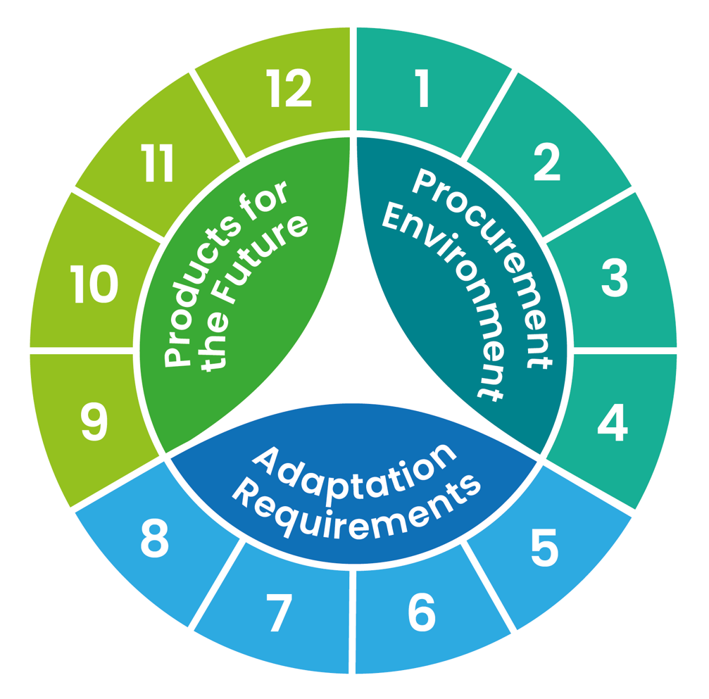
12 Principles for adaptation-positive investment
The procurement environment
Understanding the situation
Choosing the right solution
Account for full costs/opportunities
A golden thread
Future supply chain environment
Adaptation-ready relationships
Future configurations
Contract flexibility
Future operational environment
Quality monitoring and reporting
Avoid adding to emissions
Account for multiple risks
Avoid maladaptation
Account for interconnectivity
Source: Louise Elstow (2025) from Life Resystal Project ‘Procuring for Adaptation’ Guide.
https://life-resystal.eu/wp-content/uploads/2025/01/Adaptation-Procurement-Guide-V1.0-20250114-PUBLISHED.pdf

Slide 3

Adaptation Action
Adaptation action is the result of a decision/ requirement to take action
What action is taken is constrained by:
What is appropriate for the risk
What is available / accessible
What people know about
What people care about/think is important
What has happened before
Relationships between decision makers
Process and procedure
What your organisation does about adaptation will depend on these….
What can you influence?

Slide 4
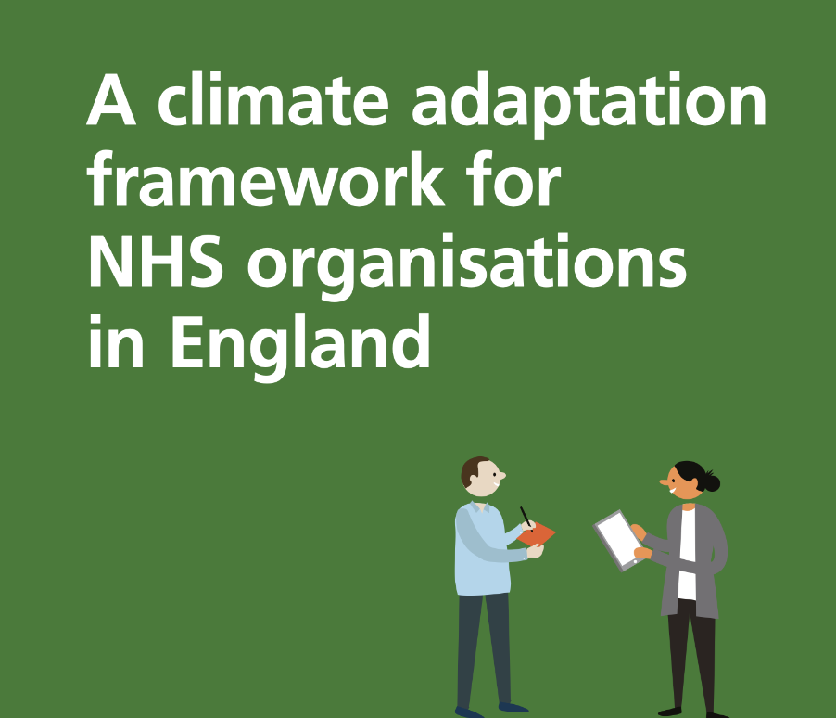
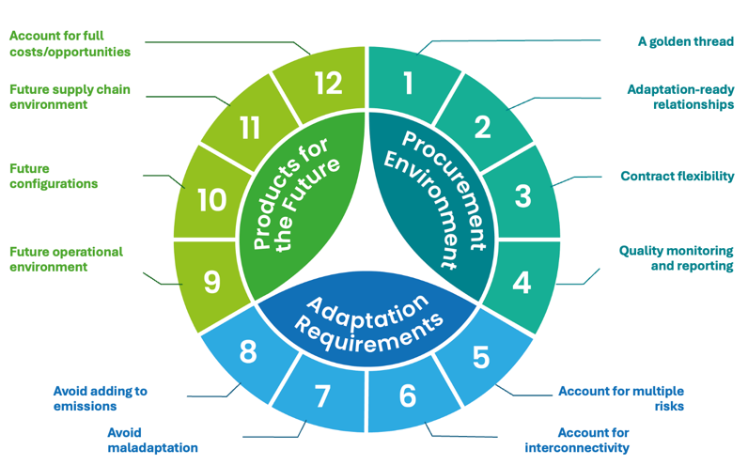
Webinar 4: Tools to embed
Speaker | Topics
Louise Elstow | Welcome, introduction to PEACCH and the final session
Morgan Roberts | Introduction to the NHS Climate Adaptation Framework and NHS Climate Change Risk Assessment (CCRA) Tool
Petar Tabakov | The future of sustainable procurement and what this means for adaptation
Louise Elstow | 12 principles for making adaptation-positive investment decisions
Karen Amber | NHS Commercial Solutions Sustainable Estates Solutions Framework
Alexis Percival | Finding creative ways to fund adaptation
Maryam Imani | Embedding monitoring of implementation for good governance – case study of drainage systems (SUDS) at ARU’
Louise Elstow | Facilitated Q&A session Closing of the webinar series

