Slide 1

Andrew Urquhart
Sustainability Lead
SNEE Integrated Care Board
and
Essex Climate Anchors Working Group Chair
Essex Healthcare Climate Adaptation Workshop
15th July 25

Slide 2
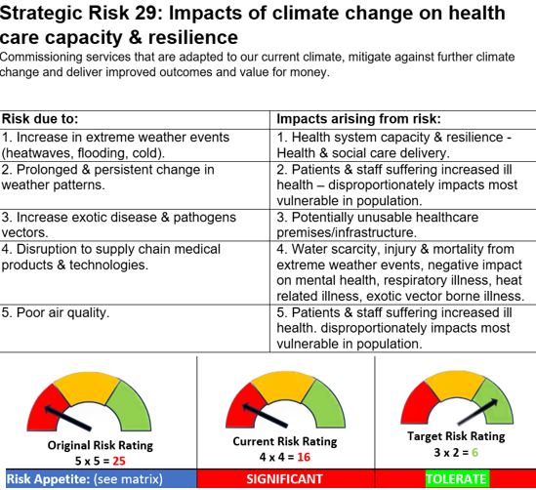
ICB’s risk appetite for this risk is SUBSTANTIAL therefore at the current risk rating the ICB is to TOLERATE the risk Current Aggregated Assurance Rating: LIMITED Either some of the Assurances noted on the current BAF demonstrate that the Controls in place are not effectively managing the Risk and action is required to address and / or there are gaps in assurance.
Notes:
Our revised BAF captures the overall risks to ensure we shift emphasis away from just short-term emergency preparedness and adopt strategic commissioning.
CQC … Adapting and changing pathways…
The ICB’s risk appetite for this risk is SUBSTANTIAL therefore at the current risk rating the ICB is to TOLERATE the risk.
Current Aggregated Assurance Rating: LIMITED
Either some of the Assurances noted on the current BAF demonstrate that the Controls in place are not effectively managing the Risk and action is required to address and / or there are gaps in assurance.

Slide 3
Gaps… Trust Green Plan governance & adaption leads – are they linked in & attending steering groups? Green Plan S18 Standard contract & quarterly returns are useful too ‘high level’ PCN Estates infrastructure strategies & awareness Digital What Good looks Like sustainability pillar
BAF Control & assurances
Controls; 1. ICB Green Plan. 2. Trusts Green Plan returns & governance. 3. Multi-agency planning by LRFs. 4. Primary care PCNs awareness & adoption. 5. Trust S18 SC annual report returns received. 6. Surface water flooding plan. 7. Air Quality system wide work. 7. SIA Launch (commissioning). 8. Standard NHS T&Cs (procurement). 9. Mandatory net zero training (workforce).
Assurances; 1. ICS Board oversight & approval. 2. LRF Executive Boards. 3. Debriefs held after incidents. 4. ICB 5. Sustainability Steering Group. 6. Trust steering groups and Estates teams now commenced integrating approaches following ICB BAF driving system (requires further integration)
Notes:
Our revised BAF captures the overall risks to ensure we shift emphasis away from just short-term emergency preparedness and adopt strategic commissioning.
CQC … Adapting and changing pathways…
SIA launch & Trusts & system roll out

Slide 4
NHS England » A climate adaptation framework for NHS organisations in England ‘Effective leadership, governance arrangements, inclusive planning approaches and collaboration across teams and services are all key to successful adaptation’. ‘No organisation can adapt alone; by working together we can do more to achieve shared adaptation outcomes’.
What have we learnt & done ?
This takes time and is iterative
Discussed and listened to our Trusts who wanted the ICB to support by leading
Used BAF as an engagement tool
Given the work ‘teeth’ & focus
Estates, Digital, EPRR, S18 standard contract reviews, Primary Care Resilience Forum, PH discussions
Started to cross reference with existing policies, impact assessments & processes (SIA, primary care business cases)
Identified gaps in assurance
Started to address gaps in assurances esp. around primary care
Created a platform for next stage development alongside the adaptation framework
Used the weather as discussion point,(How British)!
Notes:
Our revised BAF captures the overall risks to ensure we shift emphasis away from just short-term emergency preparedness and adopt strategic commissioning.
CQC … Adapting and changing pathways…
SIA launch & Trusts & system roll out

Slide 5
Further information & Appendices
Andrew.Urquhart@snee.nhs.uk
NHS SNEEICS - Green Plan
Notes:
Our revised BAF captures the overall risks to ensure we shift emphasis away from just short-term emergency preparedness and adopt strategic commissioning.
CQC … Adapting and changing pathways…
SIA launch & Trusts & system roll out

Slide 6
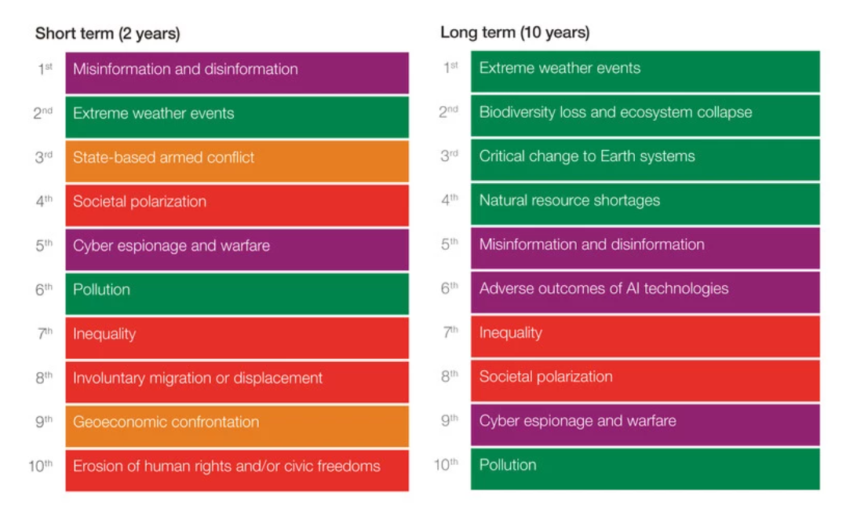
World Economic Forum 2025 Global Risks
Notes:
Source Global Risks Report 2025 | World Economic Forum

Slide 7
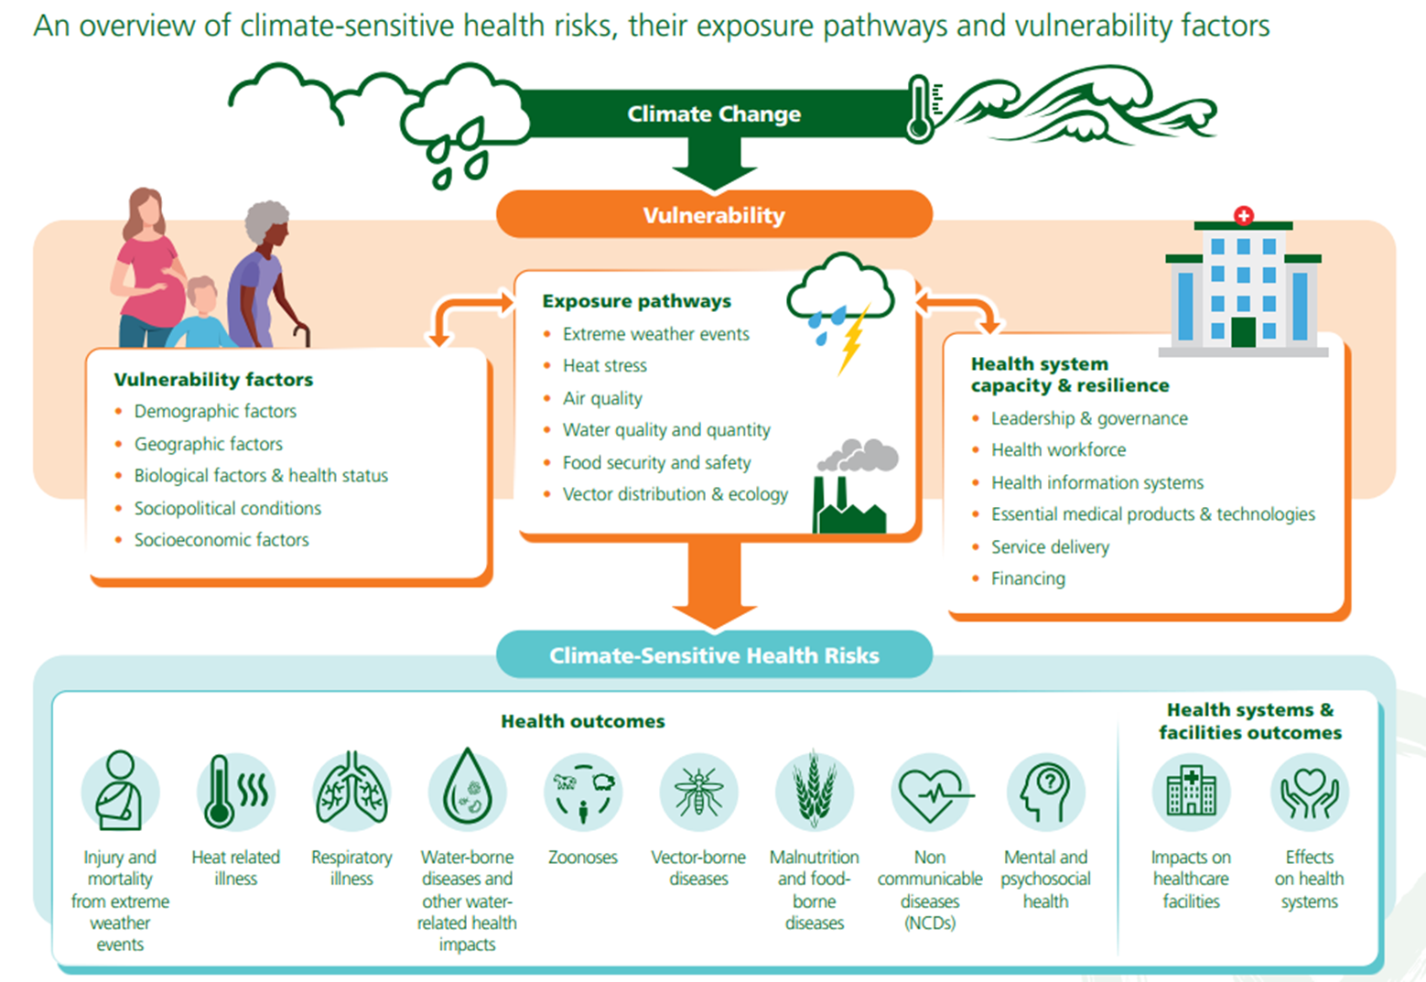
These factors are built into revised ICB BAF Source Climate change (who.int)

Slide 8
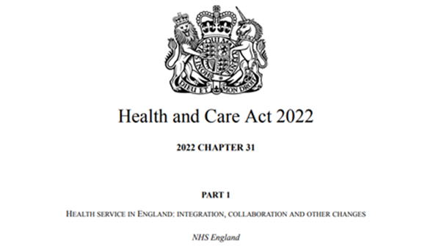

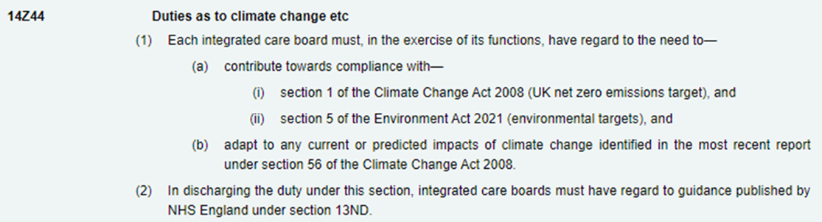
Many initiatives prioritize immediate and near- term climate risk reduction which reduces the opportunity for transformational adaptation
Notes:
Note. Slide source EoE Greener NHS Big Conversation – Adapting our approach to climate adaptation April 24, Stella Cockerill.
Health & Care Act makes tackling climate change & climate adaptation mandatory.
Note many approaches focus on extreme weather events (short term) whilst overlooking & not grasping longer term issues, which in term can channelled as an opportunity.
AR6 Climate Change 2022: Impacts, Adaptation and Vulnerability — IPCC
Feb 2022
C. Current Adaptation and its Benefits
C.1 Progress in adaptation planning and implementation has been observed across all sectors and regions, generating multiple benefits (very high confidence). However, adaptation progress is unevenly distributed with observed adaptation gaps (high confidence). Many initiatives prioritize immediate and near- term climate risk reduction which reduces the opportunity for transformational adaptation (high confidence).
C.2 There are feasible and effective adaptation options which can reduce risks to people and nature. The feasibility of implementing adaptation options in the near-term differs across sectors and regions (very high confidence). The effectiveness of adaptation to reduce climate risk is documented for specific contexts, sectors and regions (high confidence) and will decrease with increasing warming (high confidence). Integrated, multi-sectoral solutions that address social inequities, differentiate responses based on climate risk and cut across systems, increase the feasibility and effectiveness of adaptation in multiple sectors (high confidence).
C.3 Soft limits to some human adaptation have been reached, but can be overcome by addressing a range of constraints, primarily financial, governance, institutional and policy constraints (high confidence). Hard limits to adaptation have been reached in some ecosystems (high confidence). With increasing global warming, losses and damages will increase and additional human and natural systems will reach adaptation limits (high confidence).
C.4 There is increased evidence of maladaptation across many sectors and regions since the AR5. Maladaptive responses to climate change can create lock-ins of vulnerability, exposure and risks that are difficult and expensive to change and exacerbate existing inequalities. Maladaptation can be avoided by flexible, multi-sectoral, inclusive and long-term planning and implementation of adaptation actions with benefits to many sectors and systems (high confidence).
C.5 Enabling conditions are key for implementing, accelerating and sustaining adaptation in human systems and ecosystems. These include political commitment and follow-through, institutional frameworks, policies and instruments with clear goals and priorities, enhanced knowledge on impacts and solutions, mobilization of and access to adequate financial resources, monitoring and evaluation, and inclusive governance processes (high confidence).

Slide 9
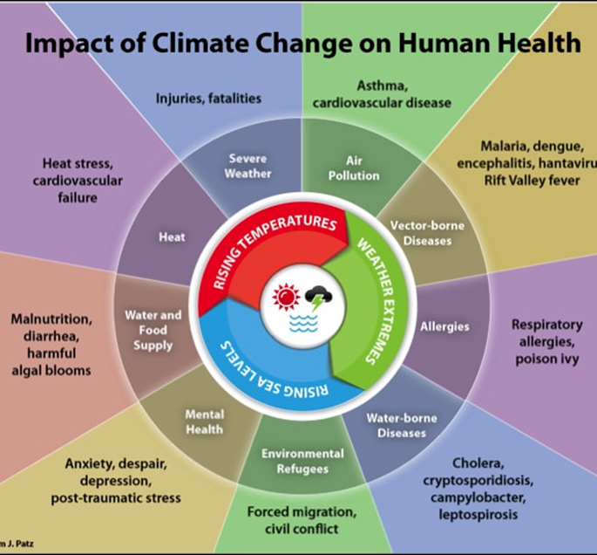
We need to adapt
Adaptation in health and social care:
involves adapting to the current and future effects of climate change.
aims to reduce mortality and morbidity associated with climate change, while ensuring resilience and service continuity.
are actions or processes that strengthen the sector’s capacity to provide a quality care while the climate changes.
Adaptation is not:
just emergency response, preparedness and planning.
solely focused on investment and updating infrastructure.
enough without mitigation activities!
Notes:
Note. Slide source EoE Greener NHS Big Conversation – Adapting our approach to climate adaptation April 24, Stella Cockerill.
Barriers to Adaptation
A complex and fragmented health sector - competing priorities, siloed working
Problems are difficult, in some cases chronic - these demand a sustained, co-ordinated strategic response from multiple actors in order to make a difference to long-term vulnerability
EVERYBODY has a role, but responsibilities remain unclear…
Timescales
Impacts – the need to make the case at scale
Cost-benefit analysis and trade-offs – who pays and who ‘wins’?

