Slide 1
Planning & delivering healthcare in a climate change environment
Policy, expectations & resources
Presented by: Stella Cockerill
Notes:
Standard title slide

Slide 2
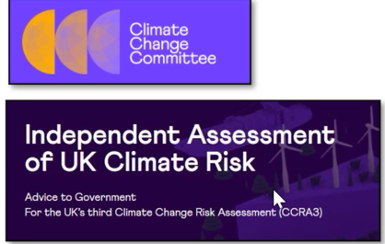
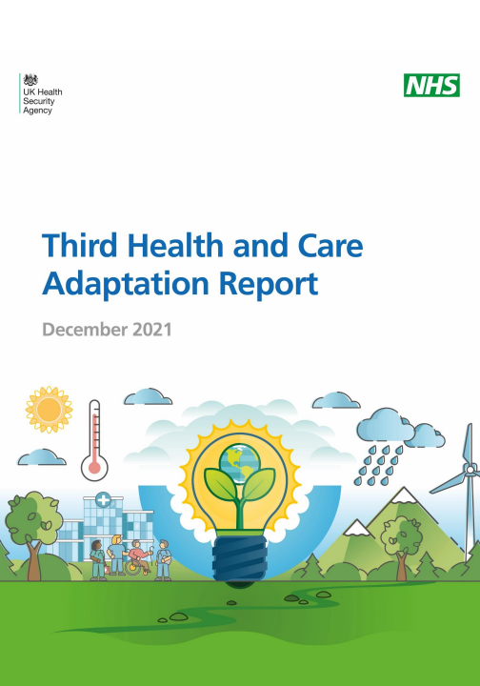


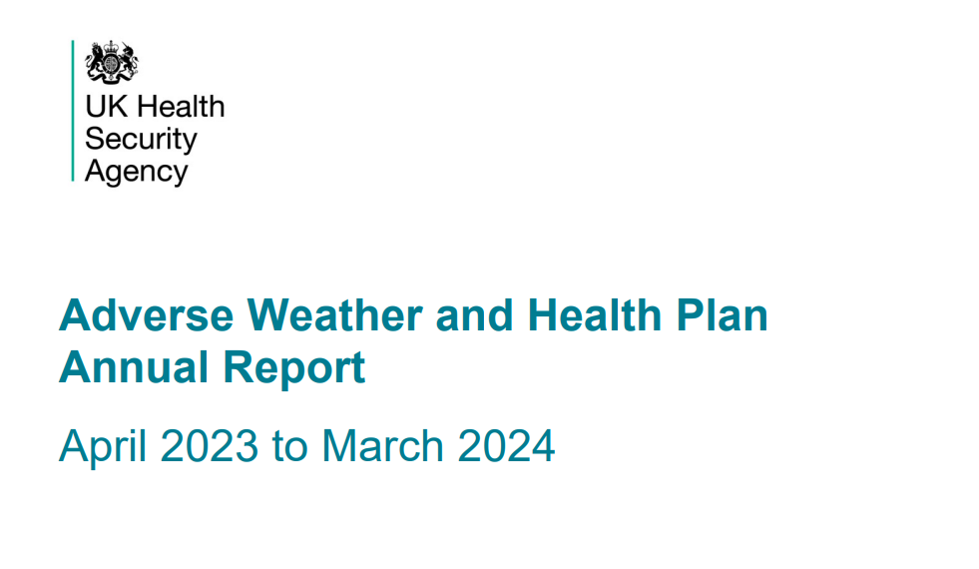
Adaptation policy the national landscape
Statutory duty to report on progress of (NAP3)
Responsibility
UKHSA & NHS England have a duty to report on assessment of risk to health
NHS England » 4th Health and climate adaptation report
Inadequate – slow - not top priority
Improve objectives & targets
Improve coordination across government
Integrate adaptation into all relevant polices
Improve evaluation & monitoring
Progress in adapting to climate change: 2025 report to Parliament - Climate Change Committee
Adverse Weather and Health Plan - GOV.UK

Slide 3
Adaption expectations on NHS Trusts and ICBs
Climate Change Act 2008
5 year planning & reporting cycle
Environment Act 2021-
Complying with the biodiversity duty - GOV.UK (www.gov.uk) 1st Jan 2024
PPN 06/20: Duty to add min 10% social value weighting to all procurements
Health & Care Act 2022
Green Plans
NHS England » Green plan guidance
Health and Care Act (2022)
New duties on NHS ICBs/trusts to consider statutory emissions & environmental targets in their decisions. Requires health services to adapt to both current & predicted climate impacts, as per the Climate Change Act 2008
Have an adaptation lead and a long-term adaptation plan
Standard NHS Contract
NHS Adaptation reports
CQC’s single assessment framework & also supporting guidance for trusts
CQC
NHS Standard Contract 2025/26 Service Conditions (Full Length) All reasonable steps to minimise adverse impact on the environment
The Third National Adaptation Programme (NAP3) and the Fourth Strategy for Climate Adaptation Reporting
NHS England » 4th Health and climate adaptation report
Safe Environments – this focuses on ensuring that services are prepared for, and resilient to, adverse weather events.
Governance, Management and Sustainability – this considers services’ emergency preparedness planning.

Slide 4

Green Plan expectations
All providers and commissioners of NHS-funded services must comply with the adaptation provisions within the NHS Core Standards for emergency preparedness, resilience and response (EPRR) and the NHS Standard Contract to support business continuity during adverse weather events
set out actions to prepare for severe weather events and improve climate resilience of local sites and services, including digital services for a supporting Climate Change Risk Assessment Tool
In addition, systems should:
in partnership with emergency response colleagues and others, identify interdependencies between services and the necessary mutual aid requirements to prevent service disruptions
share findings with resilience partners (for example, local resilience forums and directors of public health) to ensure critical information is integrated into broader emergency planning and climate adaptation planning practices
In addition, trusts should:
factor in the effects of climate change when making infrastructure decisions and designing new facilities, including enhancements like improved green spaces, drainage systems and passive cooling solutions
ensure adequate cascading of weather health alerts and relevant messaging across the organisation, in line with the government’s Adverse Weather and Health Plan
Notes:
Plain slide with subhead and bullets

Slide 5
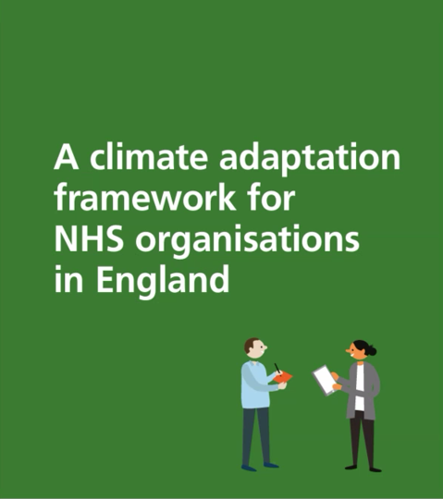
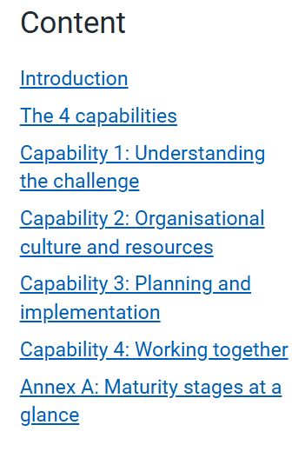
Adaptation Resources
Understanding the Challenge
Organisational culture & resources
Working together
Planning & implementation
The Climate Adaptation Framework
NHS England » Climate adaptation resources
Based on the concept that an organisation has a level of ’capability’ that determines its ability to delver climate adaptation.
This is multifaceted and has 4 adaptation capabilities and 4 maturity stages
Beginner
Intermediate
Advanced
Mature
Notes:
Climate Adaptation Resources Published
NHS England has now published two resources to support NHS organisations to prepare for and respond to the impacts of climate change, in line with actions outlined in NHS green plan guidance and the 4th health and climate adaptation report.
The NHS Climate Change Risk Assessment tool is designed to support NHS organisations to identify and assess climate related risks and impacts to their sites and services.
The Climate Adaptation Framework for the NHS was developed through a project led by the Greener NHS teams in the North West, North East & Yorkshire and NHS Greater Manchester, with support from two independent organisations with expertise in public sector adaptation, Verture and Sustainability West Midlands and a task and finish group of NHS Colleagues from ICB’s and Trusts across the north.
This framework provides a holistic approach to organisational change. It is centred around the development of four key capabilities that NHS organisations will need to adapt and become resilient to climate change. It is also referenced in the ‘Progress in adapting to climate change: 2025 report to Parliament’ which was published on the 30th April, in section 3 under Health and Wellbeing.
🔗NHS England » Climate adaptation resources
🔗NHS England » Green plan guidance
🔗NHS England » 4th Health and climate adaptation report
🔗Progress in adapting to climate change: 2025 report to Parliament - Climate Change Committee
ain slide with subhead and bullets

Slide 6
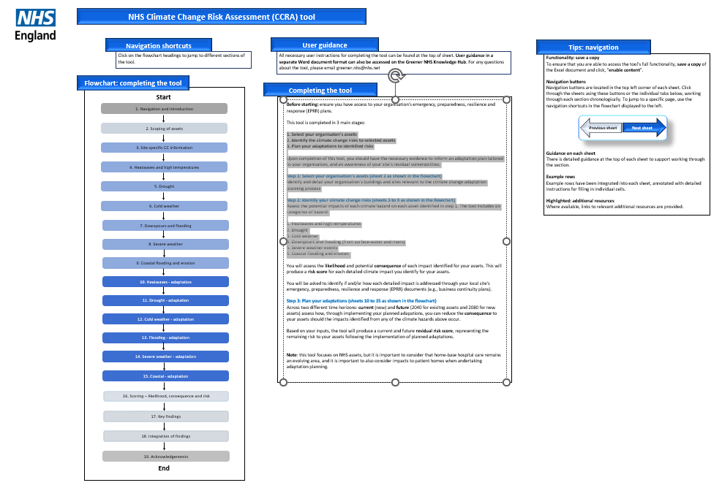


Adaptation Policy and Requirements
The Climate Change Risk Assessment (CCRA) tool NHS England » Climate adaptation resources
The NHS Climate Change Risk Assessment (CCRA) tool supports NHS trusts, system leaders and other NHS organisations to:
identify climate-related risks specific to their operations
understand their potential impact on healthcare delivery
plan a response through identifying potential adaptations
progress towards NHS net zero commitments
maintain service continuity during climate disruptions.
For guidance on using the CCRA tool, please visit the Greener NHS website.
STEPS TO USING THE CCRA TOOL
1. Select your organisation's assets
2. Identify the climate change risks to selected assets
3. Plan your adaptations to identified risks
1. Heatwaves and high temperatures
2. Drought
3. Cold weather
4. Downpours and flooding (from surface-water and rivers)
5. Severe weather events
6. Coastal flooding and erosion
Notes:
Plain slide with subhead and bullets

Slide 7
Other useful resources
Met Office: Climate change visualisation tool | Met Office and BBC tool to show what climate change might look like in your area
Local Authority CCRAs https://climatedataportal.metoffice.gov.uk/pages/lacs | Where they exist, the CCRA completed by your ocal council will have already included a detailed assessment of relevant climate change projections in your area. District, parish, or regional council websites may also contain a range of helpful information.
UK climate risk indicators | Users can plot and download time series showing change indicators for specific locations. The indicators that are limited to those calculated in the Climate Resilience Programme project. Some of these indicators are very good but others are much more specific and were selected as illustrative of a broader category of indicator.
Met Office: Integrated data archive system | Collects observational weather station data.
Estates Returns Information Collection (ERIC) Estates Returns Information Collection, Summary page and dataset for ERIC 2024/25 - NHS England Digital | Data on past overheating and flooding occurrences on secondary care sites
UK Climate Risk, Evidence for the Third UK Climate Change Risk Assessment (CCRA3) – Summary for England (2021) | This document is the main source of climate change information for the UK. Chapter 2 contains a summary of climate change in England.
Local Climate Adaptation Tool (LCAT) | Evidence-based tool designed to show decision-makers how their local climate will change. Impacts on public health, which groups are most vulnerable, and adaptation methods most appropriate to your local area are also considered (not healthcare-specific).
Home – weADAPT | weADAPT is one of the world’s leading and longest-running collaborative platforms for climate change adaptation. Find the latest knowledge, share your work and connect with others working on similar issues.

Slide 8
End slide

