Slide 1
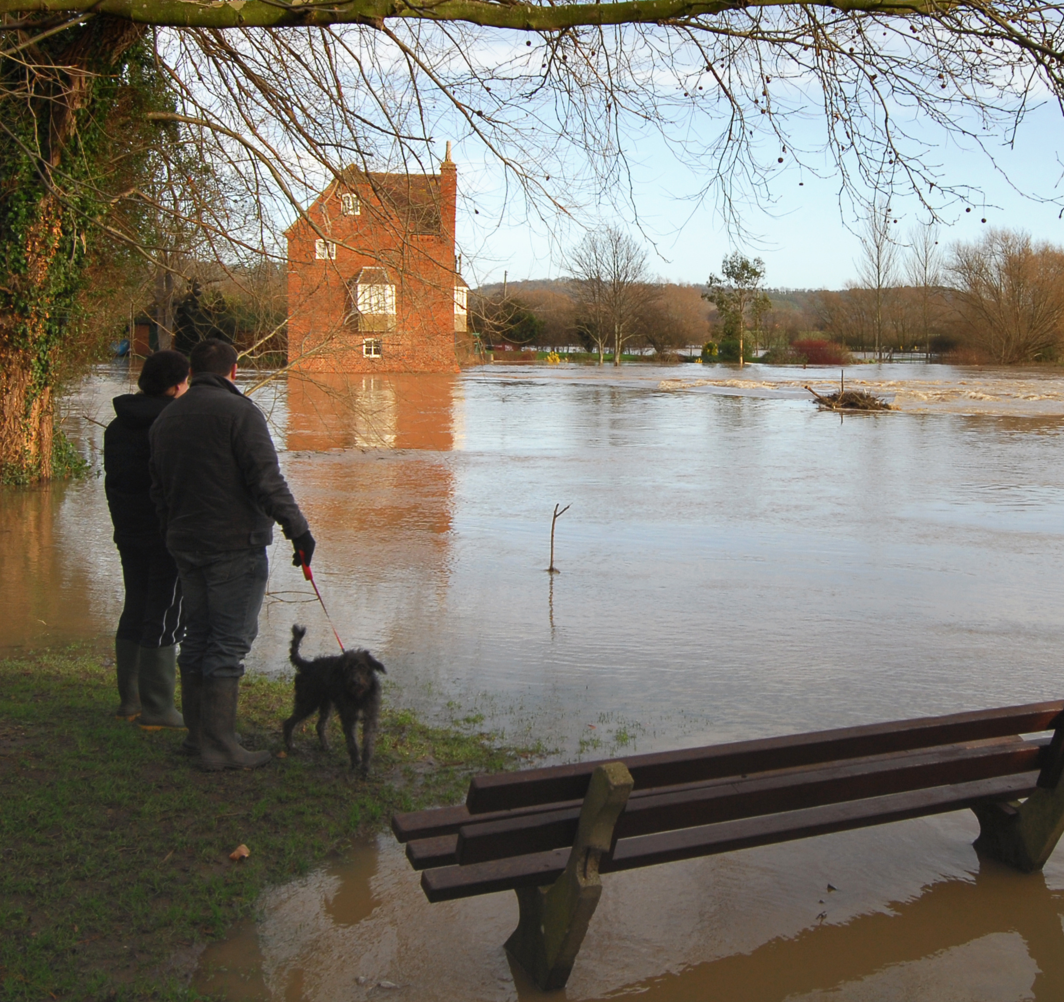
Preparing the NHS for Climate Change
Embedding adaptation into health systems
Morgan Roberts, Sustainability West Midlands
25 June 2025
River Avon in flood © Leading lights via Getty Images
Notes:
25 June 12:00
20 Minutes 12:05 to 12:25

Slide 2
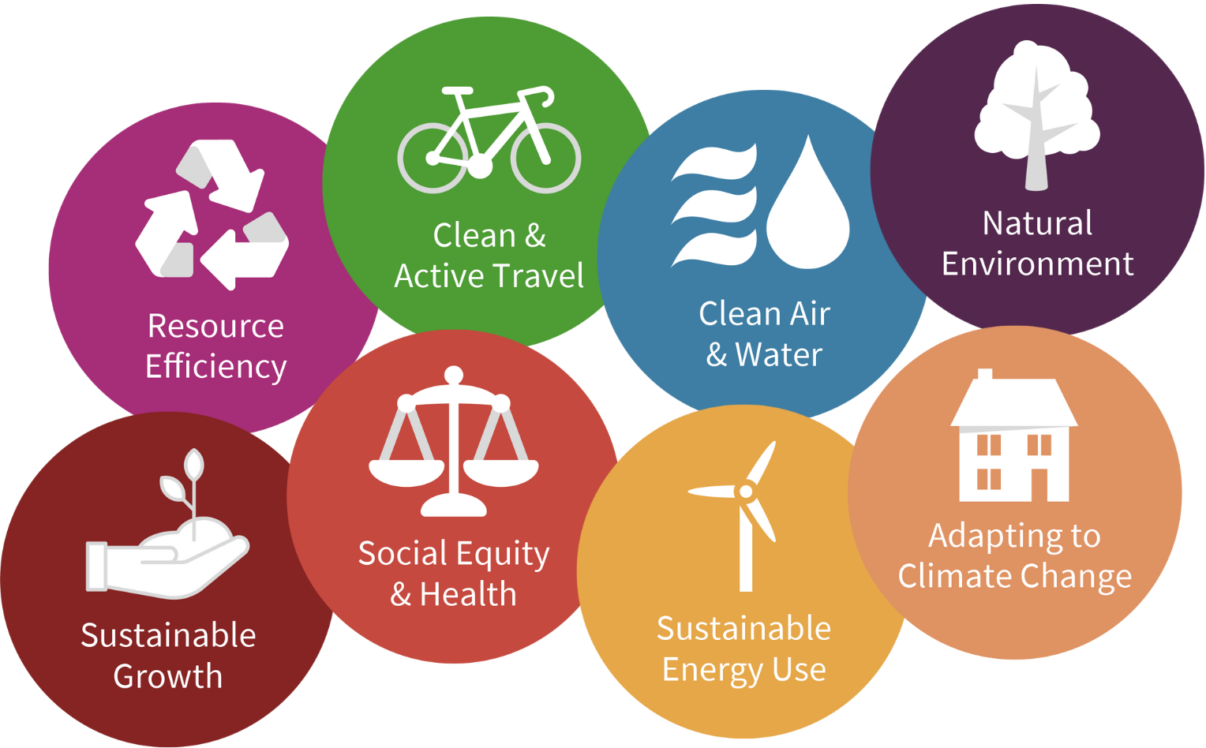
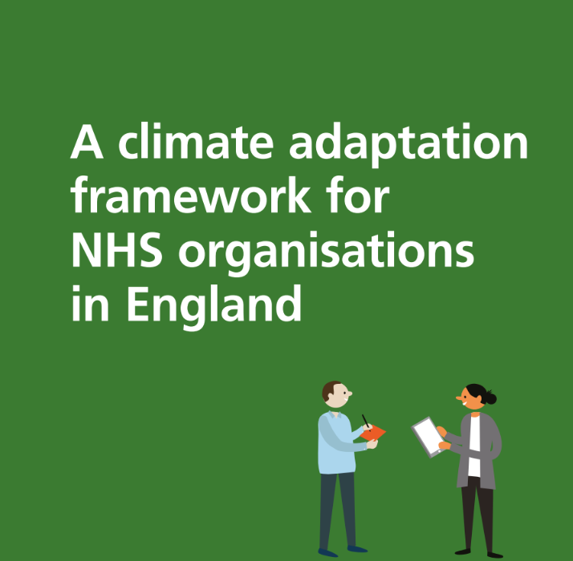
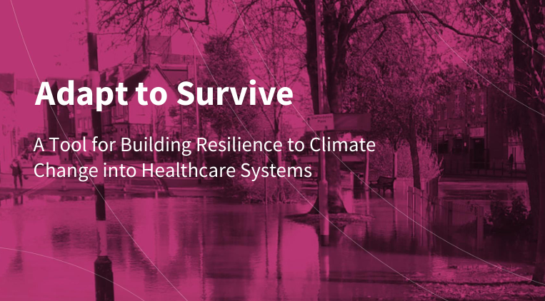
Who we are
Sustainability West Midlands are the independent advisor for sustainability in the region (and beyond!)
Supporting all sectors to be more sustainable, fairer, and greener
Have been supporting the NHS with adaptation
Notes:
Mention that we support the NHS through funded projects such as the MACC Hub but also through independent consultancy with Trusts or ICBs

Slide 3
Today
Understand that true climate resilience is about embedding adaptation throughout your organisations and goes beyond just hard measures or having an adaptation plan
Gain an overview of the Adaptation Policy and Requirements for the NHS, and three main pieces of guidance available to support your adaptation planning and delivery

Slide 4
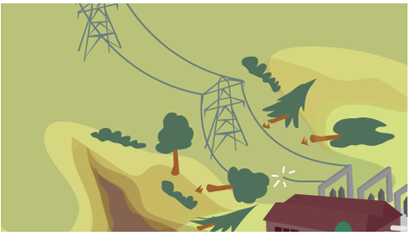

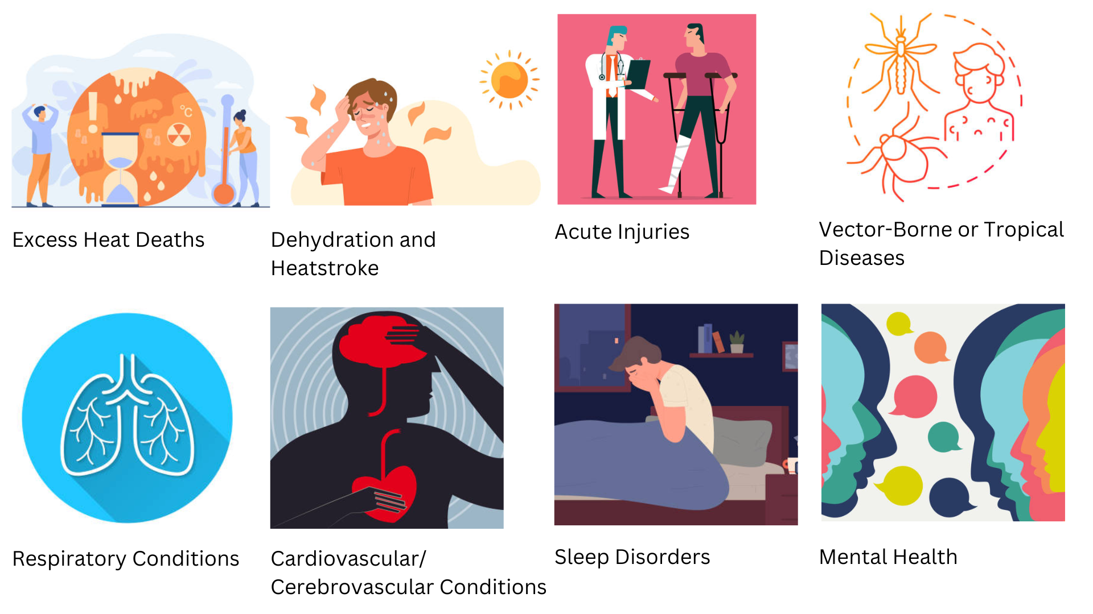
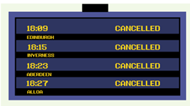

How is healthcare affected by climate change?
Hazards
Flooding
Heavy rain
Heatwaves
High winds
Energy efficiency and security
Homes and businesses flooding
Infrastructure and cascading impacts
Building performance and thermal comfort
Graphic by SWM
Graphics from the Adaptation Scotland programme
Notes:
I won’t go over this in any detail as how climate change impacts health and health, and what adaptation is, has been covered in the past three webinars, and you can go back and watch these if you’d like more context.
As a super quick reminder, we are talking about adapting to the impacts of climate change, which for healthcare can look like everything from supply chain or utility disruption to increased health conditions and demand. It is important to understand that some impacts will happen regardless of our net zero efforts, and that climate change is a thing of the present, not the future. We are already experiencing impacts that our systems are not fit to manage, hence why we are all here to discuss this topic today!

Slide 5
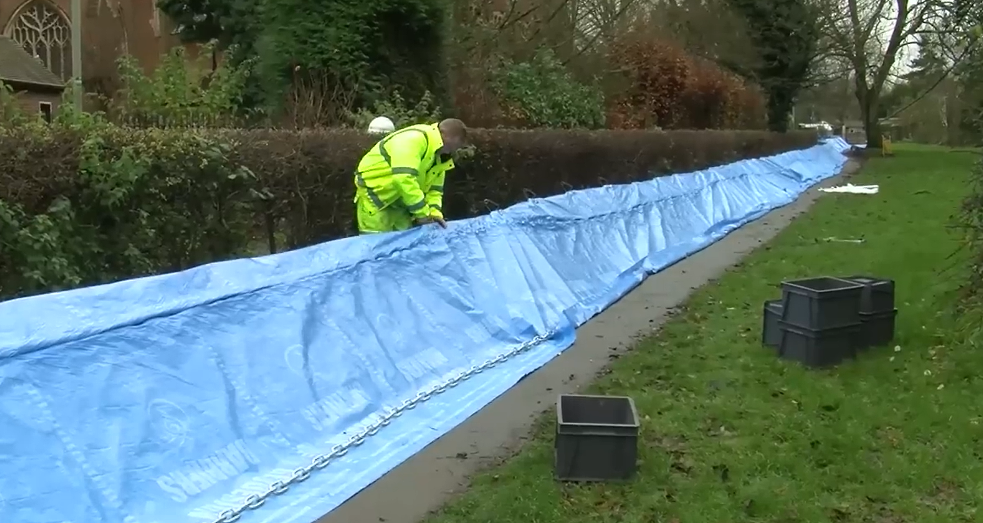
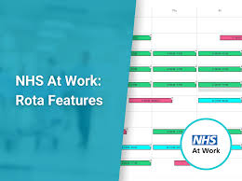
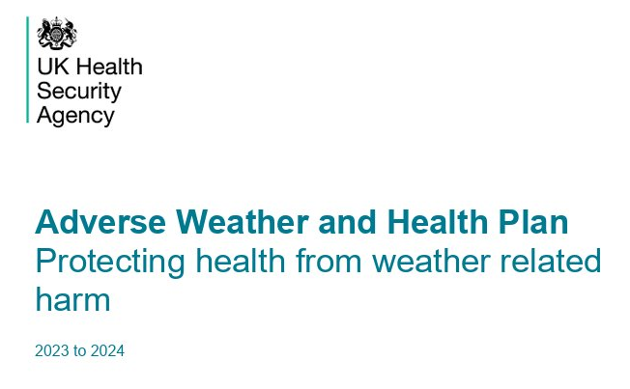
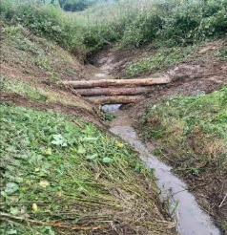
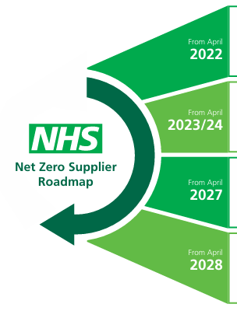

What does Adaptation look like?
Adaptation includes any action to reduce exposure or vulnerability to the actual or expected impacts of climate change.
Physical (Hard and NBS)
Operational
Policies and strategies
Flood barriers in Oxford ©Environment Agency
Leaky barrier in the River Lymn NFM project ©South & East Lincs Climate Action Network
Notes:
As we have also learnt in the webinars so far, adaptation is about reducing exposure and/or vulnerability to these impacts of climate change, but this is not only about building physical assets.
Being able to deliver adaptation is also not only reliant on having an adaptation plan or list of actions, as a list on someone’s desk is only useful if systems, resource, and expertise are in place to ensure these are delivered effectively. When we think about adaptation as minimising exposure or vulnerability to impacts, that can help us see how embedding adaptation within an organisation is the most effective way to build resilience, rather than just building defences. Addressing exposure and vulnerability can take many forms, including training, changing processes, and having strategies in place. This is why today I am going to take you through three core pieces of guidance NHSE provides/recommends, that not only help you create an adaptation plan as a tickbox, but help you embed adaptation into your system.

Slide 6




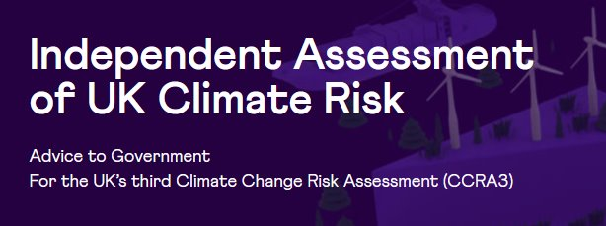




Adaptation Policy and Requirements
https://www.gov.uk/government/publications/third-national-adaptation-programme-nap3
https://www.theccc.org.uk/publication/progress-in-adapting-to-climate-change-2025/
https://www.england.nhs.uk/long-read/4th-health-and-climate-adaptation-report/
Notes:
Before I introduce the three pieces of guidance, I wanted to give some policy context….
Now is a good time to recognise that there is much to be done nationally to support adaptation in the NHS; there is very limited resource or direct support to deliver adaptation, as is reflected by the CCC’s report last month stating that healthcare is one of the areas that remains most poorly prepared in the UK. “We're trying to improve the NHS. Unless we take into account that it has to be resilient to the climate, we're going backwards”
Baroness Brown

Slide 7
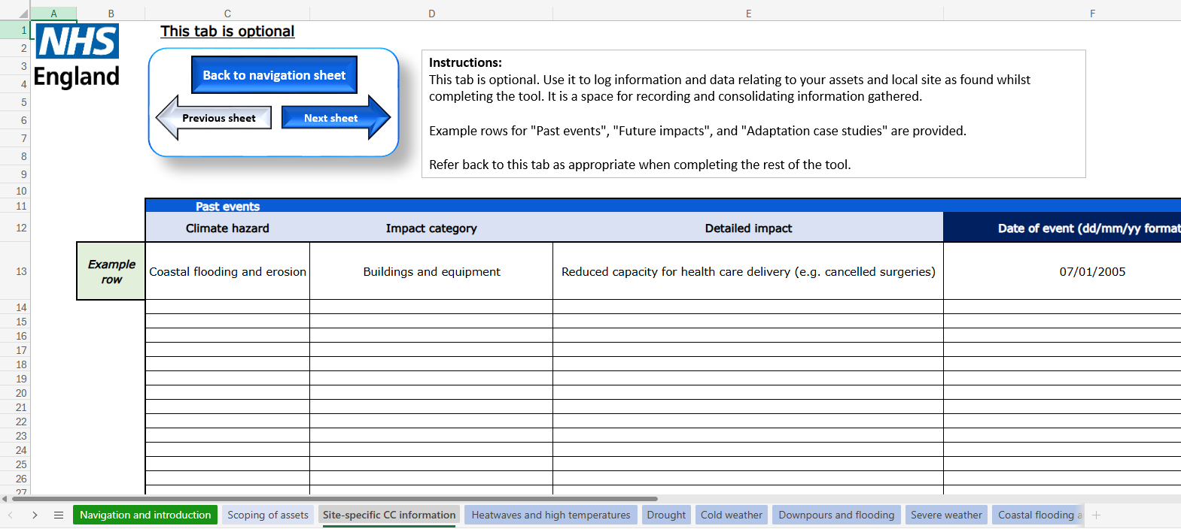

Adaptation Policy and Requirements
Climate Change Risk Assessment tool
Climate Adaptation Framework
Green Plan Guidance
Notes:
As I have already alluded to, however, there is an increasing amount of support out there for planning and delivering adaptation. I will focus on three main ones today with a major focus on the CAF which was developed with the fact in mind that adaptation needs to be embedded, ongoing, and holistic. After me, there will be other tools also helping really embed adaptation into existing practices shared by the other presenters here.

Slide 8
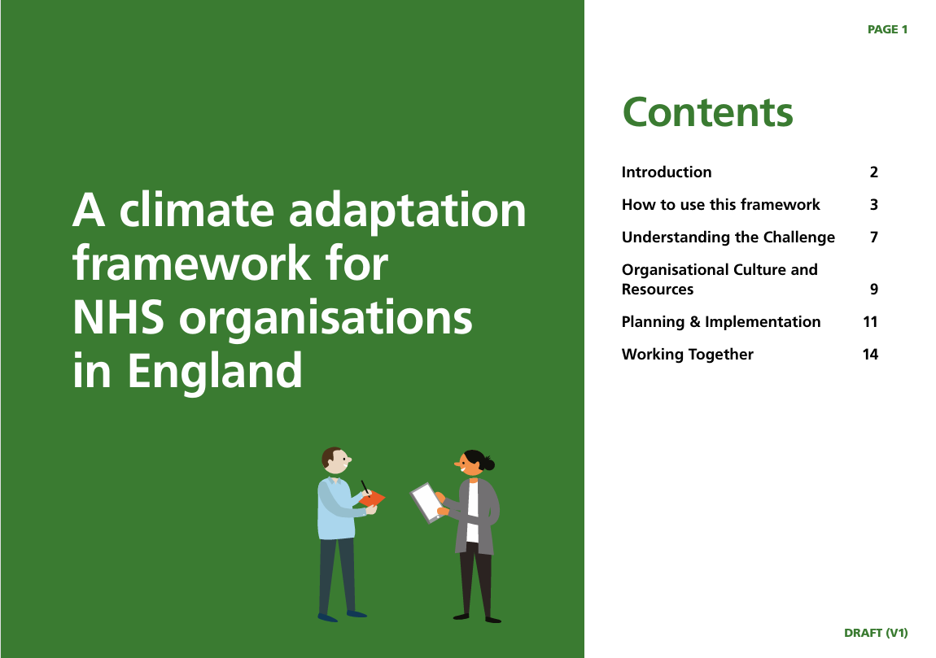
Embedding Adaptation
Now official NHS Guidance
https://www.england.nhs.uk/long-read/a-climate-adaptation-framework-for-nhs-organisations-in-england/

Slide 9

The Climate Adaptation Framework
Based on the concept that an organisation has a level of ‘capability’ that determines its ability to deliver climate adaptation. This is multi-faceted, comprising four adaptation capabilities and maturity stages.
By understanding the challenge, we can make informed decisions based on actual or expected change.
Find ways to align adaptation activities with your organisation’s wider organisational strategy, eventually becoming part of business as usual.
Adaptation is an ongoing challenge that requires strategic planning and implementation to achieve outcomes.
Forge connections with key partners to share ideas and find opportunities to collaborate.

Slide 10
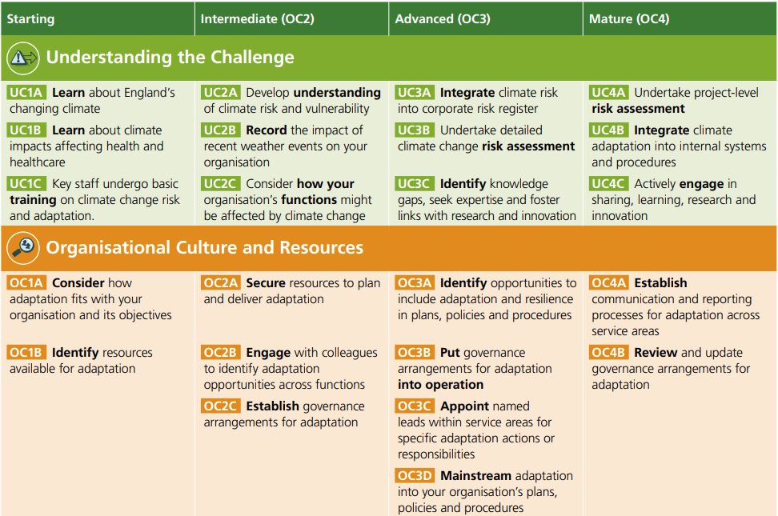
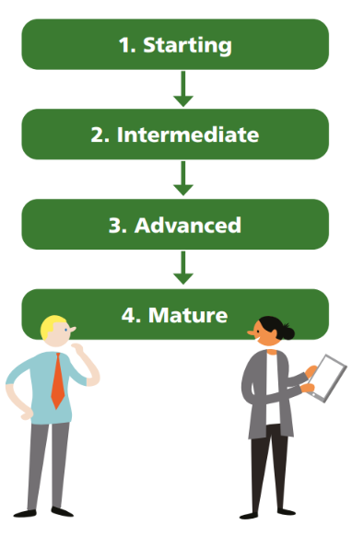
The Climate Adaptation Framework

Slide 11
Climate Change Risk Assessment tool
Identify climate-related risks
Understand their impact
Start identifying adaptation options
Maintain service continuity during climate disruptions
Support net zero commitments
Resources to support you in assessing your climate risk:
Check your long-term flood risk - Environment Agency
Local Authority Climate Service - Met Office
Local Climate Adaptation Tool
Adapt to Survive Toolkit - Sustainability West Midlands
https://www.england.nhs.uk/publication/climate-adaptation-resources/

Slide 12
Green Plan guidance
Systems and Trusts must "set out actions to prepare for severe weather events and improve climate resilience of local sites and services, including digital services"
Identify interdependencies
Share findings with resilience partners
Inform design decisions using climate projections
Communicate weather warnings and advice
https://www.england.nhs.uk/long-read/green-plan-guidance/
Notes:
And references key documents, NHS Core Standards for EPRR, NHS Standard Contract, and CCRA tool

Slide 13

Including adaptation in your Green Plan
Takes you through producing…
An overview of climate projections for your site and communities
A summary of the climate risks posed
Your current progress on adaptation
A summary of the very high priority actions from your adaptation plan
Other references throughout the rest of your green plan to adaptation
https://weadapt.org/placemarks/maps/view/including-adaptation-in-your-green-plan-adaptation-plan-template-and-guidance-for-the-nhs/

Slide 14
Key takeaways
Adaptation is not a ‘nice to have’
Adapting to climate change is necessary to achieve NHS strategic priorities and objectives
There are tools and resources available to you
Effective leadership and governance is essential
Innovation and collaboration can drive adaptation at a local and regional level

Slide 15
Your next steps
See whether your organisation or partners have an adaptation plan or climate change in their risk register
Use the resources shared when updating your Green Plan this year and share them with colleagues
Measure your ‘adaptation maturity’ and decide some next steps using the Climate Adaptation Framework
Let us know if you would like to remain engaged in this topic

Slide 16
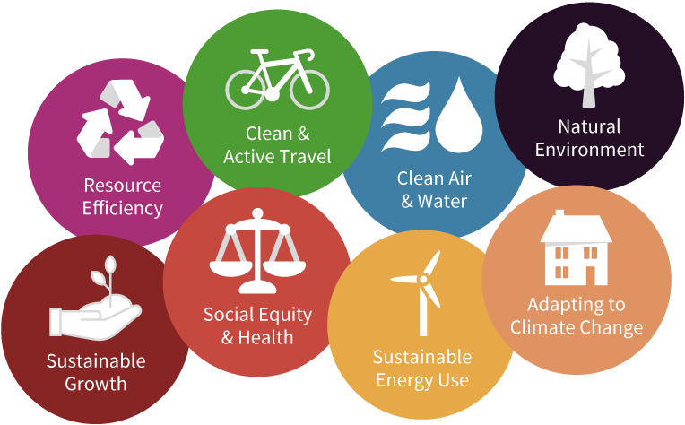
Keep in touch
morgan.roberts@swm.org.uk
www.swm.org.uk
LinkedIn: Sustainability West Midlands
swm.org.uk/consultancy/climate-change-adaptation-support/

